Slide 1

Session 3 · Design: choosing the right study
Week 3 · Saturday · online, 19:30-22:30
Recap quiz on Session 2 (10 min)
3.1 Study designs in pictures (45 min)
Whole-class exercise: Name that design (15 min)
Break (15 min)
3.2 More designs: trial variants, pilots, quality improvement, qualitative (30 min)
Whole-class exercise: choose the design (15 min)
Proposal builder 3: design, setting and population (45 min), then wrap-up (5 min)
Neudata | #ClearDataClearImpact
Notes:
Session 3 opening (19:30). Welcome to Week 3. In Sessions 1 and 2 we asked a question and found the evidence. Today we choose how a study answers a question. Next Saturday (Session 4) we judge whether we can trust the answer and how big the effect is.
Teaching point: the design decides what you are allowed to claim at the end. A good question with the wrong design produces a weak study.
How we work online (repeat briefly): quick answers go in the poll. For other questions the instructor calls on two or three people to answer with the microphone on. Use the 'raise hand' button to speak. Every exercise is done by the whole class together, with the instructor typing the class answer on the shared screen. There are no groups.
Pace: this is a slow session on purpose. Every design is shown as a picture or a short table, then as a worked example, then checked with a quick poll.
Running example: our fluid question, answered twice: by a small randomised trial (Paper 1, Boulet 2024) and by a large cohort (Paper 2, Hyun 2023). Both are in the course folder, Course/Papers.
Ask the class (call on two or three people, microphone on): who has ever collected data for a study? Expected: a few. Use them as examples later.
Timing: 1 minute. Clock: 19:30 recap quiz (10), 19:40 section 3.1 (45), 20:25 Name that design (15), 20:40 break (15), 20:55 section 3.2 (30), 21:25 choose the design (15), 21:40 proposal builder 3 (45), 22:25 wrap-up (5), 22:30 end.

Slide 2
Recap quiz: three questions on Session 2
QUICK QUIZ | 9 min
Q1. Your PubMed search finds 3,000 papers. Add a concept with AND, or a synonym with OR?
Q2. After the title and abstract, what do you read next in a paper?
Q3. An abstract says 'a trend towards lower mortality (p = 0.42)'. What is this called?
Then re-read your own research question (your Proposal Part 1 from Sessions 1 and 2): 3 min
How we run it
Answer in the poll (30 s each)
Results on screen, then the answer
No marks, just a warm-up
OUTPUT Poll answers, and your own question re-read
Neudata | #ClearDataClearImpact
Notes:
Purpose: wake up Session 2 and put each participant's own question back in front of them. Today's proposal builder chooses a design for it.
Run it as three poll questions (Zoom or Teams poll, or a form). Show the results, then the answer.
Answers. Q1: AND with another concept narrows the search. OR widens it. Q2: the figures and tables (reading order: title, abstract, figures and tables, then methods). Q3: spin (describing a non-significant result as if it were a benefit).
Misconception to catch: 'p = 0.42 is nearly significant'. It is not. The honest phrase is 'no clear difference'.
Ask the class after Q3 (call on two or three people, microphone on): how should the sentence be rewritten? Expected answer: 'mortality did not differ clearly between groups (p = 0.42)'.
Timing: 9 minutes (about 6 for the questions, 3 for re-reading). Together with the opening slide this is the 10-minute recap.

Slide 3
Key words of the day
The words you will use today (no need to memorise definitions)
The pieces
Who decides?
Which way in time?
After the break
Exposure: what comes first
Outcome: what we count later
Comparison group
Observational: we watch
Experimental: we assign
Randomised: chance assigns
Cross-sectional: snapshot
Case-control: look back
Cohort: follow forward
Cluster and crossover trials
Non-inferiority and pilot trials
Time series, qualitative
KEY MESSAGE Two questions name most designs: who decided the exposure, and which way does time run?
Neudata | #ClearDataClearImpact
Notes:
Section 3.1 starts here (45 minutes in all, this slide to the 'caused or associated' poll).
Read the four headings only. The details come slide by slide. These words are also listed at the top of the Session 3 exercise sheet (PDF sent before the session).
Teaching point: almost every design question becomes easy once people can name the exposure and the outcome. We practise that first.
Misconception: 'design names must be memorised'. No. They can be worked out from the two questions on the key message.
Ask the class (call on two or three people, microphone on): in our fluid question, what is the exposure and what is the outcome? Expected answer: exposure = restrictive fluid strategy (vs usual care). Outcome = death by day 28.
Timing: 1 minute.

Slide 4
One question, two designs
In adults with septic shock, does a restrictive fluid strategy reduce 28-day mortality? Both papers: course folder, Course/Papers
Paper 1: Boulet 2024, randomised trial
Paper 2: Hyun 2023, cohort study
50 patients randomised, 48 analysed
Restrictive (non-resuscitation) fluids vs usual care
Primary outcome: fluid balance at day 5
The investigator assigns the strategy
Sepsis registry: 11,981 patients, 20 hospitals
Positive vs negative fluid balance, days 1-3
Outcome: death by day 28 (matched pairs)
The investigator observes what happened
KEY MESSAGE Same question, two designs: the design decides what you may claim.
Neudata | #ClearDataClearImpact
Notes:
This is the thread for the whole session. Read the question aloud: it is the PICO (Population, Intervention, Comparison, Outcome) the class built in Session 1.
Where the papers are: both full texts (original and annotated) are in the course folder, Course/Papers: 'Paper 1 - Boulet 2024 Crit Care (RCT)' and 'Paper 2 - Hyun 2023 Ann Intensive Care (cohort)'. Participants met them in Session 2.
Teaching point: Boulet assigned the fluid strategy by chance (an experiment). Hyun only observed what clinicians did and what happened afterwards (an observational cohort).
Point out a detail people miss: Boulet's primary outcome was fluid balance at day 5, not mortality. It was a pilot trial. Hyun looked at 28-day mortality, which is our question, but could not assign anything.
Misconception: 'the bigger study is always the better study'. Size reduces random error. It does not remove bias. We come back to this in Session 4.
Ask the class (poll, or call on two or three people): which study would you trust more to tell you whether restriction saves lives? Expected answer: mixed, and that is the point. Neither answers it fully. Keep the tension. We resolve it by the end of 3.1.
Timing: 2.5 minutes.

Slide 5
3.1 Study designs in pictures
Did the investigator assign the exposure, or just watch?
That one question sorts almost every study design. (45 minutes)
Neudata | #ClearDataClearImpact
Notes:
Section marker for 3.1. The 45 minutes run from the key-words slide to the 'caused or associated' poll, including one short poll.
Teaching point: we learn designs as pictures on a timeline, not as definitions. For each design we ask: who decided the exposure, and in which direction does time run? Each picture is followed by a worked example in steps.
Tell the class they do not need to memorise names. By the end they will be able to sketch them.
Timing: 30 seconds.

Slide 6
Four families of study designs
Descriptive
Observational
Experimental
Studies of studies
Describes, no comparison
Case report or case series
Cross-sectional survey
Compares groups, we watch
Case-control
Cohort (prospective or retrospective)
Compares groups, we assign
Randomised controlled trial (RCT)
Non-randomised trial
Combine many studies
Systematic review
Meta-analysis
KEY MESSAGE Descriptive designs describe. Analytical designs (observational and experimental) compare groups.
Neudata | #ClearDataClearImpact
Notes:
Go left to right. Descriptive studies describe what is there, with no comparison. Analytical studies compare groups to test an association, and they come in two kinds: observational (the investigator watches what happens in normal care) and experimental (the investigator decides who gets what).
Systematic reviews sit apart: they are studies of studies, combining many of the designs on this slide.
Misconception: 'observational means bad'. No. Many key questions (harm, prognosis, rare diseases) can only be answered observationally. It is about fit, not rank.
Ask the class (poll): which card does Paper 1 (Boulet) belong to? Paper 2 (Hyun)? Expected answer: Boulet = experimental, RCT. Hyun = observational, cohort.
Timing: 2 minutes.

Slide 7
Exposure and outcome: the two words you need
Example | Exposure (comes first) | Outcome (counted later)
Paper 2: Hyun 2023, cohort | Positive fluid balance by day 3 | Death by day 28
Paper 1: Boulet 2024, RCT | Restrictive fluid strategy | Fluid balance at day 5
Another example: ICU infection | Parenteral (intravenous) nutrition | Candidaemia (Candida in the blood)
Another example: the ward | Air mattress | Pressure injury
Exposure: a treatment, strategy or risk factor. Outcome: death, infection, injury, a lab value. Comparison group: people without the exposure, or with usual care.
Neudata | #ClearDataClearImpact
Notes:
Before any design, everyone must be able to name the two pieces of a question.
Exposure: what comes first (a treatment, a strategy, a risk factor, a behaviour). Outcome: what we count later (death, infection, injury, a lab value). The comparison group is people without the exposure, or with usual care.
Walk down the rows. The same variable can play different roles: fluid balance is the outcome in Boulet (day-5 balance) but the exposure in Hyun (balance by day 3, outcome death). The last two rows are other examples that come back later today.
Misconception: 'the exposure must be harmful'. No. A treatment is an exposure too.
Ask the class (call on two or three people, microphone on): in our running question, name the exposure, the outcome and the comparison. Expected: restrictive fluid strategy. Death by day 28, usual care.
Timing: 3 minutes.

Slide 8
Descriptive designs: describe, do not compare
Case report or case series
Cross-sectional study
A few unusual patients, described in detail
No comparison group
Raises ideas but cannot test them
e.g. the first reports of thalidomide harm
One snapshot of a whole unit, on one day
Gives prevalence: how many have it now
Exposure and outcome measured together
Cannot show which came first
KEY MESSAGE Descriptive studies raise questions. They cannot answer 'does X cause Y?'
Neudata | #ClearDataClearImpact
Notes:
Case report or series: a few unusual patients written up in detail. Historically important (first reports of AIDS, thalidomide harms) because they raise alarms and hypotheses.
Cross-sectional study: one snapshot of a population at one moment, for example a one-day survey of every patient in the ICU. It measures prevalence (how many have it now).
Teaching point: in a cross-sectional study exposure and outcome are measured at the same moment, so you usually cannot tell which came first.
Misconception: 'a cross-sectional study can show cause because it has two groups'. It can compare groups (analytical cross-sectional), but time order is missing.
Ask the class (call on two or three people, microphone on): how could you measure, on one day, how common a positive fluid balance is in your ICU? Expected answer: a point-prevalence survey of all patients present that day.
Timing: 2 minutes.

Slide 9
Another example: a one-day point-prevalence survey
A cross-sectional study you could run next week
Choose a day
Examine everyone
Record both
Count
All inpatients on all wards, one weekday
Two trained nurses, one standard form
Pressure injury (yes or no) and mattress type, at the same visit
e.g. 37 of 412 patients = 9% prevalence today
KEY MESSAGE A snapshot gives prevalence. It cannot show which came first.
Neudata | #ClearDataClearImpact
Notes:
Another example (outside the fluid question), to make 'cross-sectional' concrete. Hypothetical numbers.
Steps 1-2: everyone present on one day, examined the same way (this protects against information bias, which we meet in Session 4). Step 3: exposure (mattress) and outcome (pressure injury) are recorded at the same moment. Step 4: the result is a prevalence: 37 of 412 patients, 9%.
Teaching point: you can compare groups (injury on standard vs air mattress), but you cannot tell whether the mattress came first or whether patients with injuries were moved onto air mattresses.
Misconception: 'cross-sectional = low quality'. For 'how common is it now?' it is exactly the right design, and it is cheap and fast.
Ask the class (call on two or three people, microphone on): what in our ICU could you measure in one day for the fluid question? Expected: today's fluid balance and today's kidney function for every patient present.
Timing: 2 minutes.

Slide 10
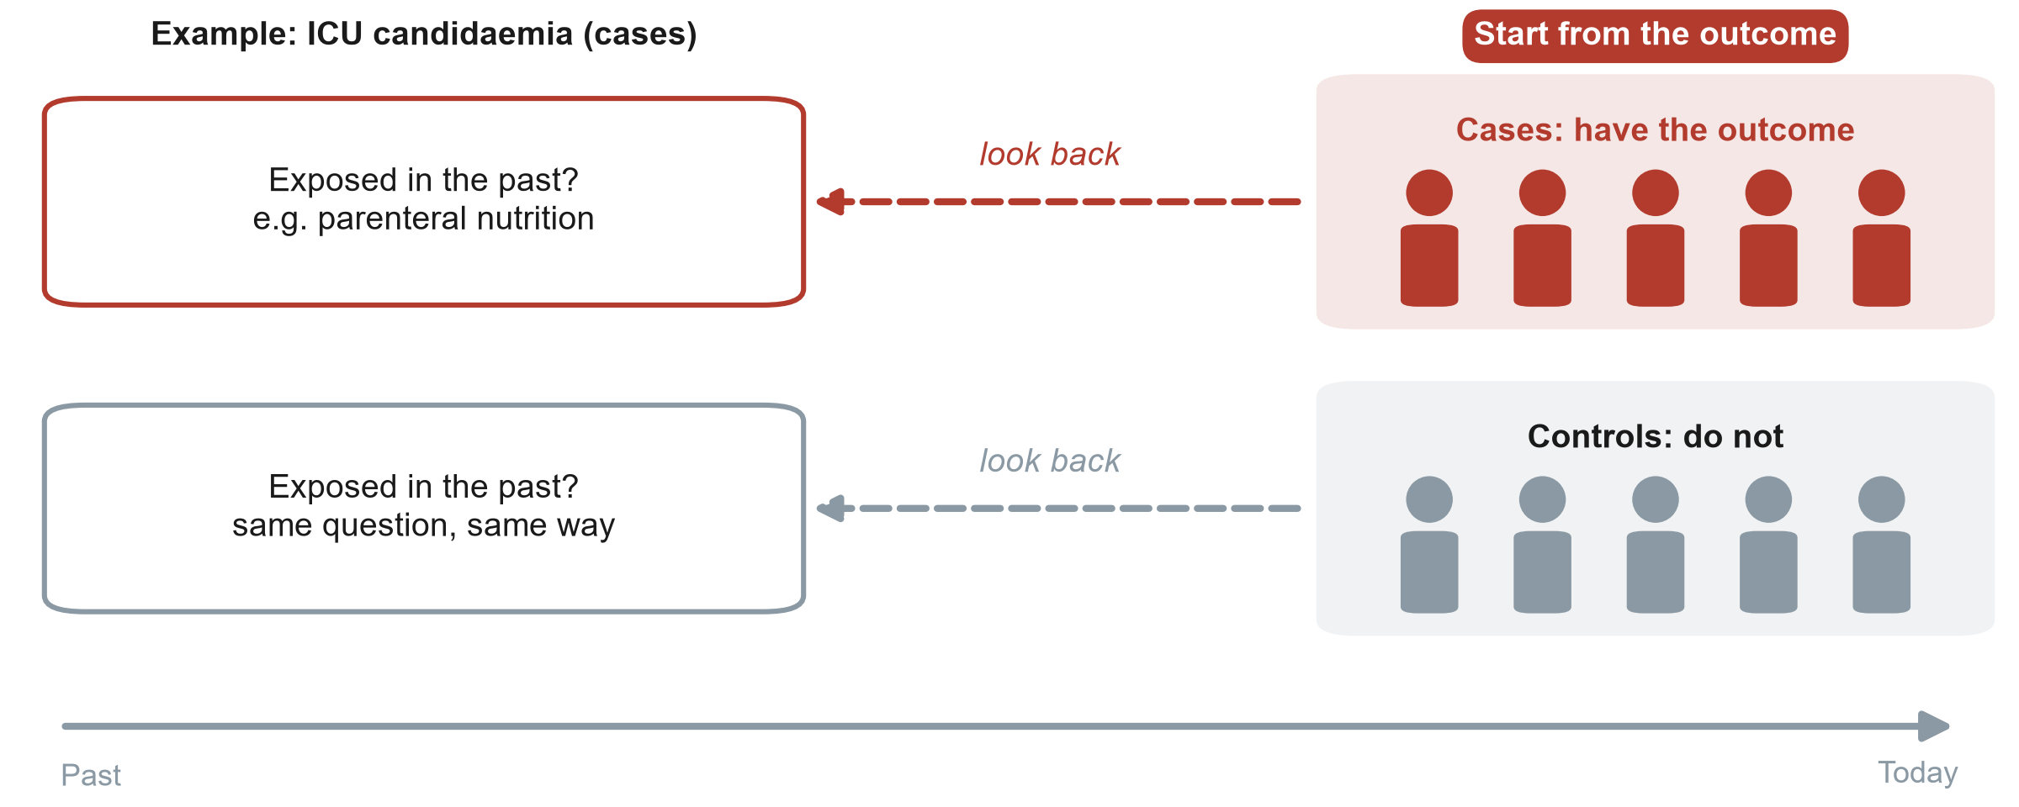
Case-control: start from the outcome, look back
ICU: intensive care unit
KEY MESSAGE Case-control: pick people by outcome, then compare their past exposures.
Neudata | #ClearDataClearImpact
Notes:
Trace the arrow with the cursor from right to left. We start today with people who already have the outcome (cases) and similar people who do not (controls). Then we look back for the exposure.
Example on the picture: ICU patients who developed candidaemia (cases) versus ICU patients who did not (controls). Look back in the records for parenteral nutrition.
Strengths: efficient for rare outcomes or long latency, because you do not need to follow thousands of people. Weaknesses: recall bias, choosing good controls is hard, and you can only calculate an odds ratio, not risks.
Misconception: 'case-control is the same as a retrospective cohort because both use old records'. The difference is how people are selected: by outcome in case-control, by exposure in a cohort.
Ask the class (call on two or three people, microphone on): why can you not calculate the risk of candidaemia from a case-control study? Expected answer: the investigator chose how many cases and controls to include, so the proportion with the outcome is set by design, not by nature.
Timing: 2.5 minutes.

Slide 11
Another example: a case-control study in the ICU
Question: is parenteral nutrition a risk factor for candidaemia in the ICU?
Find cases
Find controls
Look back
Compare
Report
40 ICU patients with candidaemia, from lab records
80 ICU patients without it, same units and months
Parenteral nutrition in the 14 days before?
Exposed: 24 of 40 cases vs 16 of 80 controls
An odds ratio (OR), calculated in Session 4
KEY MESSAGE Cases and controls are chosen by outcome. Exposure is measured looking back.
Neudata | #ClearDataClearImpact
Notes:
Another example (outside the fluid question). In Session 4 the class calculates the odds ratio for a case-control study on our fluid question that uses the same numbers (24 of 40 vs 16 of 80), so take your time here.
Step 1: cases are people with the outcome. Step 2: controls are similar people without it, from the same source (same ICUs, same period). Choosing controls well is the hardest part. Step 3: look back for the exposure, the same way for both groups. Step 4: 60% of cases vs 20% of controls were exposed. Step 5: the result is an odds ratio (OR = 6.0, which we calculate next Saturday).
Misconception: 'controls should be healthy volunteers'. No. Controls must come from the population that produced the cases, otherwise the comparison is unfair.
Ask the class (call on two or three people, microphone on): why can we not report the risk of candidaemia from this study? Expected answer: we chose how many cases and controls to include (1:2), so the proportion with candidaemia is set by us.
Timing: 2.5 minutes.

Slide 12
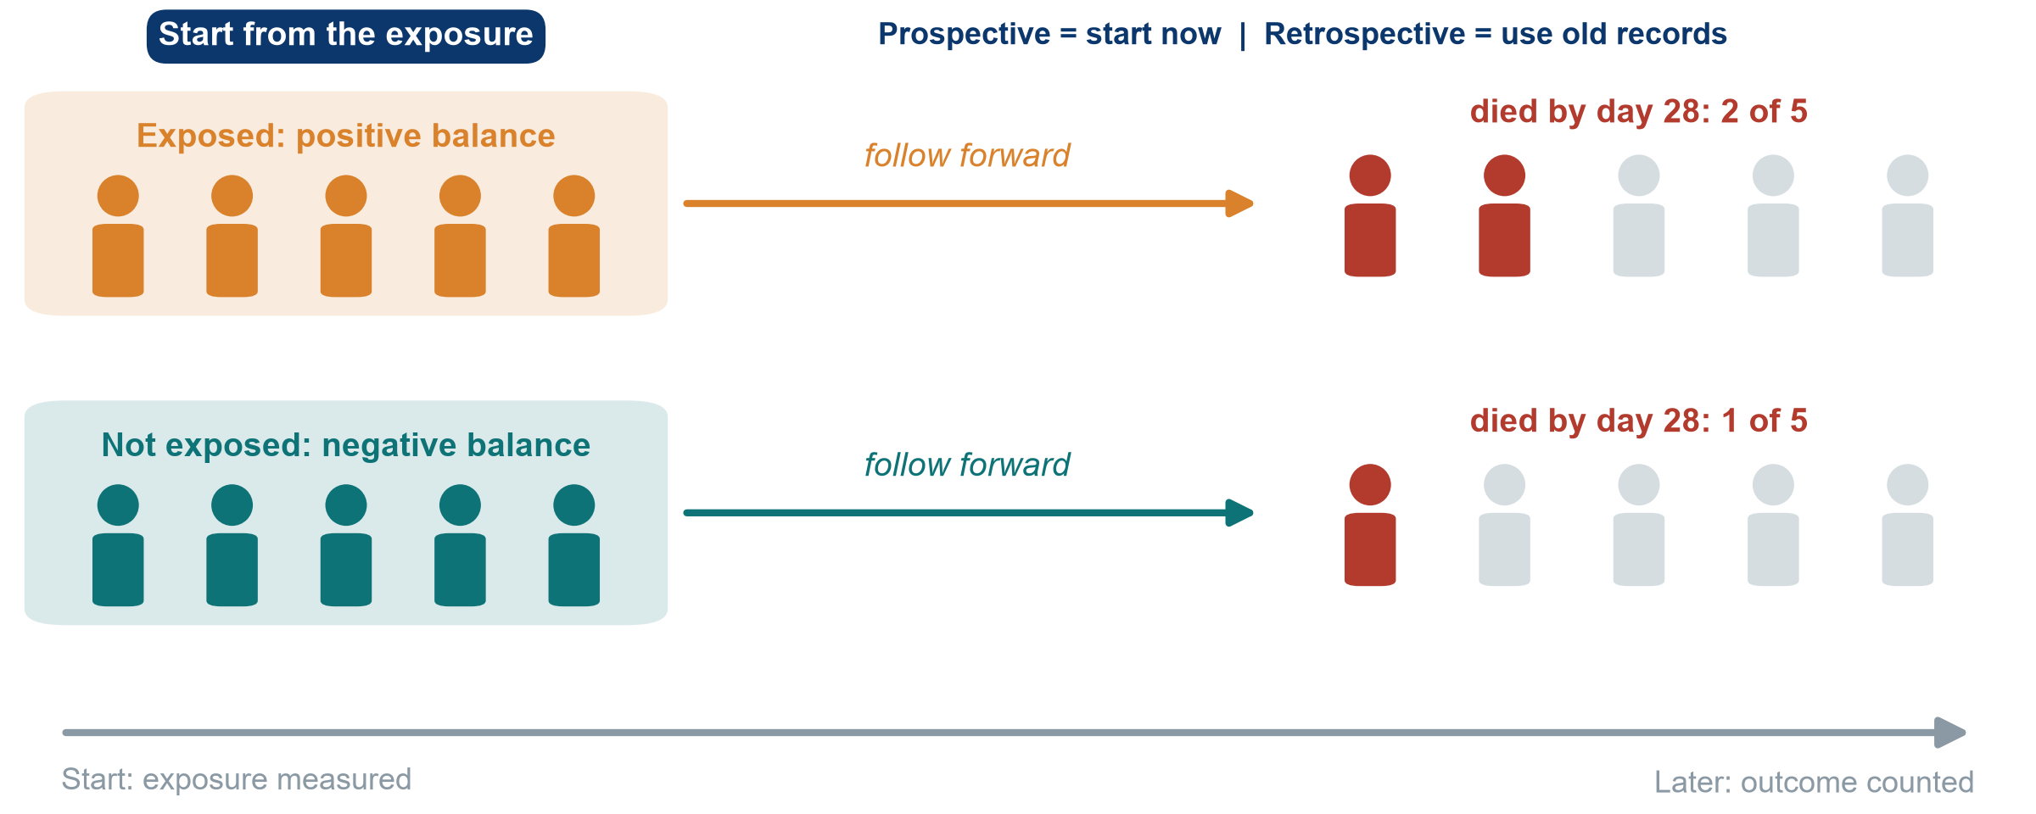
Cohort: start from the exposure, follow forward
KEY MESSAGE Cohort: exposure first, outcome later, so time runs the right way.
Neudata | #ClearDataClearImpact
Notes:
Arrow left to right. Group people by exposure (here: positive versus negative fluid balance in the first ICU days) and count who develops the outcome (death by day 28). This is Paper 2, Hyun 2023.
Prospective cohort: you start now and follow into the future. Retrospective cohort: you start in old records, but the logic is still exposure then outcome. Hyun analysed a registry whose data were collected prospectively.
Strengths: clear time order, can study several outcomes, gives risks and incidence. Weaknesses: slow and costly if prospective, poor for rare outcomes, and confounding, because the investigator did not choose who got more fluid.
Misconception: 'retrospective means poor quality'. Not necessarily. The quality depends on how well the data were recorded.
Ask the class (call on two or three people, microphone on): in Hyun, who decided which patients received more fluid? Expected answer: the treating clinicians, according to how sick the patient looked. Hold that thought for confounding in Session 4.
Timing: 2 minutes.

Slide 13
Worked example: Paper 2 (Hyun 2023), step by step
Question: is a positive fluid balance associated with death by day 28?
Define the cohort
Measure exposure
Follow forward
Compare
Adults with sepsis in 20 hospitals, ICU stay of 3 days or more
Cumulative fluid balance, ICU days 1-3: positive or negative
Record who dies by day 28
Matched pairs. Hazard ratio (HR) 2.13 for day 2
KEY MESSAGE A cohort groups people by exposure and follows them to the outcome.
Neudata | #ClearDataClearImpact
Notes:
This is how Paper 2 (Hyun 2023, course folder Course/Papers) works. It is a good example of a cohort built from a registry whose data were collected prospectively.
Step 1: the cohort: who is followed (and who is left out: patients who left the ICU before day 3). Step 2: exposure measured before the outcome. Step 3: outcome counted later. Step 4: compare the groups. Hyun used propensity-score matching to make them similar (483, 373 and 392 matched pairs for days 1, 2 and 3). Day 2 result: hazard ratio (HR) 2.13 (95% confidence interval, CI, 1.48-3.06). Day 1 showed no clear difference. HR is explained properly in Session 6. For now 'about twice the rate of death'.
Misconception: 'a cohort needs to start today'. A retrospective cohort uses old records but still goes exposure then outcome.
Ask the class (call on two or three people, microphone on): who decided which patients received more fluid? Expected: the treating clinicians, often because the patient was sicker. We come back to this in Session 4 (confounding).
Timing: 3 minutes.

Slide 14
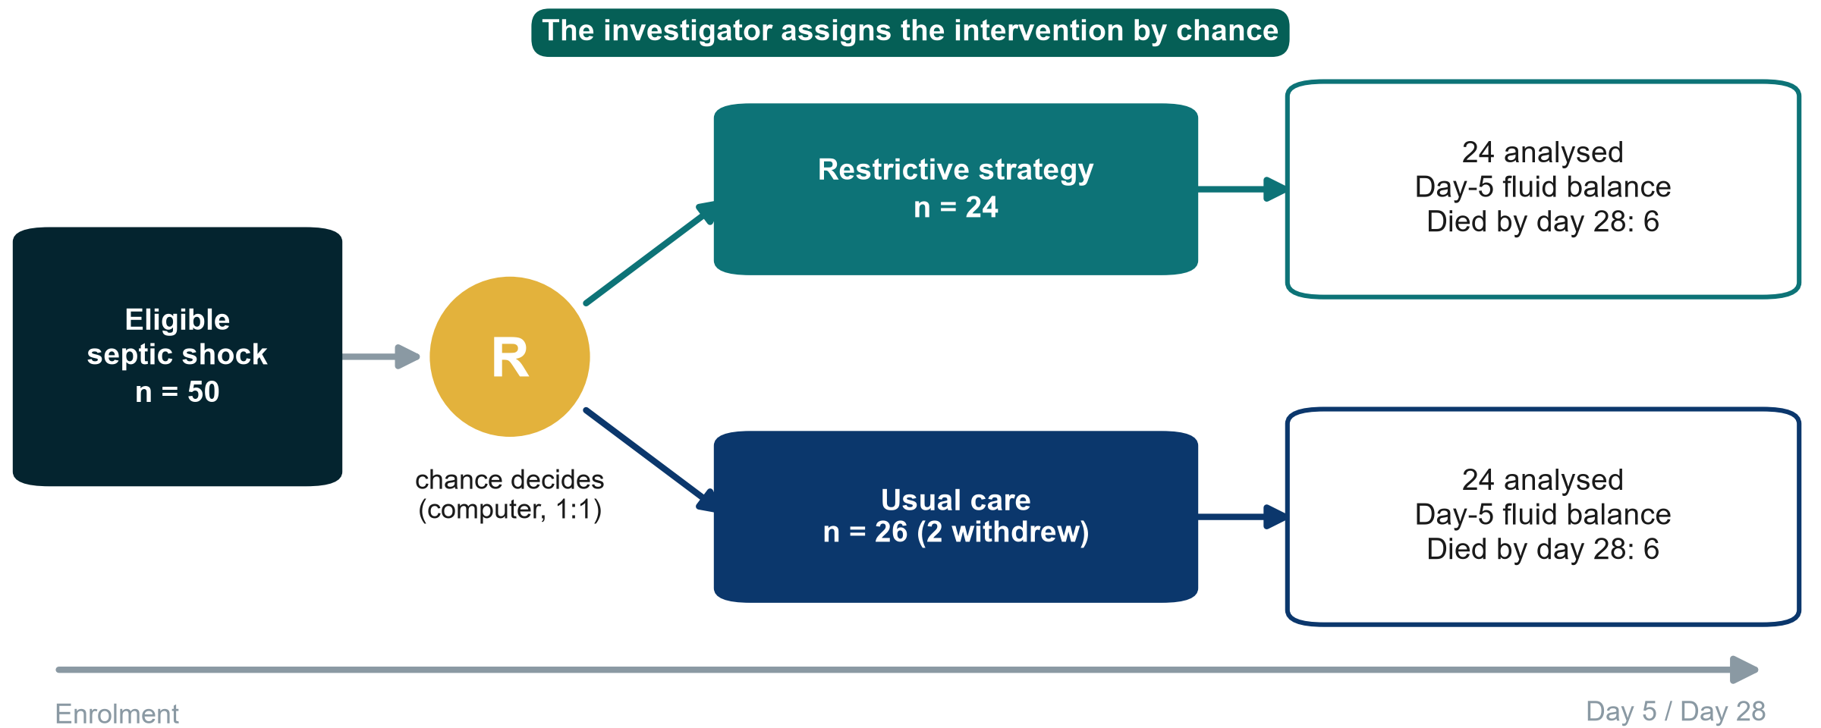
RCT (randomised controlled trial): randomise, then follow forward
R: randomisation by a central computer, 1:1
KEY MESSAGE In an RCT chance, not the clinician, decides who gets what.
Neudata | #ClearDataClearImpact
Notes:
Paper 1, Boulet 2024: 50 adults with septic shock randomised by a central computer, 1:1, to a restrictive strategy for non-resuscitation fluids or usual care. Two patients in the usual-care group withdrew consent, so 24 + 24 were analysed.
Teaching point: an RCT is a cohort in which the investigator assigns the exposure by chance. That is why groups are alike at the start, for factors we measured and factors we did not.
Note the honest result: 6 deaths in each group by day 28. With 24 patients per arm this tells us almost nothing about mortality. The trial was a pilot powered for fluid balance.
Misconception: 'RCT = truth'. A small, unblinded or badly run RCT can still mislead. Design is necessary, not sufficient.
Ask the class (call on two or three people, microphone on): why not randomise everything? Expected answer: some exposures cannot ethically be assigned (smoking, harm), some outcomes are rare or take years, and trials are expensive.
Timing: 2 minutes. After the break, 3.2 shows the other ways a trial can be laid out.

Slide 15
Worked example: Paper 1 (Boulet 2024), step by step
Question: does restricting non-resuscitation fluids reduce the day-5 fluid balance?
Eligibility
Consent
Randomise
Treat
Measure
Septic shock, age 18-85, vasopressor started less than 24 h ago
Patient or legal surrogate
Central computer, 1:1, so nobody can predict
Restrictive vs usual care for 7 days
Fluid balance at day 5. Death by day 28
KEY MESSAGE In a trial the investigator assigns the exposure by chance.
Neudata | #ClearDataClearImpact
Notes:
This is Paper 1 (Boulet 2024, course folder Course/Papers), a pilot randomised trial in 3 ICUs.
Step 1: strict eligibility criteria (we return to these in the proposal builder). Step 2: consent (in the ICU often from a surrogate), before or soon after randomisation. Step 3: randomisation by a central computer keeps the next allocation hidden (allocation concealment, Session 4). Step 4: the two strategies are delivered. Step 5: the primary outcome is the day-5 fluid balance. Death by day 28 was 6 of 24 in each group.
Misconception: 'randomised = blinded'. Not here. Clinicians knew the group. Only patients and statisticians were blinded.
Ask the class (poll): which step makes this an experiment rather than a cohort? Expected: step 3, where the investigator assigns the exposure.
Timing: 2.5 minutes.

Slide 16
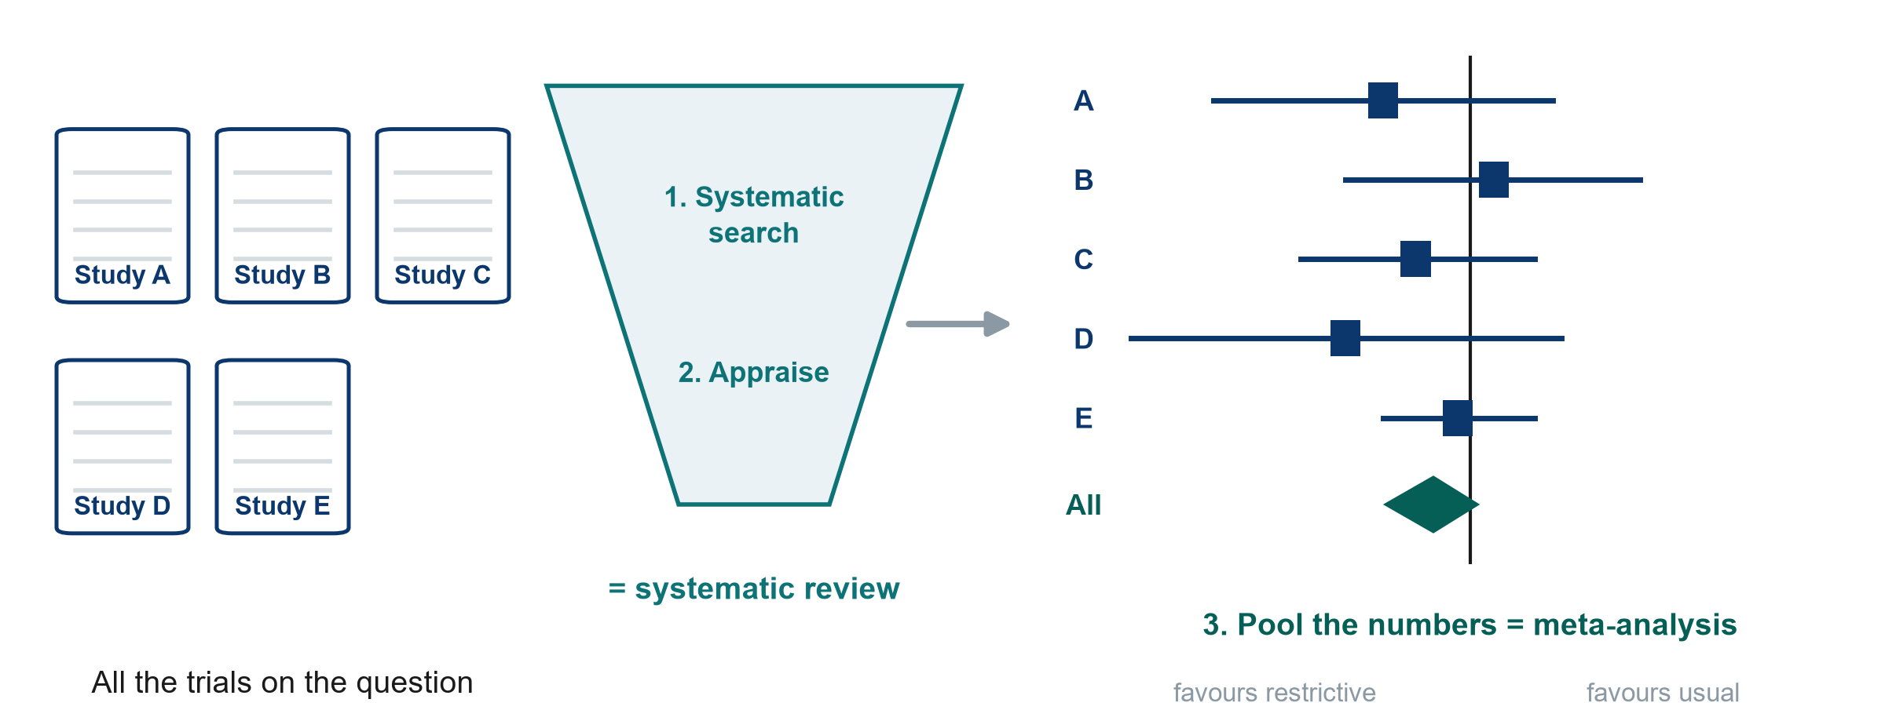
Systematic reviews and meta-analysis: studies of studies
KEY MESSAGE A systematic review searches and appraises. A meta-analysis pools the numbers.
Neudata | #ClearDataClearImpact
Notes:
A systematic review uses a pre-specified, reproducible search (remember PubMed and Boolean operators from Session 2) and appraises every study found. A meta-analysis then pools the results into one estimate: the diamond at the bottom of a forest plot.
The forest plot here is illustrative: each square is one trial, the line its 95% confidence interval, the vertical line 'no difference'. Session 4 reads a PRISMA flow diagram and a forest plot step by step.
Misconception: 'a meta-analysis is always the best evidence'. It is only as good as the studies it pools: garbage in, garbage out. A review of small biased trials gives a precise wrong answer.
Ask the class (call on two or three people, microphone on): what is the difference between a narrative review and a systematic review? Expected answer: the systematic review has a stated, reproducible method for search and selection. A narrative review is the author's choice.
Timing: 2 minutes.

Slide 17
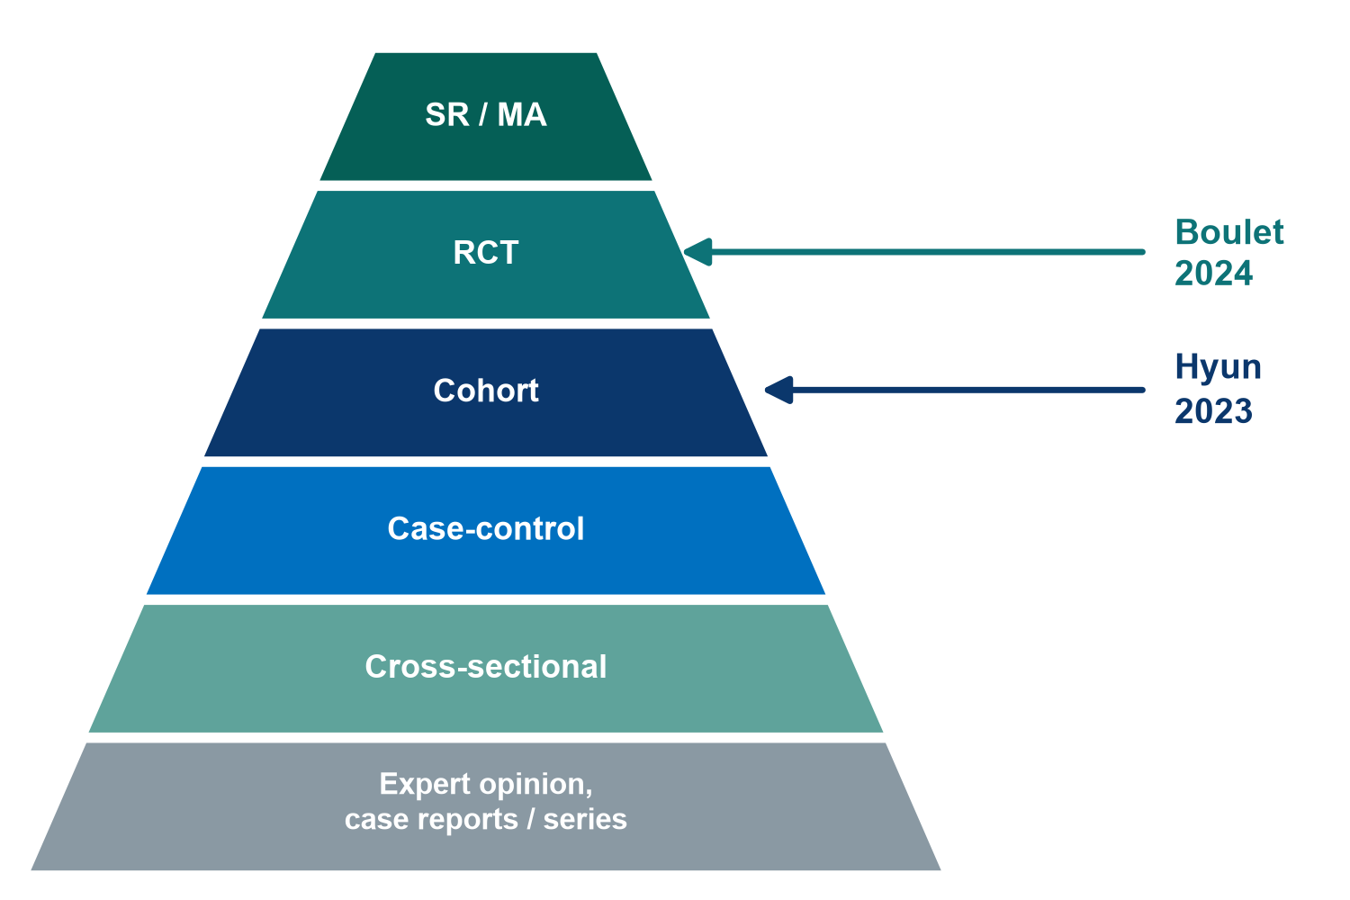
Where the two papers sit on the evidence pyramid
Read it with care
SR / MA: systematic review and meta-analysis
Higher = less prone to bias, on average
A rule of thumb, not a law
A good cohort can beat a poor RCT
The best design is the one that fits the question
Neudata | #ClearDataClearImpact
Notes:
Recap from Session 1, now with the two papers placed on it. Paper 1 (Boulet) is an RCT, Paper 2 (Hyun) a cohort.
Teaching point: the pyramid ranks designs by their typical protection against bias for questions about treatment effects. It does not rank questions about prevalence, prognosis or rare harms, where other designs are the right tool.
Misconception: 'anything on a higher level beats anything lower down'. A 48-patient pilot RCT does not overrule a careful multicentre cohort on mortality. They answer different parts of the question.
Ask the class (poll): which paper is higher, and does that make it more useful for our mortality question? Expected answer: Boulet is higher, but it was not designed or powered for mortality, so for mortality it adds little.
Timing: 1.5 minutes.

Slide 18
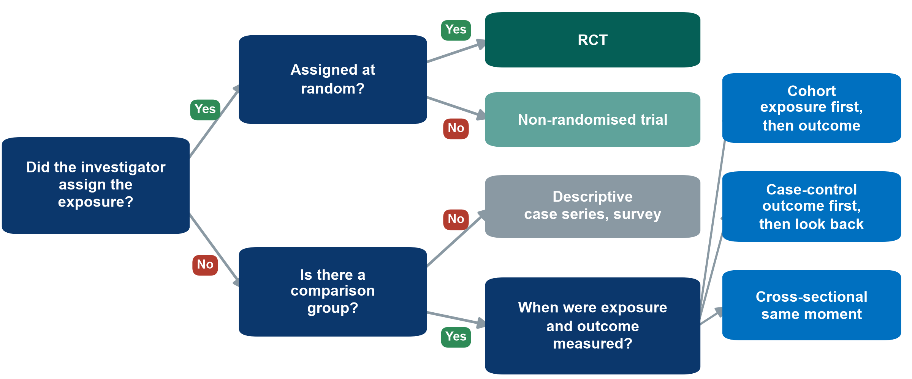
Name the design in three questions
KEY MESSAGE Assigned? Random? Which way does time run? Three questions name the design.
Neudata | #ClearDataClearImpact
Notes:
This is the tool for the 'Name that design' exercise at the end of 3.1. Walk it once slowly with Paper 1 (Boulet), then with Paper 2 (Hyun).
Boulet: did the investigator assign the strategy? Yes. At random? Yes. RCT.
Hyun: assigned? No. Comparison group? Yes (positive vs negative balance). Exposure measured first and outcome followed afterwards? Yes. Cohort.
Misconception: people name the design from words in the title ('prospective', 'registry', 'retrospective'). Titles can mislead, so use the three questions instead.
Ask the class (poll): a study compares the fluid balance and the kidney function of every ICU patient on one day. What design? Expected answer: no assignment, comparison yes, same moment = cross-sectional. And a fluid protocol introduced on one date, compared before and after? Assigned but not random: a non-randomised (quasi-experimental) study.
Timing: 5 minutes. The same tree is also in the Session 3 exercise sheet (PDF), Part A, so participants can keep it open during the exercise.

Slide 19
Every design trades something away
Strengths and weaknesses at a glance
Cross-sectional
Case-control
Cohort
RCT
+ quick and cheap
+ gives prevalence
- which came first?
+ rare outcomes
+ few patients, fast
- recall bias
- odds ratio only
+ clear time order
+ risks, many outcomes
- slow if prospective
- confounding
+ balances the unknown
+ strongest for cause
- costly, ethical limits
- selected patients
KEY MESSAGE No design is perfect: choose the one whose weakness hurts your question least.
Neudata | #ClearDataClearImpact
Notes:
Do not read every line. Pick one strength and one weakness per card and link it to a picture they have just seen.
Teaching point: the RCT's unique strength is balancing unknown confounders. Its weakness is often generalisability: trial patients are selected (Boulet excluded patients over 85, those needing dialysis and the severely malnourished).
Misconception: 'case-control studies are weak'. For a rare outcome they are often the only feasible design, and they first linked smoking with lung cancer.
Ask the class (call on two or three people, microphone on): which design would you choose to find risk factors for a rare drug reaction? Expected answer: case-control.
Timing: 2 minutes. The same table is in the Session 3 exercise sheet (PDF).

Slide 20
What can each design claim?
RCT: Paper 1, Boulet 2024 (48 patients)
Cohort: Paper 2, Hyun 2023 (thousands)
It can claim
Groups alike at the start (chance)
A difference can be blamed on the strategy
Its limits
Too small for mortality (6 vs 6 deaths)
Clinicians knew the group (single-blind)
It can claim
Large, real patients, 28-day mortality
'Associated with' (HR 2.13 on day 2)
Its limits
Cannot prove that fluid causes death
Sicker patients got more fluid (confounding)
KEY MESSAGE RCTs can say 'caused'. Cohorts should say 'associated'.
Neudata | #ClearDataClearImpact
Notes:
Back to the running example to close 3.1.
Boulet (RCT): because chance made the groups comparable, any difference in fluid balance can be attributed to the strategy. But with 48 patients and 6 deaths in each arm, it cannot tell us anything firm about mortality. Clinicians knew the allocation, which could influence how much fluid they gave.
Hyun (cohort): thousands of patients and the outcome we care about. A positive balance on days 2-3 was associated with higher 28-day mortality (hazard ratio, HR, 2.13 for day 2 and 1.56 for day 3, no clear difference on day 1). But it cannot prove that the fluid caused the deaths, because sicker patients receive more fluid.
Misconception: 'adjusted' or 'propensity-matched' turns an association into a cause. It reduces measured confounding only.
Ask the class (call on two or three people, microphone on): write one honest sentence for each paper's conclusion. Expected answer: for Boulet, 'the strategy did not clearly reduce day-5 fluid balance'. For Hyun, 'a positive balance on days 2-3 was associated with higher mortality'.
Timing: 4 minutes. Then a 3-minute poll, then the exercise.

Slide 21
Check your understanding: caused or associated?
QUICK QUIZ | 3 min
A. Paper 1, Boulet (RCT): 'The restrictive strategy did not reduce the day-5 fluid balance'
B. Paper 2, Hyun (cohort): 'A positive fluid balance causes higher 28-day mortality'
C. A one-day survey of ICU patients: 'A positive fluid balance today is associated with kidney injury today'
For each sentence
Is the wording right for the design?
Vote in the poll: right or wrong
OUTPUT One poll vote (right or wrong) for each sentence
Neudata | #ClearDataClearImpact
Notes:
Run it as a three-question poll (right or wrong for each sentence). Show the results after each.
Answers. A: right. A randomised trial may make causal statements, and this one honestly reports a null result. B: wrong. A cohort can say 'associated with', not 'causes' (Hyun's own abstract correctly says 'associated'). C: right. 'Associated' is the right word for a cross-sectional survey. It cannot show which came first.
Teaching point: this is question 8 of the 10-question appraisal checklist used in Session 8 (Course/Resources/Critical_Appraisal_Checklist.pdf): do the words match the design?
Timing: 3 minutes. This closes the 45 minutes of 3.1.

Slide 22
Exercise: Name that design
WHOLE-CLASS TASK | 15 min
Six short abstracts on our fluid question: Session 3 exercise sheet (PDF sent before the session), Part A
The instructor shows one abstract at a time on the shared screen
Vote for the design in the poll
A volunteer says the phrase that proves it, microphone on
Use the three questions: assigned? random? which way does time run?
Use the tree
Assigned and random: RCT
Outcome first, look back: case-control
Exposure first, follow forward: cohort
Same moment: cross-sectional
OUTPUT Six designs named by the class, each with one evidence phrase
Neudata | #ClearDataClearImpact
Notes:
Whole-class exercise, about 2.5 minutes per abstract. Sheet: Course/Practicals/s3_exercises.md, Part A (sent as a PDF before the session). Answer key: Course/Solutions/s3_solutions.md, Part A.
Run it: show abstract 1 on the shared screen and read it aloud. Open a poll with the design choices (cross-sectional, case-control, cohort, non-randomised study, RCT, systematic review). Show the results. Ask one volunteer (raise hand, microphone on) for the phrase that proves it, and type it next to the abstract on the shared screen. Then the next abstract.
Abstracts 3 (case-control, looks back from dialysis) and 4 (retrospective cohort that sounds like a case-control) are usually the hardest. Spend the extra time there.
Teaching point: the evidence phrase matters more than the label: 'randomly allocated', 'compared with patients who did not', 'divided them by', 'on one day'.
Misconception to listen for: 'it used old records so it is case-control'. Ask: were people selected by outcome or by exposure?
If the class is quick: the sheet has nine more abstracts on other topics for self-study (Part A, extra practice). Announce the break at the end of this slide.

Slide 23
Break
15 min
Neudata | #ClearDataClearImpact
Notes:
The slide is only a picture on purpose. Before the break, say: stand up, stretch, drink some water. Optional thought: which design might fit your own question? We restart with more study designs.
15-minute break (20:40-20:55). Put a countdown timer on the shared screen and leave the session open.
Restart on time: start the next slide even if a few people have not yet turned their cameras back on.

Slide 24
3.2 More designs
Real projects bend the basic designs.
Trial variants, non-inferiority, pilots, quality-improvement designs and qualitative research. (30 minutes)
Neudata | #ClearDataClearImpact
Notes:
Section marker for 3.2 (30 minutes).
Why this matters: most projects in a hospital department are not classic two-arm trials. They are unit-level changes, quality-improvement projects, pilots or interviews. Knowing these designs lets participants choose something feasible for their own proposal.
Timing: 30 seconds.

Slide 25
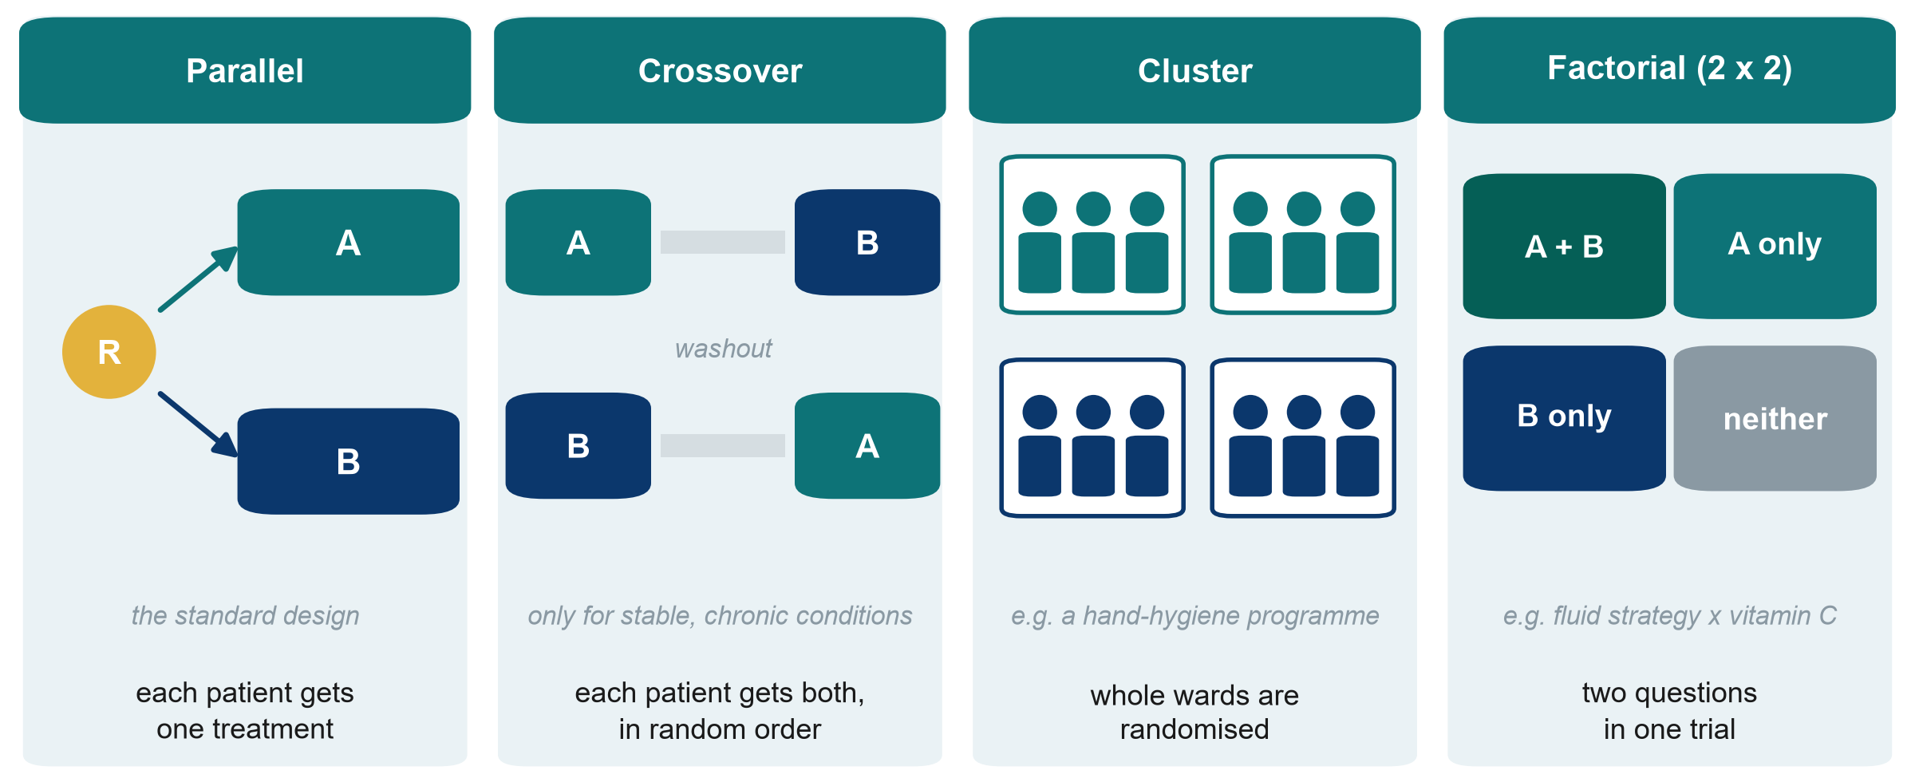
Not every trial is parallel: four layouts
R: randomisation. A and B: the two treatments
KEY MESSAGE Choose the trial layout that fits the treatment and the unit of care.
Neudata | #ClearDataClearImpact
Notes:
Most trials are parallel: each patient gets one treatment (Boulet). Three variants solve particular problems.
Crossover: each patient receives both treatments in random order, with a washout in between, and acts as their own control, so fewer patients are needed. Only for stable, chronic conditions where the effect wears off (e.g. inhalers in chronic obstructive pulmonary disease). Useless in septic shock: the patient is not the same on day 7.
Cluster: whole wards, ICUs or hospitals are randomised, not individual patients. Use it when the intervention works at unit level (a hand-hygiene programme, a sepsis bundle, a nurse-led fluid charting protocol) or when patients in the same unit would 'contaminate' each other. Needs more patients, because patients in one cluster resemble each other.
Factorial: two questions in one trial. Patients are randomised twice (e.g. fluid strategy and vitamin C), giving four groups. Efficient if the two treatments do not interact.
Misconception: 'a cluster trial is a weaker trial'. It is a proper RCT. The analysis must account for clustering.
Ask the class (poll): you want to test a new fluid-balance charting protocol run by ICU nurses. Which layout? Expected answer: cluster. Randomise ICUs, not patients.
Timing: 5.5 minutes.

Slide 26
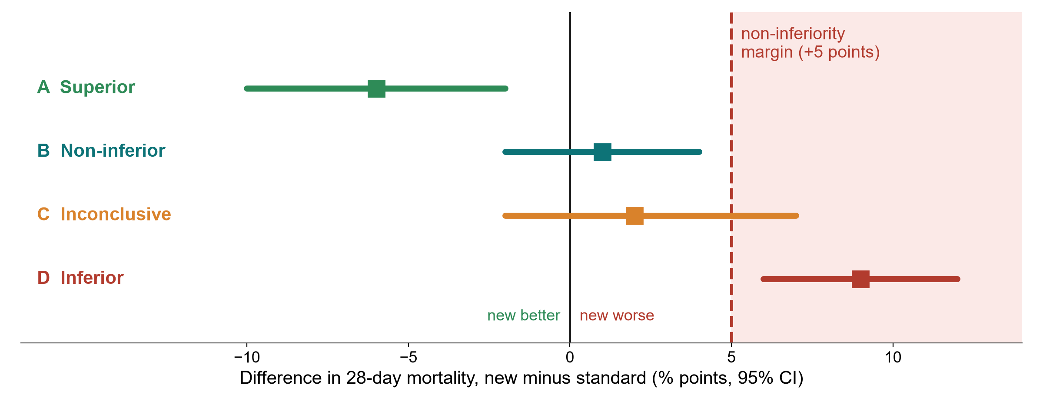
Superiority or non-inferiority? The margin picture
CI: confidence interval. Hypothetical results.
KEY MESSAGE Non-inferiority: the whole CI must stay below a margin fixed in advance.
Neudata | #ClearDataClearImpact
Notes:
A superiority trial asks: is the new treatment better? A non-inferiority trial asks: is it not unacceptably worse (usually because it is cheaper, safer, simpler or uses less fluid).
The margin (here +5 percentage points of mortality, hypothetical) is the largest loss we would accept. It is fixed in the protocol, before the data, with clinical reasoning.
Read the bars (difference and 95% confidence interval, CI). A: the whole CI is below 0, so superior. B: the CI crosses 0 but stays below the margin, so non-inferior. C: the CI crosses the margin, so inconclusive. D: the whole CI is above the margin, so inferior.
Misconception: 'p > 0.05 in a superiority trial shows the treatments are equivalent'. No. Absence of evidence is not evidence of absence. Boulet's p = 0.42 does not show that restriction is as good as usual care.
Ask the class (poll): who should decide the margin: the statistician or the clinicians? Expected answer: clinicians (and patients), with the statistician. It is a clinical judgement.
Timing: 5 minutes.

Slide 27
Pilot and feasibility studies: the rehearsal
Paper 1, Boulet 2024: a pilot trial
A pilot asks: can we do the big trial?
1,201 patients screened
50 randomised (4%)
48 analysed (96%)
About 3 patients per month across 3 ICUs
Can we recruit enough patients?
Will patients or families consent?
Can staff deliver the intervention?
Are outcomes measurable and complete?
What numbers do we need for the big trial?
KEY MESSAGE A pilot asks 'can we do it?', not 'does it work?'
Neudata | #ClearDataClearImpact
Notes:
Boulet 2024 calls itself a pilot. Its real value is in the numbers on the left: 1,201 patients screened for 50 randomised (about 4%), roughly 3 patients per month across 3 ICUs, 48 of 50 analysed.
A pilot or feasibility study tests the machinery of the big trial: recruitment, consent, whether staff can deliver the intervention, whether outcomes can be measured completely, and the numbers needed to calculate the sample size.
Teaching point: a pilot should not be used to claim effectiveness. Its success criteria are about feasibility (e.g. 'recruit 2 patients per site per month', 'over 90% data completeness').
Misconception: 'our small study did not find an effect, so we call it a pilot'. A pilot is planned as a pilot from the start, with feasibility objectives.
Ask the class (poll): from these numbers, would you launch a 1,000-patient trial in the same 3 ICUs? Expected answer: not as designed. At 3 patients per month it would take decades. You need many more sites or broader eligibility.
Timing: 4 minutes.

Slide 28
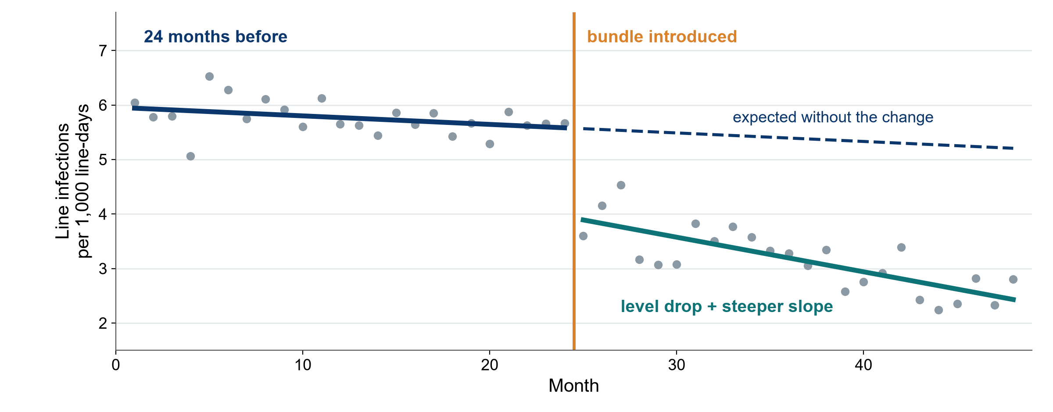
Quasi-experimental designs: before-after and interrupted time series
Simulated data for teaching. ITS: interrupted time series, QI: quality improvement.
KEY MESSAGE Compare against the trend you expected, not against one 'before' average.
Neudata | #ClearDataClearImpact
Notes:
Most quality-improvement (QI) projects introduce a change for everyone at once, with no randomisation and no parallel control. These are quasi-experimental designs.
The simple before-after study compares the average before with the average after. Weak: rates often fall anyway (seasons, new staff, other projects, regression to the mean after a bad month).
The interrupted time series (ITS) is much stronger: many measurements before and after (here 24 monthly points each). We compare what happened with what the pre-change trend predicted (dashed line). We look for a change in level (the drop) and in slope (steeper fall).
Teaching point: ITS is the standard design for evaluating a bundle, a protocol or a policy in one hospital. Add a control series (a unit that did not change) to make it stronger.
Misconception: 'the infection rate fell after our bundle, so the bundle worked'. Only if the fall is bigger than the existing trend.
Ask the class (call on two or three people, microphone on): what else changed in your hospital in the same month as your last QI project? Expected answer: usually something (staff rotation, a new policy, an audit), which is exactly why a trend matters.
Timing: 5 minutes.

Slide 29
Qualitative designs: when numbers cannot answer
Why? How? What is it like? Words, not numbers, analysed as themes
In-depth interviews
Focus groups
Observation
One person, open questions
Usually 30-60 minutes
e.g. why urine output goes unrecorded at night
6-8 people discuss together
Views spark other views
e.g. how families experience consent in the ICU
Watch what people actually do
It may differ from what they say
e.g. how fluid charts are filled in
KEY MESSAGE Qualitative research explains why and how. It complements numbers.
Neudata | #ClearDataClearImpact
Notes:
Some questions are not about how many or how much but about why, how and what it is like. Why do nurses not chart urine output at night? How do families experience surrogate consent in the ICU? Numbers cannot answer these.
Three main methods: in-depth interviews (one person, open questions), focus groups (6-8 people, discussion reveals shared views and disagreements), and observation (what people actually do, which may differ from what they say).
Sampling is purposive (choose people who know the topic) and continues until no new themes emerge (saturation). Analysis looks for themes in transcripts. Reporting guidelines: COREQ (Consolidated criteria for Reporting Qualitative research) or SRQR (Standards for Reporting Qualitative Research).
Mixed methods combine both: a trial plus interviews to understand why an intervention was or was not delivered.
Misconception: 'qualitative means anecdotal'. Done properly it is systematic, transparent and peer-reviewed.
Ask the class (call on two or three people, microphone on): one question about fluid management in your unit that only interviews could answer. Expected answer: why fluid charts are incomplete, why doctors hesitate to stop maintenance fluids.
Timing: 4.5 minutes.

Slide 30
Match the design to the question
If your question is... | Start with | Example on our fluid question
How common is it right now? | Cross-sectional | Patients with a positive fluid balance in our ICU today
Rare outcome: what raised the risk? | Case-control | Patients with sepsis who needed new dialysis, looking back at their fluid
What happens after an exposure? | Cohort | Positive fluid balance and death by day 28 (Paper 2)
Does this treatment work? | RCT | Restrictive vs usual fluids (Paper 1)
What do all the studies say? | Systematic review and meta-analysis | All fluid-restriction trials, pooled
Start from the question, and the design follows from it. Then check that it is feasible in your setting.
Neudata | #ClearDataClearImpact
Notes:
This is the practical summary of both sections of today. Read each row as: if your question sounds like this, start with this design.
Teaching point: in the proposal builder later today every participant will justify the design of their own question with exactly this logic: 'my question is about X, so the best feasible design is Y'.
Note the word feasible: the ideal design for 'does restriction save lives?' is a large RCT, but a participant with one ICU and no funding may honestly choose a retrospective cohort and state its limits.
Misconception: 'we must do an RCT to be taken seriously'. A well-done, honestly reported cohort is publishable and useful.
Ask the class (poll): we want to know how many ICU patients have a positive fluid balance today. Which design? Expected answer: cross-sectional (point prevalence).
Timing: 5.5 minutes. This closes the 30 minutes of 3.2.

Slide 31
Exercise: choose the design
WHOLE-CLASS TASK | 15 min
Five planning questions about our fluid question: exercise sheet, Part B
For each: vote in the poll for the best feasible design
A volunteer gives one reason and the main weakness. The instructor types them on the shared screen
Then your own question: two or three people say their design, and 'caused' or 'associated'
Remember
Does it work? RCT or cluster trial
Not worse? Non-inferiority trial
Already changed? Time series
Why or how? Qualitative
Can we do it? Pilot
OUTPUT Five designs chosen together, then a few people share their own design and claim
Neudata | #ClearDataClearImpact
Notes:
Whole-class exercise. Sheet: Session 3 exercise sheet (Course/Practicals/s3_exercises.md, PDF sent before the session), Part B. Key: Course/Solutions/s3_solutions.md, Part B.
Run it: about 2 minutes per question (10 minutes), then 5 minutes for the participants' own questions.
Answers for the five questions: 1 a cheaper strategy that only needs to be not worse for 28-day mortality (non-inferiority RCT, margin fixed in advance), 2 a nurse-led fluid-balance charting protocol for whole ICUs (cluster randomised trial), 3 a sepsis bundle with a fluid limit already introduced in 2023, with monthly data (interrupted time series), 4 why night nurses find it hard to record urine output (qualitative interviews or focus groups), 5 can our two ICUs recruit patients and deliver restrictive fluids before a large trial (pilot or feasibility study).
Own questions: call on four or five people to say 'my design is ..., so I may say caused / associated' with the microphone on, and comment briefly. This is the bridge to the proposal builder.
Common problem: choosing an RCT for a harm or prognosis question. Ask: could you ethically assign this exposure?
If the class is quick: Part B of the sheet also has four questions on other topics for self-study.

Slide 32
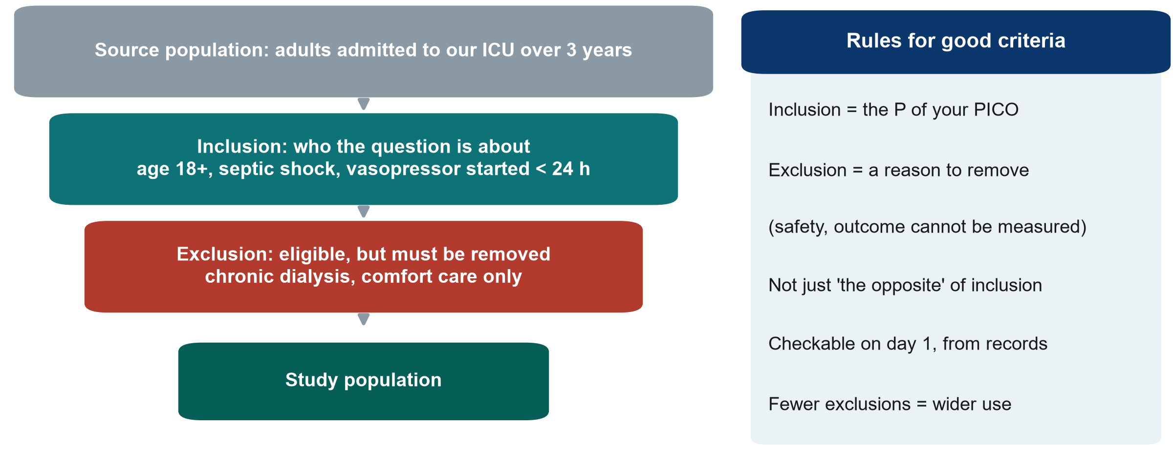
Who is in your study? Inclusion and exclusion criteria
KEY MESSAGE Inclusion describes your P (Population). Exclusion removes eligible people for a stated reason.
Neudata | #ClearDataClearImpact
Notes:
Proposal builder 3 starts here (45 minutes in all, the figure shown on the builder banner and in the agenda: this slide 3 minutes, then 42 minutes of builder work).
This slide prepares the proposal builder: everyone writes the study population of their own proposal today.
Walk down the funnel with the ICU example (an observational version of our fluid question). Source population: everyone who could be studied. Inclusion criteria: the P (Population) of the PICO, made measurable (age 18 or over, septic shock, vasopressor started within 24 h). Exclusion criteria: people who meet the inclusion criteria but must be removed for a reason, such as safety or an outcome that cannot be measured (chronic dialysis, comfort care only).
Compare with Paper 1 (Boulet): included septic shock, age 18-85, within 24 h of vasopressor start. Excluded acute kidney injury needing renal replacement therapy within 24 h, end-stage kidney disease, severe malnutrition (body mass index below 18).
Misconception: writing exclusions as the opposite of inclusions ('age under 18' is not an exclusion, it is simply not included).
Teaching point: every extra exclusion makes the study cleaner but the result applies to fewer patients (external validity, Session 4).
Ask the class (call on two or three people, microphone on): give one good exclusion criterion for our fluid study. Expected: chronic dialysis (the fluid balance cannot be interpreted), comfort care only.
Timing: 3 minutes.

Slide 33
Proposal builder 3: design, setting and population
PROPOSAL BUILDER | 45 min
Watch: the instructor writes Part 2a live for the running example (15 min)
Design and a 3-5 sentence justification, chosen with the decision tree
Setting: where, when, which units, which data source
Population: 3-5 inclusion and 3-5 exclusion criteria, each exclusion with a reason
Your turn: draft the same for your own question (20 min, quiet individual work)
Three volunteers read their design sentence aloud for feedback (7 min)
Check your draft
Design matches the question?
Feasible in your unit?
Inclusion = your P (Population)?
Each exclusion has a reason?
'Caused' or 'associated'?
OUTPUT Your own Proposal Part 2a drafted (finish it as homework)
Neudata | #ClearDataClearImpact
Notes:
Worksheet: Session 3 exercise sheet (PDF), Part C, and the proposal template (Course/Templates/Research_Proposal_Template.docx, Part 2). Everyone writes their own proposal. There are no groups.
Rhythm (42 minutes): 15 minutes in which the instructor fills in Part 2a for the running example on the shared screen, thinking aloud, 20 minutes in which participants draft their own Part 2a quietly (cameras optional, the instructor stays online for questions in the chat), 7 minutes in which three volunteers read their design and justification sentence aloud and the instructor comments.
Model answer for the running example (observational version), to write live: retrospective cohort of adults with septic shock in our ICU over 3 years. Justification: an RCT is ideal but not feasible for one ICU without funding. Existing charts record fluid in and out and outcomes. We will say 'associated with'. Setting: one adult mixed ICU, 3 calendar years, electronic chart and ICU register. Inclusion and exclusion as on the funnel slide. Full model in Course/Solutions/s3_solutions.md, Part C.
Common problems: an RCT chosen for an exposure that cannot be assigned. A setting that is far too large. Exclusions that repeat the inclusions in the negative.
The rest of Part 2 (exposure, comparator, outcomes, biases) is built in Session 4.
Timing: warn at 10 minutes and 2 minutes before the end of the individual slot.

Slide 34
Session 3 in one slide
3.1 Basic designs
3.2 More designs
Your proposal
Snapshot, look back, follow forward
RCT: chance assigns the exposure
RCT may say 'caused', cohort says 'associated'
Cluster, crossover, factorial
Non-inferiority needs a margin
Pilot, time series, qualitative
Design and justification
Setting
Inclusion and exclusion criteria
KEY MESSAGE The question picks the design. The design decides what you may claim.
Neudata | #ClearDataClearImpact
Notes:
Session recap (22:25). Ask three volunteers (raise hand) to explain one card each in their own words.
If time is short, read the key message only.
Timing: 2 minutes. With the wrap-up slide (3 minutes) this is the 5-minute close.

Slide 35
Wrap-up and homework
DISCUSSION | 5 min
Exit question (chat or 1-question form): doctors chose restrictive fluids for some patients with septic shock and not for others. Both groups are followed to day 28. Which design? 'Caused' or 'associated'?
Why: it checks today's key idea. The instructor reads every answer and opens Session 4 with them
Homework: finish your own Proposal Part 2a (design, setting, population)
Reading: 'Patients' in Paper 1 (Boulet) and 'Data source' in Paper 2 (Hyun), in Course/Papers
Next Saturday (Session 4): can we trust the result, and how big is the effect?
OUTPUT One exit answer per person, in the chat or the form
Neudata | #ClearDataClearImpact
Notes:
Exit question answer: a cohort (grouped by the exposure the doctors chose, followed forward). It may only say 'associated', because doctors choose restrictive fluids for patients who differ in many ways (less sick, or more fluid-overloaded). This previews confounding by indication next Saturday.
Purpose of the exit question: it checks whether the main idea of today landed. Read all the answers before Session 4 and open Session 4 by showing three of them (anonymously).
Timing: 3 minutes after the 2-minute recap slide (5 minutes in all, as on the banner and in the agenda). Finish at 22:30.

Slide 36
Extra slides: Session 3
Extra slides: Session 3
Use if time allows, or for self-study
Neudata | #ClearDataClearImpact
Notes:
Extra: the slides after this point are optional. Use them if the class is quick, for questions, or point participants to them for self-study (the deck is shared as a PDF after the session).
Timing: skip in the live session unless time allows.

Slide 37
The decision tree in action: Paper 1 (Boulet) and Paper 2 (Hyun)
Assigned?
Random?
Comparison?
Time order?
Design
Boulet: yes, the trial assigned the strategy
Hyun: no, clinicians decided
Boulet: yes, by a central computer
Hyun: yes, positive vs negative balance
Hyun: exposure on days 1-3, then death by day 28
Boulet: RCT
Hyun: cohort
KEY MESSAGE Walk every paper through the same questions before reading its results.
Neudata | #ClearDataClearImpact
Notes:
Extra: a slow walk-through of the decision tree with the two running-example papers (both in Course/Papers). Useful if the 'Name that design' exercise showed confusion.
Boulet: assigned? Yes. Random? Yes. So RCT. Hyun: assigned? No. Comparison group? Yes. Exposure measured before outcome? Yes. So cohort.
Ask participants to do the same for a paper from their own reference list (Proposal Part 1).
Timing: 2 minutes if used.

Slide 38
More practice (other examples): name the design
QUICK QUIZ | 3 min
A. All 300 inpatients are checked today for a urinary catheter and for urinary infection
B. Patients with ventilator-associated pneumonia are compared with patients without it for earlier sedation use
C. Patients who received early mobilisation (the physiotherapist's decision) and those who did not are followed to discharge
Choose
Cross-sectional
Case-control
Cohort
RCT
OUTPUT One design named for each scenario (answers on the next slide)
Neudata | #ClearDataClearImpact
Notes:
Extra: three more scenarios from other wards, for a quick poll or for self-study.
Watch for scenario C: some will say RCT because there are two groups. Ask: who decided who got mobilised? (The physiotherapist, not chance.)
Timing: 3 minutes including the answer slide, if used.

Slide 39
Answers: name the design (other examples)
A. Cross-sectional
B. Case-control
C. Cohort
One day, everyone
Exposure and outcome measured together
Gives prevalence
Chosen by outcome (pneumonia)
Look back for exposure (sedation)
Gives an odds ratio
Grouped by exposure (mobilisation)
Followed forward to discharge
Not an RCT: nobody randomised
KEY MESSAGE Ask: chosen by exposure or by outcome? Assigned by chance or not?
Neudata | #ClearDataClearImpact
Notes:
Extra: answers to the previous slide.
Teaching point for C: two groups do not make a trial. If chance did not decide, it is observational.
Misconception: 'looking at old records makes it case-control'. Selection decides: by outcome = case-control. By exposure = cohort.
Timing: included in the 3 minutes, if used.

Slide 40
More practice (other examples): which design?
QUICK QUIZ | 3 min
A. A cheaper antibiotic schedule. We only need to show it is not worse
B. A hand-hygiene programme delivered to whole wards
C. Why do families refuse research consent in the ICU?
Choose
Cluster trial
Non-inferiority trial
Qualitative interviews
OUTPUT One design for each (answers in the notes)
Neudata | #ClearDataClearImpact
Notes:
Extra: more practice on the 3.2 designs, with examples from other topics.
Answers. A: non-inferiority trial. Define the margin in advance. B: cluster randomised trial. Randomise wards, not patients. C: qualitative design using in-depth interviews (or focus groups) with families.
Timing: 3 minutes if used.

Slide 41
Choosing good controls in a case-control study
Same source
Same measurement
Matching (optional)
Same hospital, units and period as the cases
Would have become a case if they had the outcome
Same records, same questions
Ideally an assessor who does not know who is a case
e.g. age, month of admission
Do not match on the exposure itself
KEY MESSAGE Bad controls make any case-control study meaningless.
Neudata | #ClearDataClearImpact
Notes:
Extra: for participants planning a case-control study.
Controls must come from the population that produced the cases: in the candidaemia example, other ICU patients in the same units and months, not healthy volunteers.
Exposure must be measured the same way in cases and controls, ideally by someone who does not know which is which.
Matching on a few factors can improve efficiency, but over-matching (on things linked to the exposure) hides the effect.
Timing: 2 minutes if used.

Slide 42
Superiority, equivalence and non-inferiority
CI: confidence interval. Margin: the largest difference we accept, fixed in advance
Superiority
Equivalence
Non-inferiority
Is the new treatment better?
Whole CI on the 'better' side of 0
Is it about the same?
Whole CI between minus and plus the margin
Is it not unacceptably worse?
Whole CI below plus the margin
KEY MESSAGE The question (better, same, not worse) is fixed in the protocol, before the data.
Neudata | #ClearDataClearImpact
Notes:
Extra: completes the margin picture from 3.2.
Superiority trials are the usual type. Equivalence trials (common for generic drugs) need the CI inside a margin on both sides. Non-inferiority trials need only the upper side.
Misconception: 'a failed superiority trial shows equivalence'. No. It was not designed with a margin.
Timing: 2 minutes if used.

Slide 43
Making a quality-improvement evaluation stronger
More time points
A control series
Record co-interventions
At least 8-12 points before and after
Same definition every month
A unit or hospital without the change
Same months, same measure
Staff changes, new policies, audits
Write them down as they happen
KEY MESSAGE A before-after average is weak. A long, controlled time series is much stronger.
Neudata | #ClearDataClearImpact
Notes:
Extra: for participants whose project evaluates a change already made in their unit.
The interrupted time series compares the post-change data with the trend before the change. More data points, a control series and a diary of other changes make it much more convincing.
Reporting guideline for quality-improvement projects: SQUIRE 2.0 (Standards for QUality Improvement Reporting Excellence).
Timing: 2 minutes if used.

Slide 44
Copyright © Neudata, 2026
All property rights and copyright are reserved.
This presentation contains proprietary data, information, and materials developed by Neudata for dedicated use only and may not be communicated, copied, reproduced, distributed, published, or cited, in whole or in part, without the prior written consent of Neudata.
Where explicit written permission has been granted, appropriate attribution must be included, followed by “by courtesy of Neudata”.
Any unauthorized use or infringement of these materials may give rise to legal action and claims for damages, without prejudice to any other rights of Neudata, including rights relating to patents, trademarks, or other forms of intellectual property protection.
Neudata | #ClearDataClearImpact
Notes:
Copyright slide. Leave it on screen while participants leave the meeting.

