Slide 1

Session 2 · Find & read: the evidence
Week 2 · Saturday
Recap quiz on Session 1
2.1 Finding the evidence: PICO to search, Boolean, MeSH, live PubMed demo
2.2 Managing and citing: Zotero demo, citation styles, paraphrasing, grey literature
Break
2.3 Reading a paper in 15 minutes and 2.4 from literature to introduction
Proposal builder 2: your own search, 5 references, problem statement, working title
Neudata | #ClearDataClearImpact
Notes:
SESSION 2 OPENING (0:00, 19:30).
Open with what the Session 1 exit question showed (for example, how many people still used vague verbs) and spend one minute on it if needed.
Teaching point: last Saturday each participant started their own question. Today we find out what is already known about it, keep the references safely, and read papers efficiently.
Pace: slower than it looks. Every block has a demo or a task. Use the 'Check your understanding' slides: they show you who is lost.
Practical check before starting (chat): everyone has their PICO question, their synonym list (homework) and Zotero installed. Paste two links in the chat: the Session 2 exercise sheet (PDF) and Paper 1 as a clean PDF (the unannotated original, Course/Papers/Paper 1 - Boulet 2024 Crit Care (RCT) - original.pdf, also linked by DOI on the course website page 'The two papers').
Timing: 1 minute, then the recap quiz.

Slide 2
Recap quiz: Session 1
QUICK QUIZ | 8 min
Which course paper is a trial and which is a cohort: Paper 1 (Boulet) or Paper 2 (Hyun)?
'In adults with sepsis, is a positive fluid balance by day 3, vs not, linked to death by day 28?' Name P, E, C, O, T
Which FINER letter did our running example fail?
Which is an objective: 'to understand fluid balance' or 'to estimate the proportion fluid-positive on day 3'?
Write H0 for: does a restrictive protocol reduce fluid balance at day 5?
OUTPUT Answers in the online quiz form (link in the chat), checked against the next slide
Neudata | #ClearDataClearImpact
Notes:
RECAP QUIZ (0:00-0:10, 19:30-19:40). Individual, in a short online form (or answers typed in the chat), 6 minutes, then 2 minutes to show the form results on screen. Answers on the next slide. The questions are also on the Session 2 exercise sheet.
This also re-activates last Saturday's vocabulary for today's search.
Latecomers: let them join at question 2.
Timing: 8 minutes.

Slide 3
Recap quiz: answers
Designs
PECO(T)
Feasible
Estimate
H0
Paper 1 is a trial (RCT)
Paper 2 is a cohort
P: adults with sepsis
E: positive balance by day 3
C: neutral or negative balance
O and T: death by day 28
Mortality needs more than 1,000 patients
'Estimate' is measurable
'Understand' is not
Fluid balance at day 5 is the same in both groups
KEY MESSAGE If you got 4 or 5 right, you are ready for today.
Neudata | #ClearDataClearImpact
Notes:
Go through the five answers in 2 minutes. Quick poll: how many did you get right (0-3, 4 or 5)?
If many missed question 4 or 5, spend one extra minute: objectives use measurable verbs, and H0 always says 'no difference'.
Timing: 2 minutes. Segment 2.1 starts at 0:10.

Slide 4
2.1 Finding the evidence
Before you study it, find out what is already known.
40 minutes: the search funnel, PICO to search blocks, Boolean, MeSH, search tools, checking for a systematic review and a live PubMed demo
Neudata | #ClearDataClearImpact
Notes:
SEGMENT 2.1 (0:10-0:50, 19:40-20:20).
Teaching point: the literature search decides whether the question is novel, gives the background for the problem statement, and shows how others measured the outcome.
Ask the class (chat): 'What do you usually do when you need evidence quickly?' Honest answers: Google, a colleague, UpToDate, a guideline. All fine for care, but a proposal needs a documented search.
Timing: 1 minute.

Slide 5
The search funnel
Write down each step: the date, the search string, the filters and the number of hits.
All of PubMed
One keyword
PICO blocks
Filters
Screen
Keep
More than 40 million records
As of October 2026
septic shock
Tens of thousands
MeSH and free text, AND and OR
A few thousand
RCT, review, adults, years
Hundreds
Read titles and abstracts
Dozens
5-10 key papers
KEY MESSAGE A good search starts wide, narrows step by step, and is written down.
Neudata | #ClearDataClearImpact
Notes:
Walk along the funnel from left to right: all of PubMed, one keyword, structured PICO blocks, filters, screening by people, a handful of key papers.
Source for the PubMed size: the PubMed 'About' page (https://pubmed.ncbi.nlm.nih.gov/about/) says 'more than 40 million citations and abstracts'. Checked on 19 October 2026 (page last updated 11 March 2025). Check it again before teaching and update the 'as of' date if the number has changed.
The other numbers are orders of magnitude only. They change every day.
Teaching point: the last two steps are done by reading, not by the computer.
Ask the class (chat): 'Why write down the date and the search string?' Expected: so it can be repeated. Journals and reviewers ask for it.
This slide is built from editable shapes: change a number or add a reference directly in PowerPoint.
Timing: 2 minutes.

Slide 6
From PICO to search blocks
OR inside a block, AND between blocks: (P synonyms) AND (I synonyms) AND (O synonyms). C (usual care) is usually not searched.
P: septic shock
I: restrictive fluids
O: mortality
"Shock, Septic"[MeSH]
OR "septic shock"[tiab]
OR sepsis[tiab]
"Fluid Therapy"[MeSH]
OR "fluid restrict*"[tiab]
OR "restrictive fluid*"[tiab]
OR "conservative fluid*"[tiab]
Mortality[MeSH]
OR mortality[tiab]
OR death[tiab]
KEY MESSAGE One block per PICO concept: OR inside a block, AND between blocks.
Neudata | #ClearDataClearImpact
Notes:
Turn each PICO element into a concept block: the MeSH term plus free-text words.
[tiab] = title and abstract. The asterisk (*) is truncation: restrictive fluid* also finds 'restrictive fluids'.
The comparison (usual care) is normally left out because the words vary too much.
Misconception: 'just type the whole question into PubMed'. You lose control of synonyms and logic.
Ask the class (chat): 'Which other words would authors use for restrictive?' Expected: conservative, limited, de-resuscitation, fluid removal, negative fluid balance.
Timing: 4 minutes.

Slide 7
Another example: a ward question
Question: in adults at risk on the ward, does 2-hourly repositioning reduce new pressure injuries?
P + O: pressure injury
I: repositioning
Join the blocks with AND
"Pressure Ulcer"[Mesh]
OR "pressure injur*"[tiab]
OR "pressure ulcer*"[tiab]
OR bedsore*[tiab]
"Patient Positioning"[Mesh]
OR reposition*[tiab]
OR turning[tiab]
Tip: when P and O are the same idea (pressure injury), one block can carry both.
Authors write ulcer, injury, bedsore, decubitus. MeSH collects them under "Pressure Ulcer".
KEY MESSAGE Same method for any topic: concepts in blocks, synonyms with OR, blocks with AND.
Neudata | #ClearDataClearImpact
Notes:
Another worked example, from the ward, so colleagues outside the ICU see that the method works for any topic.
Question: in adults at risk on the ward, does 2-hourly repositioning reduce new pressure injuries?
Here P and O share the same idea (pressure injury), so one block carries both. The second block is the intervention.
MeSH: authors write pressure ulcer, pressure injury, bedsore, decubitus. The MeSH heading 'Pressure Ulcer' collects them.
Ask the class (chat): 'Which other words would authors use for repositioning?' Expected: turning, position change, mobilisation, offloading.
Timing: 3 minutes.

Slide 8
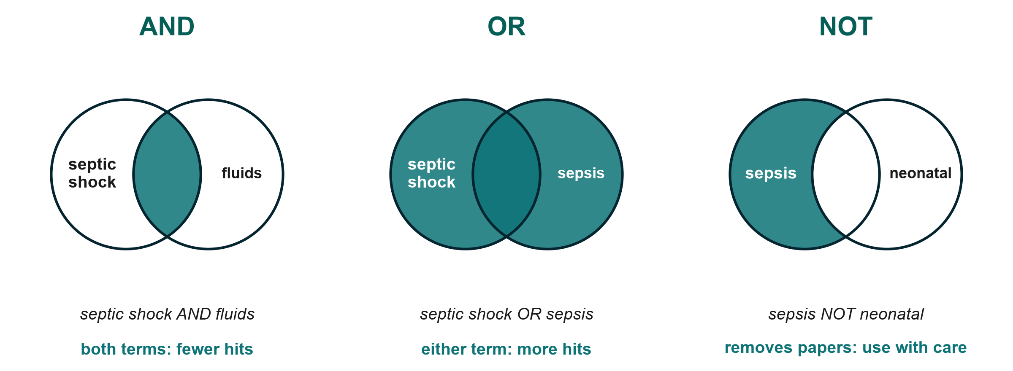
Boolean logic in pictures
KEY MESSAGE AND narrows, OR widens, NOT removes. Use NOT sparingly.
Neudata | #ClearDataClearImpact
Notes:
AND: only papers with both concepts, so fewer hits. OR: either word, so more hits. Use OR for synonyms.
NOT removes every paper that mentions the second term, even good papers that mention neonates once. That is why NOT is risky.
Tip: type the operators in capitals, and use brackets to control the order.
Ask the class (chat): 'septic shock AND fluids vs septic shock OR fluids: which gives more hits?' Expected: OR.
Timing: 2 minutes.

Slide 9
Check your understanding: AND, OR or NOT?
QUICK QUIZ | 2 min
You want papers that mention both septic shock and fluid restriction: which operator?
You want papers using either 'restrictive' or 'conservative' fluids: which operator?
Your search found 40,000 hits. Will adding a third AND block give more or fewer?
Why is 'sepsis NOT children' risky?
OUTPUT Answers in the chat (or the poll)
Neudata | #ClearDataClearImpact
Notes:
Answers: 1 AND. 2 OR. 3 Fewer (AND narrows). 4 It removes every paper that mentions children anywhere, including good adult studies that mention children once.
Timing: 2 minutes.

Slide 10
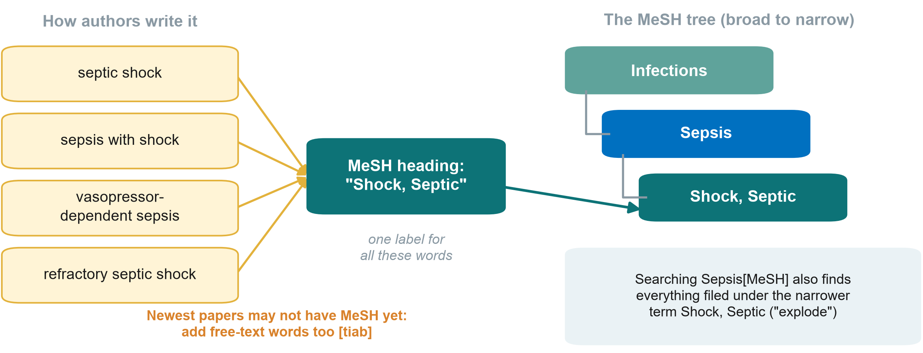
MeSH: the shared label behind many words
KEY MESSAGE Search the MeSH term AND the free-text words, joined with OR.
Neudata | #ClearDataClearImpact
Notes:
MeSH (Medical Subject Headings) is the controlled vocabulary of the US National Library of Medicine. Each MEDLINE record is tagged with MeSH terms, whatever words the authors used.
Searching a MeSH term includes the narrower terms below it ('explode'). For example, Sepsis[MeSH] includes Shock, Septic.
The newest records may not be indexed yet, so always add free-text [tiab] words.
Ask the class (chat): 'Why does MeSH help a nurse searching for pressure injury?' Expected: authors write pressure ulcer, bedsore, decubitus ulcer, and MeSH collects them under one heading.
Next slide: how to find the right MeSH term.
Timing: 2 minutes.

Slide 11
How to find the right MeSH term
MeSH Database
A paper you trust
Search details
PubMed home page, under Explore
Type a word, e.g. bedsore
It shows the heading: Pressure Ulcer
Open a relevant paper in PubMed
Scroll down to 'MeSH terms'
Reuse the ones that fit
PubMed maps your words to MeSH
Check which heading it used
KEY MESSAGE Look up MeSH terms, do not guess them.
Neudata | #ClearDataClearImpact
Notes:
Participants cannot know which words are MeSH terms. Show them three ways to find out.
Route 1, the MeSH Database: on the PubMed home page, under Explore, click 'MeSH Database' (or go to https://www.ncbi.nlm.nih.gov/mesh). Type an everyday word. The record shows the official heading, its definition, the entry terms it collects (for Pressure Ulcer: bedsore, decubitus ulcer, pressure injury and others) and its place in the tree. 'Add to search builder' sends it to PubMed.
Route 2, a known paper: open a paper you already know is relevant (for us, CLASSIC or Paper 1), scroll down to 'MeSH terms' and reuse the headings that match your concepts. The demo shows this.
Route 3, Search details: run your free-text words, then open 'Search details' on the Advanced page. PubMed's automatic term mapping shows which MeSH heading it matched.
Check the record before you use a heading: sometimes the heading is broader or narrower than you expect.
Timing: 2 minutes.

Slide 12
Four tools that sharpen a search
"Quotes"
Truncation *
Field tags
Filters
"septic shock" = the exact phrase
Not two loose words
child* finds child, children, childhood
Use it when one idea has many word endings
[tiab] title or abstract
[mh] MeSH term
[pt] article type
Article type (RCT, systematic review)
Date, age, humans
KEY MESSAGE Check 'Search details' to see exactly what PubMed searched.
Neudata | #ClearDataClearImpact
Notes:
Quotes keep a phrase together.
Truncation (the asterisk) helps when authors write the same idea with different endings. Clinical example: for a paediatric question, child* finds child, children, childhood and childhood-onset in one go, instead of typing each word with OR. Other useful stems: nurs* (nurse, nurses, nursing), restrict* (restricted, restriction, restrictive).
Cautions: child* also finds childbirth, and too short a stem (flu*) finds influenza and fluoride. In PubMed the stem needs at least four letters, and a truncated word is not mapped to MeSH, so keep the MeSH term in the block as well.
Field tags restrict where PubMed looks. Filters (left of the results) narrow by article type, date and age. Each filter needs a reason you can write down.
Misconception: 'filter to free full text'. That throws away key papers.
Timing: 3 minutes.

Slide 13
PubMed vs Google Scholar
 | PubMed | Google Scholar
What it covers | Biomedical journals, indexed by experts | Almost everything: theses, books, preprints, websites
MeSH (controlled vocabulary) | Yes | No
Filters (design, age, date) | Yes, many | Few (date, reviews)
Transparent, repeatable | Yes | No: ranking is hidden
"Cited by" a key paper | Partial | Yes
Best for | Your main, repeatable search | A quick check, grey literature, citations
KEY MESSAGE PubMed for the main search. Google Scholar to check and to follow citations.
Neudata | #ClearDataClearImpact
Notes:
PubMed: free, run by the US National Library of Medicine, biomedical journals, MeSH, many filters, a transparent search you can repeat.
Google Scholar: very broad (theses, books, preprints), good for grey literature and 'Cited by', but hidden ranking, few filters, hard to repeat.
PubMed is not the only database. Embase, the Cochrane Library, Web of Science, Scopus and CINAHL (for nursing) are the other standard sources. A systematic review searches several of them (extra slide 'Beyond PubMed'). For a Level 1 proposal, PubMed plus a trial registry is enough.
Ask the class (chat): 'A colleague found a perfect paper in Google Scholar. What should you check?' Expected: peer-reviewed or preprint? Legitimate journal? (Predatory journals: Session 8.)
Timing: 2 minutes.

Slide 14
First check: is there already a systematic review?
Search for reviews
Reviews in progress
Then decide
Learn to do one
Cochrane Library
PubMed filter: Systematic Review
PROSPERO lists registered systematic reviews
A recent, good review: build on it
None, or out of date: that is a gap
Level 3, Module A: systematic review and meta-analysis
KEY MESSAGE Before you plan a study, find out what has been done, starting with systematic reviews.
Neudata | #ClearDataClearImpact
Notes:
Teaching point: before starting any research, get an overview of what is already known about your question. The best overview is a systematic review: one you find, or one you do yourself.
Where to look: the Cochrane Library (Cochrane systematic reviews, mostly on treatments), PubMed with the article-type filter 'Systematic Review', and PROSPERO (https://www.crd.york.ac.uk/prospero/), the international register of systematic reviews that are planned or under way.
If a recent, good review answers your question, do not repeat it: build on it and move your question to the gap that remains. If there is none, or it is out of date, that gap is part of your justification.
Doing a systematic review and meta-analysis yourself is a course of its own: Level 3 has a dedicated module (Module A: systematic review and meta-analysis).
Ask the class (chat): 'Has anyone started a project and then found it had already been done?'
Timing: 2 minutes.

Slide 15
Live demo: searching PubMed for our question
LIVE DEMO | 10 min
Search one keyword, septic shock, and note the number of hits
Paste the full PICO string: P, I and O blocks joined with AND
Look at 'Search details': what did PubMed really search?
Add filters: RCT and systematic review, adults, last 10 years
Open one result: abstract, MeSH terms, 'Similar articles', 'Cited by'
Click 'Send to', then 'Citation manager' (we import it in 2.2)
Watch for
How the hits fall at each step
Which papers keep appearing
Can you find Paper 1 and the CLASSIC trial (Meyhoff 2022)?
OUTPUT A search string we can all copy (Exercise 1 on the sheet)
Neudata | #ClearDataClearImpact
Notes:
Follow Course/Demos/s2_demo.md, Part A (PubMed): exact strings, where to click, and the offline fallback.
Do not promise hit counts. Expect tens of thousands for 'septic shock' and a few thousand for the full PICO string. The numbers change every day.
CLASSIC (first time we name it): a large randomised trial, Meyhoff et al., N Engl J Med 2022, 'Restriction of Intravenous Fluid in ICU Patients with Septic Shock'. The name stands for Conservative versus Liberal Approach to Fluid Therapy of Septic Shock in Intensive Care. In 1,554 adults with septic shock in European ICUs, restricting IV fluid did not change 90-day mortality. It is the main trial behind our running example, so say this when it appears in the results.
Share your screen. Narrate slowly and pause after each step so participants can note the number of hits on their sheet. Invite synonyms for the blocks in the chat and add one or two live.
If your internet fails, switch to the screenshots (the second trainer can share them). Do not troubleshoot live.
Timing: 10 minutes.

Slide 16
Your turn: build a Boolean search
INDIVIDUAL TASK | 5 min
Take your own PICO question and your synonym list (Session 1 homework)
Exercise 1: write 2-4 synonyms for P, for I (or E) and for O
Join synonyms with OR in brackets, and the blocks with AND
Check which words are MeSH terms: MeSH Database or a known paper
We call on 2-3 people to read their string aloud, microphone on
OUTPUT One search string for your own question, to run in Proposal builder 2
Neudata | #ClearDataClearImpact
Notes:
Individual: participants write their string on the exercise sheet or in a text file. They do not search yet.
After 4 minutes, call on 2 or 3 participants by name (tell the class at the start that you will do this). Each unmutes and reads one block or the whole string aloud. Type it on your shared screen as they read, and ask the class for one missing synonym.
Listen for: missing brackets, AND and OR mixed inside one block, the comparison included as a block, NOT used without a reason.
Fast finishers: add one filter and write why.
Timing: 5 minutes. Segment 2.1 ends at 0:50.

Slide 17
2.2 Managing and citing
Keep every reference you find, and use other people's work honestly.
20 minutes: reference managers (Zotero demo), citation styles, paraphrasing safely, grey literature
Neudata | #ClearDataClearImpact
Notes:
SEGMENT 2.2 (0:50-1:10, 20:20-20:40).
Teaching point: two habits protect every proposal and paper: save references in a reference manager from day one, and never copy wording from a source.
Timing: 30 seconds.

Slide 18
Reference managers: save as you go
Collect
Export
Import
Cite
List
Tick papers in PubMed
Clipboard or My NCBI Collections
'Send to', then 'Citation manager'
Gives an .nbib file
Zotero or Mendeley (free)
EndNote (paid)
Insert citations in Word with the plug-in
Reference list built for you
Any style
KEY MESSAGE A reference manager prevents the commonest error in proposals: wrong references.
Neudata | #ClearDataClearImpact
Notes:
Teaching point: never type references by hand. A reference manager stores each paper once and formats it in any journal style.
Zotero (free, open source) and Mendeley (free) work with Word. EndNote is common in universities but paid. In this course everyone uses Zotero (installed as Session 1 homework).
Browser connectors (e.g. Zotero Connector) save a paper from the journal page in one click, often with the PDF.
Misconception: 'I will sort the references at the end'. Saving as you go takes seconds, but rebuilding a list takes hours and causes errors.
Timing: 2 minutes.

Slide 19
Live demo: from PubMed to Zotero to Word
LIVE DEMO | 5 min
Import the .nbib file from the PubMed demo into Zotero
Look: authors, title, journal, year, DOI, with nothing typed by hand
In Word, on the Zotero tab, click 'Add/Edit Citation' and type Meyhoff
Click 'Add/Edit Bibliography': the reference list appears
Open 'Document Preferences': switch Vancouver to APA and back
Watch for
[1] becomes (Meyhoff et al., 2022)
The list reformats itself
OUTPUT Everyone has seen the full cycle: collect, cite, list
Neudata | #ClearDataClearImpact
Notes:
Instructor script: Course/Demos/s2_demo.md, Part B (Step 6), with what to click, what to say and what to do if Zotero fails. The same script is Course/Demos/s2_demo.pdf and the 'Session 2 demo' page of the course website.
The words in quotation marks on the slide are Zotero's own button names in Word.
Preparation: Zotero desktop and its Word plug-in installed, an empty test library, a blank Word document.
Everyone installed Zotero as Session 1 homework, so participants can repeat each step on their own computer. Anyone whose installation fails watches now and fixes it after the session with the second trainer.
If Zotero fails, show the screenshots and say 'the same file works in Mendeley and EndNote'.
Timing: 5 minutes.

Slide 20
Citation styles: same paper, two looks
Use the style your target journal asks for. The reference manager switches in one click.
Vancouver
APA
Restricting IV fluid did not change 90-day mortality [1].
Reference list:
1. Author AA, Author BB, et al. Title. J Abbrev. Year;Vol(Issue):pages.
Numbered in the order cited. Used by most medical journals.
Restricting IV fluid did not change 90-day mortality (Meyhoff et al., 2022).
Reference list:
Author, A. A., & Author, B. B. (Year). Title. Journal, Vol(Issue), pages.
Author and year in the text. Common in nursing and social science.
KEY MESSAGE Pick the style your target journal uses, and let the software do the formatting.
Neudata | #ClearDataClearImpact
Notes:
Vancouver (numbered, in the order cited) is used by most medical journals and follows the ICMJE recommendations. APA (author and year) is common in nursing, psychology and social science.
Every journal states its style in the 'Guide for authors'. A reference manager switches between thousands of styles in one click.
Teaching point: a citation lets the reader check your claim. Cite the original study for facts and numbers, not a review that quotes it, wherever you can.
Ask the class (chat): 'Which style uses [1]?' Expected: Vancouver.
Timing: 2 minutes.

Slide 21
Citing vs copying: paraphrase safely
Method: read, close the paper, write from memory, check facts, cite.
Source (Boulet et al. 2024, abstract)
Word swaps ("patchwriting")
Own words + citation
"In ICU patients with septic shock, an optimized restrictive fluid strategy targeting hidden fluid intakes did not reduce the overall fluid balance at day 5."
"In septic shock ICU patients, an optimised restrictive approach targeting hidden fluid intakes did not lower the total fluid balance at day 5."
Same structure, same words = plagiarism, even with a reference
"A pilot trial in 48 patients found that limiting maintenance and drug-dilution fluids did not significantly change fluid balance after five days [1]."
New structure, adds context, cited
KEY MESSAGE Change the structure as well as the words, and always cite the source.
Neudata | #ClearDataClearImpact
Notes:
Left: one sentence from the conclusion of Paper 1's abstract (quoted with attribution).
Middle: 'patchwriting', the same sentence with a few words swapped. Even with a reference this is plagiarism, because the structure and most of the wording are copied. Similarity checkers used by journals detect it easily.
Right: a real paraphrase, with a new structure, extra context from the paper (pilot, 48 patients, which fluids), and a citation.
Method: read, close the paper, write from memory, check the facts, cite. If you need the exact words, use quotation marks and a citation. Quotes are rare in medical writing.
Misconception: 'if I cite it, I can copy it'. Citation credits the idea, but it does not license copying the wording. AI rewording tools do not solve this either. You remain responsible (Session 7).
Ask the class (chat): 'Is copying the Methods wording from your own earlier paper allowed?' Expected: it is text recycling. Check the journal policy, and usually rewrite or cite.
Timing: 3 minutes. Exercise 2 on the sheet practises this at home.

Slide 22
Four rules for citing safely
Cite facts
Cite sources
Own words
Check
Numbers, findings and others' ideas need a citation
Read and cite the original paper
Not a summary of it
Use a new structure
Exact words only in quotation marks
Every reference says what you claim it says
KEY MESSAGE Never cite a paper you have not read.
Neudata | #ClearDataClearImpact
Notes:
Common knowledge ('sepsis is an infection-related emergency') does not need a citation. Specific facts and numbers do.
Citing a paper you have only seen quoted elsewhere spreads errors. Check the original.
AI chat tools may invent references that look real. Every reference must be found in PubMed or on the journal site.
Timing: 1 minute.

Slide 23
Check your understanding: OK or not OK?
QUICK QUIZ | 2 min
You copy a sentence from an abstract, change two words and add [3]
You quote one sentence word for word, in quotation marks, with [3]
You write a finding in your own words but forget the citation
You cite a paper you found quoted in a review, without reading it
OUTPUT For each: a thumbs-up (OK) or thumbs-down (not OK) reaction, or the poll
Neudata | #ClearDataClearImpact
Notes:
Answers: 1 Not OK: patchwriting is plagiarism even with a citation. 2 OK (but rare in medical writing). 3 Not OK: someone else's finding needs a citation. 4 Not OK: you may repeat an error, so read and cite the original.
Timing: 2 minutes.

Slide 24
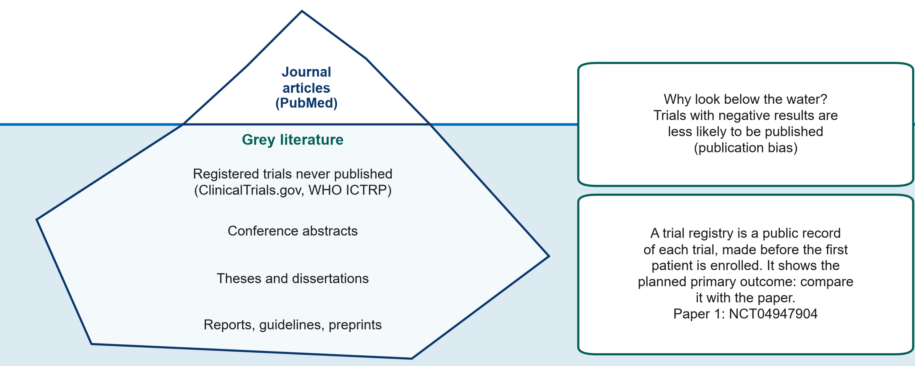
Grey literature, including trial registries
KEY MESSAGE Look below the waterline: searching grey literature, including trial registries, reduces publication bias.
Neudata | #ClearDataClearImpact
Notes:
Journal articles in PubMed are only the tip of the iceberg. Below the waterline is the grey literature: everything not published in a journal. In this course it includes trial registries (as in the course glossary), together with conference abstracts, theses, reports, guidelines and preprints.
Why it matters: studies with negative or disappointing results are less likely to be published (publication bias), so the published literature can look more positive than the truth. Searching below the waterline reduces this bias in what you find.
What a trial registry is: a public database where a clinical trial is recorded before the first patient is enrolled. The record gives the question, the design, the planned primary outcome, the planned sample size and the status (recruiting, completed, results posted). Medical journals that follow the ICMJE recommendations only publish trials that were registered.
The main registries: ClinicalTrials.gov (run by the US National Library of Medicine) and the WHO International Clinical Trials Registry Platform (ICTRP), which searches many national registries at once. Systematic reviews are registered in the same way, in PROSPERO.
Use: compare the planned primary outcome with the published paper. A switched outcome is a warning sign. Registries also show trials that finished but never published their results.
Paper 1 is registered as NCT04947904, registered before the first patient was enrolled. A good homework habit: open the registry record and compare its planned primary outcome with the paper.
Preprints (e.g. medRxiv) are not peer reviewed. Read them with extra care.
Ask the class (chat): 'Why check a registry before starting your own trial?' Expected: someone may already be running the same study.
Timing: 3 minutes. Segment 2.2 ends at 1:10, then the break.

Slide 25
Break
15 min
Neudata | #ClearDataClearImpact
Notes:
BREAK (1:10-1:25, 20:40-20:55).
Say: stand up, stretch and rest your eyes. Before we restart, open Paper 1 (link in the chat).
During the break: post the link to Paper 1 as a clean PDF in the chat for the reading task (Course/Papers/Paper 1 - Boulet 2024 Crit Care (RCT) - original.pdf, or the DOI link on the course website page 'The two papers').
Say clearly in the chat what time you will begin again, and restart on time.

Slide 26
2.3 Reading a paper in 15 minutes
You do not have to read every word. Read the right words in the right order.
40 minutes: anatomy of a paper, reading order, the abstract, spin, and a reading task on Paper 1
Neudata | #ClearDataClearImpact
Notes:
SEGMENT 2.3 (1:25-2:05, 20:55-21:35).
Teaching point: busy clinicians need a reading routine. In 15 minutes you can decide whether a paper is relevant, what it found and whether to trust it.
Check in the chat that everyone has opened the clean abstract of Paper 1 before the task.
Timing: 30 seconds.

Slide 27
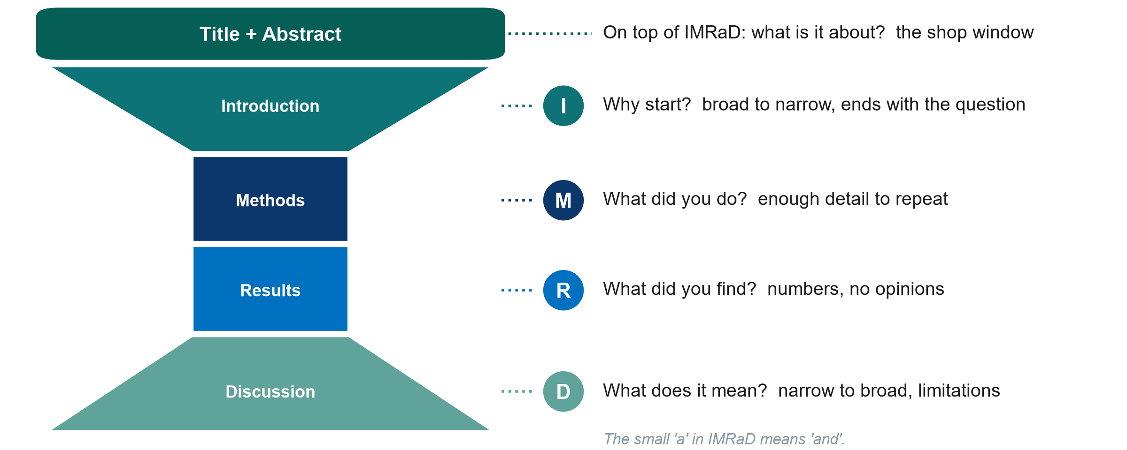
Anatomy of a paper: IMRaD
KEY MESSAGE Every original paper has the same shape: why, how, what, so what.
Neudata | #ClearDataClearImpact
Notes:
IMRaD = Introduction, Methods, Results and Discussion: the standard structure of an original research paper.
The title and the abstract sit on top of IMRaD. They are not one of its letters, which is why they come first in the picture. The small 'a' in IMRaD stands for 'and', not for 'abstract'.
The hourglass: the Introduction narrows from the broad problem to the specific question. Methods and Results are narrow and factual. The Discussion widens again to what it means for practice.
Teaching point: knowing the shape tells you where to look. The question is at the end of the Introduction, the primary outcome is in the Methods, and the main number is in the Results (and the abstract).
Misconception: 'the Discussion tells me what was found'. The Discussion is the authors' interpretation. The Results are the evidence.
Ask the class (chat): 'Where do you find who was included?' Expected: Methods (eligibility) and Results (flow chart, Table 1).
Timing: 4 minutes. Sessions 7 and 8 teach how to write each section.

Slide 28
The 15-minute reading order
Stop after step 1 or 2 if it does not answer your question. Total: about 15 minutes.
1 Title
2 Abstract
3 Figures and tables
4 Methods
5 Discussion
30 s
Relevant to my question?
3 min
PICO, design, main result
4 min
Flow chart, Table 1, main result table
5 min
Who, how chosen, primary outcome, bias protection
2-3 min
Limitations. Do conclusions match the data?
KEY MESSAGE Title, abstract, figures and tables, methods. Stop early if it is not relevant.
Neudata | #ClearDataClearImpact
Notes:
Do not read front to back. Step 1, title (30 seconds): is it about my question? Step 2, abstract (3 minutes): PICO, design, main result. Most papers are rejected here.
Step 3, figures and tables (4 minutes): the flow chart (who was lost), Table 1 (were groups similar), the main results table.
Step 4, methods (5 minutes): who, how chosen, the primary outcome, how bias was reduced. Step 5, discussion (2-3 minutes): limitations, and do the conclusions match the data?
Teaching point: you read the Introduction and full Discussion only for papers you will cite or appraise in depth.
Misconception: 'reading only the abstract is enough'. Abstracts omit limitations and can contain spin (next slides).
Timing: 3 minutes.

Slide 29
What an abstract must contain
Section | What it must contain
Background | The problem and the aim (1-2 sentences)
Methods | Design, setting, participants, intervention/exposure, comparison, primary outcome
Results | Numbers screened and analysed, primary result as effect size + 95% CI (+ p), key harms
Conclusions | Answer to the primary question, no more
Registration | Trial registry number (for trials)
Usually 250-300 words
KEY MESSAGE A good abstract lets you write the PICO and the main result without opening the paper.
Neudata | #ClearDataClearImpact
Notes:
Most clinical journals require a structured abstract: Background, Methods, Results, Conclusions (plus the trial registration number for trials).
Methods must name the design, setting, participants, intervention or exposure, comparison and the primary outcome.
Results must give the numbers screened and analysed and the primary result as an effect size with its 95% confidence interval, not only a p-value or 'significant'.
Conclusions answer the primary question, no more and no less. Reporting guidelines have abstract checklists (CONSORT for Abstracts, STROBE), covered in Session 8.
Ask the class (chat): 'An abstract says only: mortality was significantly lower (p < 0.05). What is missing?' Expected: the actual rates, the effect size and the confidence interval.
Timing: 3 minutes.

Slide 30
A results sentence: poor vs good
Illustrative numbers. Ask of every abstract: how big, how sure, by when?
Poor results sentence
Good results sentence
"Mortality was significantly lower in the intervention group (p < 0.05)."
No numbers per group
No effect size
No 95% CI
No time point
"28-day mortality was 30% with restriction vs 38% with usual care (risk difference -8 percentage points, 95% CI -15 to -1)."
Numbers per group
Effect size
95% CI
Time point
KEY MESSAGE Every main result needs: numbers per group, an effect size, a 95% CI and a time point.
Neudata | #ClearDataClearImpact
Notes:
Worked example (illustrative numbers, not from a real trial).
Left: 'significantly lower (p < 0.05)' tells us nothing about how big the difference is, how sure we are, or when it was measured.
Right: rates in each group, the size of the difference (8 percentage points), the 95% confidence interval and the time point (28 days). A reader can judge whether the difference matters clinically.
Teaching point: ask 'how big, how sure, by when?' of every result you read. Confidence intervals are explained properly in Session 6.
Ask the class (poll, left or right): 'Which sentence would you trust to change practice?' Expected: the right one, because you can see the size and the uncertainty.
Timing: 3 minutes.

Slide 31
Spin: when words go beyond the data
 | What the data say | What the words say (spin) | Seen in
p-value | p = 0.42 | "a non-significant trend" | Paper 1, Discussion
Outcomes | Primary outcome: no difference | Headline = a positive secondary outcome
Design | Observational association | "Impact of...", "reduces" | Paper 2, title
Comparison | No between-group test | "Patients improved" (before vs after only)
KEY MESSAGE Read the numbers first, then check whether the words match them.
Neudata | #ClearDataClearImpact
Notes:
Spin = reporting that makes results look more favourable than the data justify. It is common in abstracts of trials with non-significant primary outcomes.
Row 1: Paper 1's Discussion calls p = 0.42 for the primary outcome a 'non-significant trend'. A p of 0.42 is no evidence of a difference. The correct phrase is 'no significant difference, and the confidence interval was wide'. To its credit, the conclusion of Paper 1's abstract has no spin.
Row 2: highlighting a positive secondary outcome when the primary outcome showed nothing.
Row 3: causal words for observational data. Paper 2's title says 'Impact of...' although a cohort can only show association (its abstract conclusion correctly says 'associated').
Row 4: claiming improvement from before-after change within one group, with no comparison between groups.
Misconception: 'peer review removes spin'. It reduces it, but spin is frequent in published papers.
Timing: 4 minutes.

Slide 32
Check your understanding: spot the spin
QUICK QUIZ | 3 min
A cohort study: 'A positive fluid balance increases deaths in sepsis'
Primary outcome p = 0.31: 'a promising trend towards benefit'
The primary outcome shows no difference, but the abstract headline says 'improved patient satisfaction'
'Mortality fell from 30% to 22% after our new fluid protocol' (no control group)
OUTPUT For each, we call on 2-3 people, microphone on: what is the spin, and how would you rewrite it?
Neudata | #ClearDataClearImpact
Notes:
Take one item at a time. Give the class 30 seconds to think, then call on one or two participants by name to unmute and say where the spin is and how they would rewrite it. Ask the class whether anyone disagrees before you give the answer.
Answers: 1 Causal word for an observational design: write 'was associated with higher mortality'. 2 p = 0.31 is no evidence of a difference: write 'no significant difference, and the CI was wide'. 3 The headline is a secondary outcome: lead with the primary result. 4 Before-after change without a comparison, and other things may have changed: write 'mortality was lower after implementation, but without a control group we cannot attribute this to the protocol'.
Timing: 3 minutes.

Slide 33
Your turn: read Paper 1's abstract
INDIVIDUAL TASK | 12 min
Open Paper 1 (Boulet 2024, Crit Care): the abstract is on page 1
Fill the reading grid (Exercise 3): design, P, I vs C
Primary outcome, numbers screened and analysed
Main result with its 95% CI and p-value
Does the conclusion match the result? Any spin?
Type your primary outcome and main result in the chat
Clock
8 minutes reading alone
4 minutes checking in the chat
OUTPUT A completed abstract reading grid
Neudata | #ClearDataClearImpact
Notes:
Individual work, quietly for 8 minutes (cameras may go off), then 4 minutes in which everyone types the primary outcome and main result in the chat and you comment on the answers. Beginners need the extra time. Do not rush it.
Where the paper is: Course/Papers/Paper 1 - Boulet 2024 Crit Care (RCT) - original.pdf (the clean original, without our notes). It is open access (CC BY-NC-ND), so the unchanged original may be shared. The course website page 'The two papers' links to it by DOI (10.1186/s13054-024-05155-z), and you post the link in the chat at the break. The annotated versions (English and Vietnamese, also in Course/Papers) are for after the task.
Watch the chat. The hardest cells: the primary outcome (many write 'mortality', but it is cumulative fluid balance at day 5) and the main result (they should copy the difference with its 95% CI, -15.2 to 41.6, which crosses zero).
Fast finishers: read Paper 2's abstract and spot the word in its title that overstates the design ('Impact').
Timing: 12 minutes. The answers are on the next slide.

Slide 34
Paper 1's abstract: the answers
Abstract item | What Paper 1 reports
Design | Pilot RCT, single-blind (patients and statisticians), 3 ICUs
P | Adults 18-85 y, septic shock, first 24 h of vasopressors
I vs C | Restrict maintenance and drug-dilution fluids (7 days) vs standard
Primary outcome | Cumulative fluid balance at day 5 (ml/kg)
Numbers | 1,201 screened, 50 randomised, 48 analysed (24 per group)
Main result | Median 6.9 vs 35.0 ml/kg. Difference 13.2 (95% CI -15.2 to 41.6), p = 0.42
Conclusion | Did not reduce fluid balance at day 5 (matches the result)
Registration | ClinicalTrials.gov NCT04947904
KEY MESSAGE Primary outcome: fluid balance, not mortality. Read what the study actually measured.
Neudata | #ClearDataClearImpact
Notes:
Go through the grid quickly. Ask for each row in the chat before you reveal it.
Key points. (1) A pilot trial with 48 analysed patients. (2) The primary outcome is cumulative fluid balance at day 5, not mortality. (3) The confidence interval for the difference (-15.2 to 41.6 ml/kg) includes zero, so there is no evidence of a difference. (4) The abstract conclusion matches the result (good practice). (5) The trial was registered.
If a sharp participant asks: the medians (6.9 vs 35.0 ml/kg) differ by more than the reported difference of 13.2 because the 13.2 is a difference in means (the Methods report the mean difference with its 95% CI), not a difference in medians. The course annotations flag this mismatch. Park it for Sessions 6-8.
Link to our question: this trial does not answer the 28-day mortality question. It answers a feasibility-type question about fluid balance. That is exactly the 'feasible rewrite' from the FINER slide.
Timing: 5 minutes, row by row. Segment 2.3 ends at 2:05.

Slide 35
2.4 From literature to introduction
The papers you read become the first page of your proposal.
15 minutes: the literature matrix, the problem-statement funnel, a model problem statement, working title and keywords
Neudata | #ClearDataClearImpact
Notes:
SEGMENT 2.4 (2:05-2:20, 21:35-21:50).
Teaching point: reading is not the end. A literature matrix turns papers into a gap, the gap into a problem statement, and the PICO into a working title.
Timing: 30 seconds.

Slide 36
The literature review worksheet
Study | Design, size | Compared | Primary outcome: result | Key limitation
Boulet 2024 Crit Care | Pilot RCT, 3 ICUs, n = 48 | Restrict hidden fluids vs standard | Fluid balance at day 5: no significant difference | Small, not powered for mortality
Hyun 2023 Ann Intensive Care | Matched cohort, registry, 20 hospitals | Positive vs negative fluid balance | 28-day death higher if positive by day 2-3 | Observational: confounding possible
Meyhoff 2022 N Engl J Med | Large RCT (CLASSIC), n = 1,554 | Restrictive vs standard IV fluid | 90-day death 42.3% vs 42.1%: no difference | Clinicians not blinded
Your paper 4 | ... | ... | ... | ...
KEY MESSAGE One row per paper: 5 rows today, the same columns for every paper.
Neudata | #ClearDataClearImpact
Notes:
The worksheet is in Course/Templates (literature review worksheet). One row per paper, the same columns each time.
Rows 1-3 show the course papers: Paper 1 (Boulet 2024, pilot RCT: fluid balance, no significant difference), Paper 2 (Hyun 2023, matched cohort: positive balance on days 2-3 associated with higher 28-day mortality), and CLASSIC (Meyhoff 2022: no difference in 90-day mortality).
Notice: the three papers measure different outcomes at different times. A matrix makes that visible at once.
Teaching point: the 'key limitation' column is where the gap, and your study's justification, comes from.
Timing: 3 minutes.

Slide 37
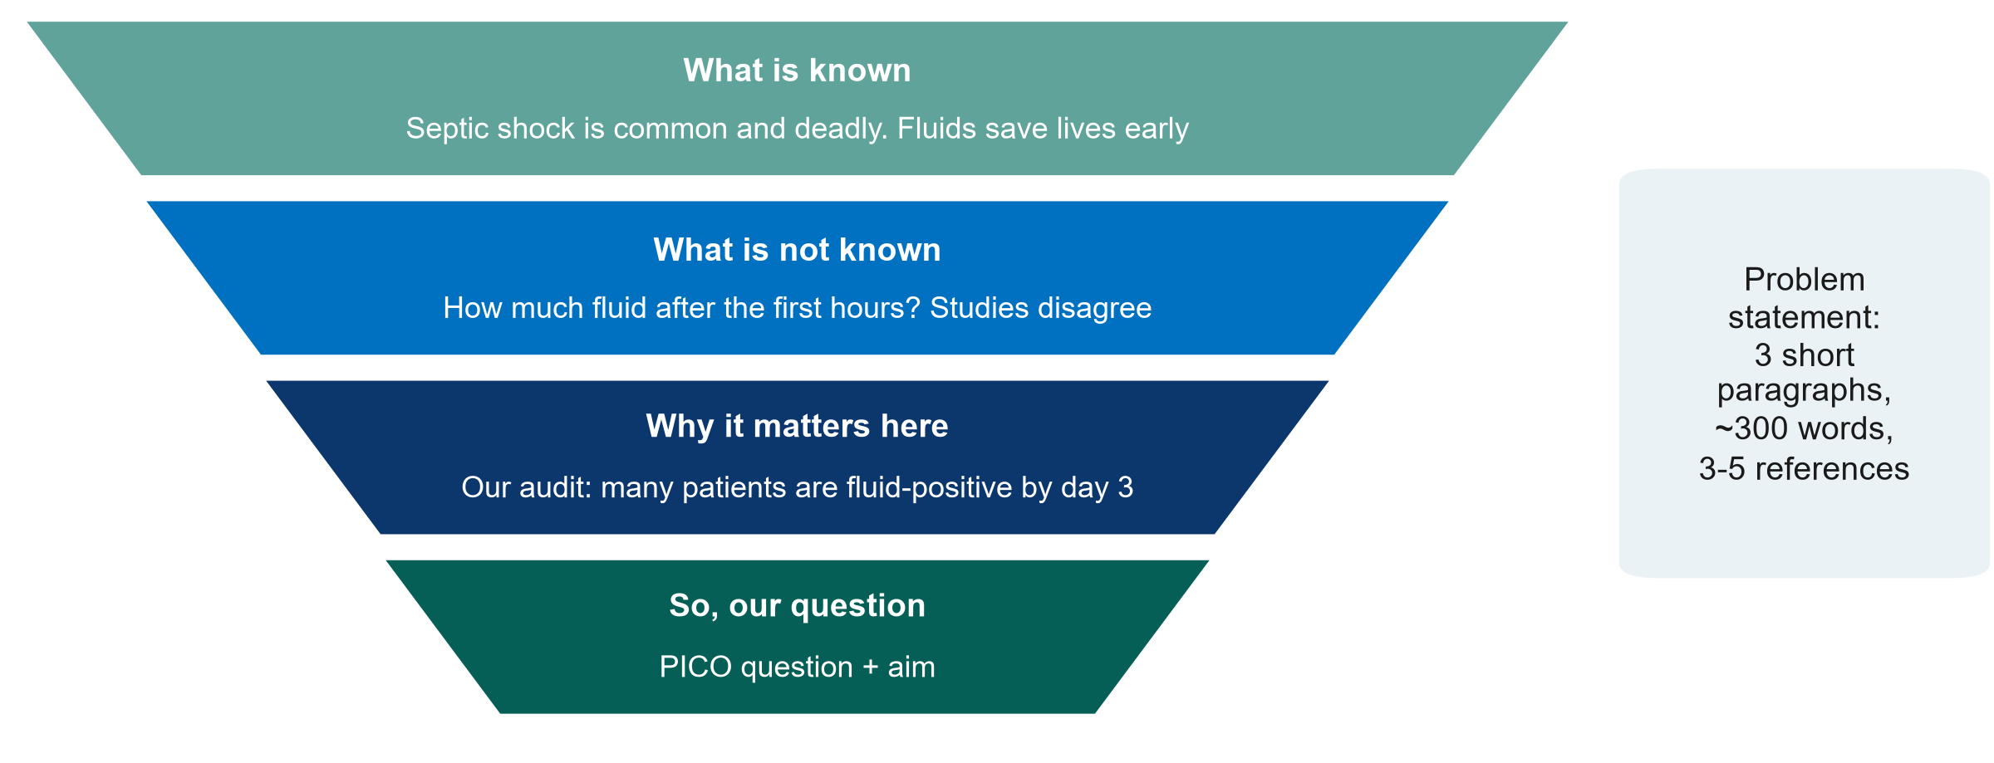
From literature to your Introduction
KEY MESSAGE Known, not known, why here: the question then follows naturally.
Neudata | #ClearDataClearImpact
Notes:
The papers you read become the Introduction of your proposal. It is the same funnel as the top of the IMRaD hourglass.
Paragraph 1, what is known: the size of the problem and current practice, with references.
Paragraph 2, what is not known: the gap (conflicting studies, no studies in patients like ours, outcomes not measured). Your literature matrix's 'limitation' column feeds this paragraph.
Paragraph 3, why it matters here: local data (an audit, an incident review, a number from your unit). Then state the question and aim.
Misconception: 'the background must review everything ever written'. Paper 1's introduction does the whole funnel in under 500 words.
Timing: 3 minutes.

Slide 38
A model problem statement
Paragraph | Model text
1 What is known | Septic shock is a leading cause of ICU death. Early fluids restore perfusion, but continued fluids often produce a positive fluid balance, which cohort studies associate with higher mortality [2].
2 What is not known | Large trials of restrictive fluids found no mortality difference [3, 4], and a pilot targeting hidden fluids did not significantly reduce fluid balance [1]. Whether restriction is achievable in our setting is unknown.
3 Why it matters here | Our 3-month audit found that most septic shock patients were fluid-positive by day 3, and practice varies between consultants. We therefore ask: [PICO question].
Model text: replace the audit numbers with your own
KEY MESSAGE Three short paragraphs, each with its own job, and references in brackets.
Neudata | #ClearDataClearImpact
Notes:
This is what the funnel looks like as real text, for the feasible rewrite of the running example.
Paragraph 1 (known) cites Paper 2. Paragraph 2 (not known) cites CLASSIC, CLOVERS and Paper 1 and ends with the gap. Paragraph 3 (why here) uses local data (replace the audit statement with your own numbers) and ends with the question.
Teaching point: every factual sentence carries a citation number, and the last sentence leads straight into the PICO question.
Misconception: 'the problem statement should be long and impressive'. About 300 words is enough for a proposal.
Model text in English. You may write your proposal in Vietnamese, but search and cite in English.
Timing: 4 minutes.

Slide 39
Working title and keywords from PICO
From the PICO
Working title (13 words)
Keywords (3-6)
P: adults with septic shock
I: restrictive fluids
C: usual fluids
O: fluid balance
D (design): pilot RCT
"Restrictive versus usual fluids in adults with septic shock: a pilot randomised trial"
10-16 words, with population, comparison and design visible
No abbreviations, and no 'impact' or 'effect' for observational data
MeSH terms that are not already in the title
Fluid Therapy
Water-Electrolyte Balance
Critical Care
Vasoconstrictor Agents
KEY MESSAGE Your PICO already contains your title: add the design and keep it short.
Neudata | #ClearDataClearImpact
Notes:
A good title names the population, the intervention and comparison (or exposure), and the design, in about 10 to 16 words.
Example from the feasible rewrite: 'Restrictive versus usual fluids in adults with septic shock: a pilot randomised trial' (13 words).
Avoid abbreviations and promotional or causal words ('impact', 'novel', 'effect of'), especially for observational designs (compare Paper 2's title).
Keywords: 3 to 6, ideally MeSH terms not already in the title, so the paper is found by more searches (the Paper 1 annotations make the same point).
Ask the class (chat): 'Is Fluids in the ICU a good title?' Expected: no. It has no population, no comparison and no design.
Timing: 4 minutes. Segment 2.4 ends at 2:20.

Slide 40
Proposal builder 2
Now find the evidence for your own question: one search, five papers, one problem statement, one title.
35 minutes: we search live for the running example, then you search for your own question
Neudata | #ClearDataClearImpact
Notes:
PROPOSAL BUILDER 2 (2:20-2:55, 21:50-22:25). The 35 minutes start with this slide.
Teaching point: everything taught today is applied to each participant's own question from last Saturday. Everyone works on their own proposal. Nobody works in a group.
By the end, each participant has a documented search, some of the 5 references in Zotero and the worksheet, and a first draft of the problem statement and working title. The rest is homework.
Move straight to the next slide.

Slide 41
Proposal builder 2: the evidence for your own question
PROPOSAL BUILDER | 35 min
Watch us screen the running-example search live, and suggest papers and terms in the chat
Run your own search string in PubMed. Note the date and the number of hits
Screen titles and abstracts, pick 5 key papers and save them to Zotero
Fill one row per paper in the literature review worksheet
Draft your problem statement (known, not known, why here) and a working title
Two volunteers read their title and gap sentence aloud
Timing
0-10 min: we model it live
10-30 min: you search and draft your own
30-35 min: two volunteers share
OUTPUT Your Proposal Part 1 continued: search, 5 references, problem statement, title
Neudata | #ClearDataClearImpact
Notes:
Minutes 0-10, whole class: re-run the running-example string from the demo, screen the first titles together (participants say 'keep' or 'drop' in the chat and suggest extra terms), save two papers to Zotero, fill one worksheet row and point to the model problem statement and title.
Minutes 10-30, everyone works alone on their own question. Cameras may go off. The trainers answer questions in the chat. Common problems: too many hits (add a block or a filter), too few (add synonyms), a comparison block, AND inside a block.
Anyone who cannot finish the 5 references records the string, database and date. The remaining references become homework.
Minutes 30-35: two volunteers read their title and gap sentence aloud, microphone on, and the class suggests one improvement each in the chat.
What good looks like: Course/Solutions/s2_solutions.md (Exercise 4).
Timing: 35 minutes. Wrap-up starts at 2:55 (22:25).

Slide 42
Key words of the day
Key word | In one line
MeSH | The shared label PubMed gives to many ways of writing one idea
AND / OR / NOT | Narrows / widens / removes. OR inside a block, AND between blocks
Reference manager | Stores each paper once and formats citations in any style
Patchwriting | Copying with a few words swapped: plagiarism even if cited
IMRaD | Introduction, Methods, Results and Discussion
Spin | Words that claim more than the numbers show
Neudata | #ClearDataClearImpact
Notes:
WRAP-UP (2:55-3:00, 22:25-22:30).
Read the six key words quickly. They are also in the course glossary (EN-VN).
Timing: 1 minute.

Slide 43
Session 2 recap
Search
Cite honestly
Read smart
PICO blocks, MeSH and free text
OR inside, AND between
Write the search down
Zotero from day one
Your own words
Read what you cite
Title, abstract, figures, methods
Numbers before words
KEY MESSAGE Weeks 1-2 are done: you have a question, five papers and a title.
Neudata | #ClearDataClearImpact
Notes:
Read the three messages, then ask one participant: 'What is the first thing you look for in an abstract?' Expected: the primary outcome and its result with a CI.
Link forward: over the next two Saturdays (Sessions 3 and 4) we choose the right design to answer each question, and meet bias, confounding and measures of effect using the two fluid papers.
Timing: 1.5 minutes.

Slide 44
Exit question (in the chat)
QUICK QUIZ | 2 min
Answer now in the chat, or in the 1-question form linked there
Q1: which gives more hits: septic shock AND fluids, or septic shock OR fluids?
Q2: what was the primary outcome of Paper 1?
Why we ask
It is not homework and not marked
It shows us what is still unclear
We read every answer before Session 3
OUTPUT One short answer per person, before you leave
Neudata | #ClearDataClearImpact
Notes:
Purpose: a 2-minute check of understanding. It is not homework.
Answers: Q1 OR (either term). Q2 Cumulative fluid balance at day 5 (ml/kg), not mortality.
Save the chat (or the form responses) and read them after the session. If more than a quarter get either wrong, open Session 3 with it and revisit it in the recap quiz.
Timing: 1.5 minutes.

Slide 45
Homework before Session 3 (next Saturday)
INDIVIDUAL TASK
Finish your 5 key references, worksheet rows and problem statement
Read one of your papers with the 15-minute routine
Read the abstract of Paper 2 (Hyun 2023) with the reading grid (Exercise 3)
Exercise 2 (paraphrasing), at home
Optional: look up Paper 1 (NCT04947904) on ClinicalTrials.gov
Ready for next Saturday
Your Proposal Part 1
Your literature review worksheet
OUTPUT Proposal Part 1 complete before Session 3
Neudata | #ClearDataClearImpact
Notes:
Be specific: about 60-90 minutes over the week, on your own.
The two papers are in Course/Papers (annotated versions in English and Vietnamese). Session 3 uses both abstracts to compare an RCT with a cohort.
Remind participants to email their Part 1 to the trainers if you offer written feedback between sessions.
Close on time. Thank the class.
Timing: 1 minute.

Slide 46
Extra slides: Session 2
Use if time allows, or for self-study
Neudata | #ClearDataClearImpact
Notes:
EXTRA SLIDES (Session 2).
Everything after this slide is optional. Use it if the class is fast or asks, or point participants to it for self-study.
The core session is complete without these slides.

Slide 47
Beyond PubMed: other places to search
Database | What it covers | Access
Cochrane Library | Cochrane systematic reviews (CDSR) and a register of controlled trials (CENTRAL) | Search and abstracts free
Embase | Large biomedical database, strong on drugs and conference abstracts | Subscription
Web of Science, Scopus | Many disciplines, with links to the papers that cite each paper | Subscription
CINAHL | Nursing and allied health | Subscription
Epistemonikos | Systematic reviews in health, in many languages | Free
Registries | Trials: ClinicalTrials.gov, WHO ICTRP. Reviews: PROSPERO | Free
Neudata | #ClearDataClearImpact
Notes:
EXTRA: other databases.
Key message: for a Level 1 proposal, PubMed and a registry are enough. A systematic review searches several databases.
Before any new study, look for an existing systematic review first (core slide 'First check'). The Cochrane Library is the place to start for treatment questions: the Cochrane Database of Systematic Reviews (CDSR) holds Cochrane's own reviews, and CENTRAL is its register of controlled trials.
Embase overlaps with MEDLINE but adds many drug and European journals and conference abstracts. Web of Science and Scopus cover many disciplines and are strong for following citations. CINAHL is the main nursing database. APA PsycInfo covers mental health and behaviour.
Epistemonikos (free) collects systematic reviews from many sources. WHO Global Index Medicus brings together regional databases, including the Western Pacific Region Index Medicus, which can matter for local-language journals.
Embase, Web of Science, Scopus and CINAHL usually need an institutional subscription. Ask your library.
A systematic review searches at least two or three of these, plus registries and grey literature. Level 3 has a dedicated module on systematic review and meta-analysis (Module A): protocol and PROSPERO registration, a multi-database search, risk of bias, pooling and PRISMA 2020 reporting.
Timing: 2 minutes if used.

Slide 48
PubMed Clinical Queries: a ready-made filter
Open
Type
Choose
Scope
PubMed home page
Clinical Queries, under Find
Your topic words
e.g. septic shock fluid restriction
Category: therapy, diagnosis, etiology or prognosis
Broad: finds more
Narrow: more precise
KEY MESSAGE A quick shortcut for 'is there good evidence?', not a replacement for your own search.
Neudata | #ClearDataClearImpact
Notes:
EXTRA: PubMed Clinical Queries.
Clinical Queries applies validated search filters for study types that answer clinical questions.
Good for a quick look before a ward round or to check your own search did not miss an obvious trial.
The interface changes from time to time. Check it before showing it live.
Timing: 2 minutes if used.

Slide 49
Optional demo: Google Scholar and 'Cited by'
LIVE DEMO | 3 min
Search: restrictive fluid septic shock mortality
Look: journals, theses, preprints, ranked by a hidden algorithm
Under a key trial, click 'Cited by', then search within citing articles
Click the quote icon to see export formats
OUTPUT Participants see what Scholar adds and what it lacks
Neudata | #ClearDataClearImpact
Notes:
EXTRA: Google Scholar demo.
Course/Demos/s2_demo.md, Part C.
Say: 'Scholar is excellent for following citations forward and for grey literature, but there is no MeSH, few filters, and the same search may give different results next month.'
If Scholar shows a CAPTCHA, do not try to solve it while sharing your screen. Skip to the screenshots.
Timing: 3 minutes if used.

Slide 50
Text recycling, AI tools and similarity checks
Text recycling
AI rewording
AI references
Similarity checks
Reusing your own published wording
Check the journal policy
Does not remove plagiarism
You stay responsible
May be invented
Find every one in PubMed
Journals screen submissions for copied text
KEY MESSAGE Write from understanding, cite what you use, and check every reference yourself.
Neudata | #ClearDataClearImpact
Notes:
EXTRA: text recycling, AI and similarity checks.
Text recycling ('self-plagiarism'): some reuse of standard Methods wording may be accepted if cited and allowed by the journal. Never reuse Results or Discussion text.
AI tools: journals require disclosure of AI use (Session 7 covers integrity and AI in detail).
Timing: 2 minutes if used.

Slide 51
Copyright © Neudata, 2026
All property rights and copyright are reserved.
This presentation contains proprietary data, information, and materials developed by Neudata for dedicated use only and may not be communicated, copied, reproduced, distributed, published, or cited, in whole or in part, without the prior written consent of Neudata.
Where explicit written permission has been granted, appropriate attribution must be included, followed by “by courtesy of Neudata”.
Any unauthorized use or infringement of these materials may give rise to legal action and claims for damages, without prejudice to any other rights of Neudata, including rights relating to patents, trademarks, or other forms of intellectual property protection.
Neudata | #ClearDataClearImpact
Notes:
Copyright slide. Leave it on screen while participants leave the meeting.

