Slide 1

Foundations of Clinical Research
Level 1: From Clinical Question to Publication
8 Saturday evenings online, 19:30 to 22:30, 24 contact hours
Trainers: Vương Mỹ Lượng & Bernard Osang'ir
Date: 31/10/2026
Notes:
Title slide (0:00, 19:30).
Welcome everyone. Introduce the trainers in one sentence each.
Key message: over eight Saturday evenings, one session a week, we walk the whole road of research together: from a question at the bedside to a paper ready to submit.
No statistics software, no formulas to memorise: pictures, examples from your own departments, and short tasks we do together as one class. We go slowly. Nobody is expected to know anything yet.
Online set-up: ask everyone to check sound, rename themselves with their full name, and find the chat, the poll and the 'raise hand' button. We use all three today.
Timing: 1 minute.

Slide 2
Every day you make decisions that research could improve.
This course helps you ask those questions properly, answer them and publish the answer.
Neudata | #ClearDataClearImpact
Notes:
Open with a question to the class: 'Think of one thing in your department where colleagues do it differently and nobody knows which way is best. Type it in the chat.'
Read 2-3 answers aloud. Expected: fluids, sedation, mobilisation, wound dressings, line care.
Key teaching point: research starts from clinical uncertainty, not from statistics.
Copy the chat answers into the shared course document. They are candidate topics for your own proposals.
Timing: 2 minutes.

Slide 3
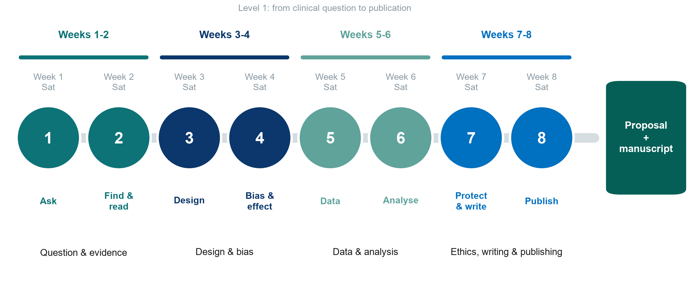
Eight Saturdays, eight sessions
Neudata | #ClearDataClearImpact
Notes:
Walk along the road: Weeks 1-2 the question and the evidence. Weeks 3-4 design and bias. Weeks 5-6 data and analysis. Weeks 7-8 ethics, writing and publishing. One online session every Saturday (19:30 to 22:30), with a full week between sessions for the homework.
This whole course is Level 1: it covers every step from question to publication. Weeks 1-4 build understanding and design skills. Weeks 5-8 apply them to data, writing and publishing.
One running example travels with us: fluids in septic shock and 28-day mortality. From Session 5 it continues in the course study, FLUID-ICU.
Timing: 2 minutes.

Slide 4
This course is Level 1 of three
Level 1 (this course)
Level 2 (hands-on)
Level 3 (advanced)
From question to publication
Ask, design, analyse, write and publish
8 sessions, whole department
Statistical modelling in R
Linear, logistic, count, Cox
Table 1, missing-data basics
Your own analysis project
Research craft and advanced methods
Reproducibility, Git, Quarto
Journal figures, sensitivity analyses, meta-analysis
More on request
KEY MESSAGE Level 1 is this course, Level 2 is statistical modelling in R, Level 3 is advanced methods.
Neudata | #ClearDataClearImpact
Notes:
This course (Level 1) takes you from a clinical question to a published paper. Level 2 is a hands-on statistics course in R for those who want to run analyses themselves. Level 3 covers advanced, specialised methods.
Within Level 1 we use a realistic dataset of 620 ICU patients (FLUID-ICU): we describe it, analyse it and write it up. The trainers run the software. You read and interpret the results.
Misconception to defuse: 'research is only for statisticians or professors'. Most good clinical questions come from nurses and doctors at the bedside.
Timing: 1 minute.

Slide 5
Two things you will produce, each on your own
Both are individual work. We guide every step in class.
Your research proposal
A draft manuscript
On a question from your own department
Built one part at a time, Sessions 1 to 7
Submitted by everyone in Session 8
A few volunteers also present it
Based on the course study, FLUID-ICU
You choose one of its five questions (Q1 to Q5)
We give you the results. You write the paper
After Session 8 you review one colleague's draft
KEY MESSAGE
Neudata | #ClearDataClearImpact
Notes:
Product 1: your own research proposal on a question from your own department, built one part every two weeks and submitted in Session 8. About five volunteers present theirs in Session 8 (6 minutes each). The written proposal is what is scored for everyone.
Product 2: your own draft manuscript. FLUID-ICU is a course study of 620 ICU patients with sepsis. It has five research questions (Q1 to Q5). Each of you chooses one question and receives its results pack (tables and figures). Yes: we give you the results and you write the paper. You do not analyse data yourself.
We read the results together in Weeks 5-6 and write in Weeks 7-8. After Session 8 each participant reviews one colleague's draft (the trainers assign it) and replies to the review of their own draft, like real authors.
Point to the briefs in the course folder: Course/Assignment/proposal_brief and Course/Assignment/manuscript_brief.
Timing: 3 minutes.

Slide 6
By the end of the course you will be able to
Ask & find
Design
Analyse
Write & publish
Turn a problem into a PICO question
Search PubMed and manage references
Read a paper in 15 minutes
Pick the right study design
Recognise bias and confounding
Read RR, OR, NNT and forest plots
Plan good data and a CRF
Read CIs, p-values and regression
Interpret a real dataset's results
Plan ethics and registration
Write each section of a paper
Submit and answer reviewers
KEY MESSAGE Understand and interpret: you will not be asked to calculate.
Neudata | #ClearDataClearImpact
Notes:
Walk across the four cards, one per two-week block.
Key teaching point: the aim is understanding and interpretation, not computation. The trainers run the analyses. You learn to read them and write them up.
Ask the class: 'Which card worries you most? Answer in the chat.' Expected: analyse. Reassure: we go slowly, with pictures, and check understanding every 20 minutes.
Return to this slide in Session 8 to show progress.
Timing: 2 minutes.

Slide 7
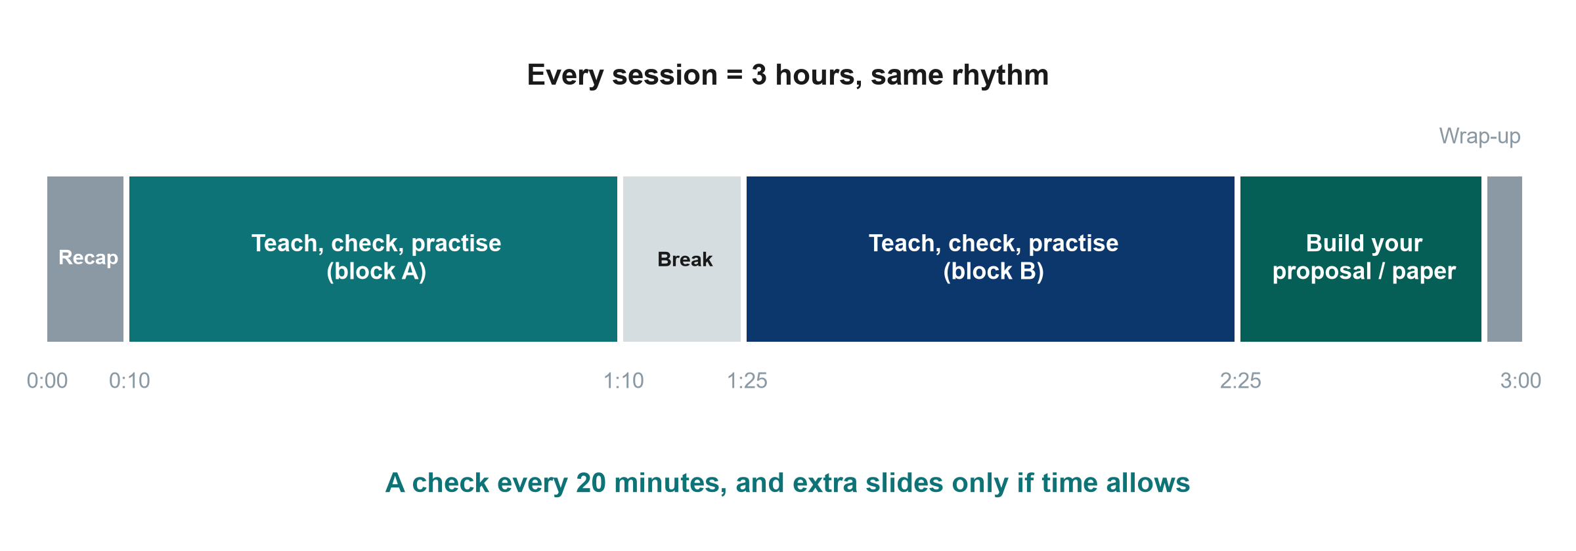
How each session runs
Neudata | #ClearDataClearImpact
Notes:
Same rhythm every Saturday, 19:30 to 22:30: recap, two teaching blocks with checks and short tasks, a 15-minute break, and time to build your proposal or your paper.
Every 20 minutes we stop for a quick check of understanding, usually a poll. If the class is not with us, we slow down. Each session ends with 'extra slides' that we only use if there is time. You can read them at home.
Keep the break to 15 minutes and start again on time.
Timing: 1 minute.

Slide 8
Build your proposal one part at a time
Part 1
Part 2
Part 3
Part 4
Submit
Sessions 1-2
Question, background, aims
Sessions 3-4
Design and participants
Sessions 5-6
Data collection, sample size, analysis plan
Session 7
Ethics, feasibility, publication plan
Session 8
Complete proposal submitted
KEY MESSAGE Your own question, one template, one part every two weeks, submitted in Session 8.
Neudata | #ClearDataClearImpact
Notes:
Part 1 (Weeks 1-2): the question and the background. Part 2 (Weeks 3-4): the design. Part 3 (Weeks 5-6): the data and the analysis plan. Part 4 (Session 7): ethics, feasibility and a publication plan.
In each proposal-builder slot the trainer first fills in the part for the running example on a shared screen. then you draft the same part for your own question.
Everyone submits the complete proposal in Session 8. About five volunteers present theirs (6 minutes each).
Template: Course/Templates/Research_Proposal_Template.docx (sent by email before Session 1).
Timing: 1 minute.

Slide 9
Welcome: introduce yourself
WHOLE-CLASS TASK | 6 min
Type your name, department and profession in the chat
Add one question you wish research could answer in your department
Read the other messages: many are possible research topics
A few of you then say your question with the microphone on. We keep the full list for your proposals
Example message
Lan, ICU, nurse
'Do patients with septic shock need less fluid than we give?'
OUTPUT One introduction per person in the chat, and a few spoken questions
Neudata | #ClearDataClearImpact
Notes:
The class is about 30 doctors and nurses joining from home. We work as one class for every task, so there are no groups and no roles.
Give 3 minutes for typing. Then call on 4-5 people to say their question with the microphone on and point out shared themes (fluids, sedation, infection, mobilisation, medication safety).
Save the chat after the session and paste the questions into the shared course document. They are the starting list for each person's own proposal in Proposal builder 1.
Timing: 6 minutes.

Slide 10
How we learn together online
Ask anything
Go slow
Bring your department
Online habits
There are no silly questions
Use the chat or 'raise hand'
We check understanding often
Extra slides only if time allows
Use examples from your own practice
No patient names or details
Camera on when you can
Microphone off unless speaking
When called on, answer with the microphone on
Back on time after the break
Neudata | #ClearDataClearImpact
Notes:
Set the climate: this is a safe place to say 'I do not understand'. A private chat message to the trainer is fine.
Language: questions and chat can be in Vietnamese or English, whatever helps you think.
Patient confidentiality applies to every example: no names or identifiable details.
Timing: 1 minute.

Slide 11
Pre-course quiz (online form)
QUICK QUIZ | 15 min
Open the quiz form: the link is in the chat now
24 multiple-choice questions, one answer each (about 12 minutes)
Work alone: no notes and no colleagues
Guess if you are not sure: this is not an exam
Enter your participant code, not your name
Why a quiz now?
Shows where the class starts
The same quiz again in Session 8
We measure the course, not you
OUTPUT Form submitted (participant code only)
Neudata | #ClearDataClearImpact
Notes:
The quiz is Course/Assessment/pre_post_quiz.md (24 questions, 3 per session), set up before the course as an online form. Paste the link in the chat at this slide.
Participant code: the number next to each name on the attendance list, sent by email before Session 1. The same code is used in Session 8 so the two scores can be compared.
Reassure: results are anonymous and used only to measure what the course achieved.
Close the form after 15 minutes. Do not give answers today. The same quiz is repeated in the last 15 minutes of Session 8, and the answers are shared after that second attempt.
Timing: 15 minutes. Session 1 teaching starts at 0:35 (20:05).

Slide 12
Session 1 · Ask: from clinical problem to research question
Week 1 · Saturday
1.1 Why research? Evidence, the two course papers, types of research, the road to publication
Break
1.2 From problem to question: PICO(T) and PECO, FINER, a whole-class task
1.3 Aims, objectives and hypotheses (quick exercise)
Proposal builder 1: start your own question, aim and objectives
Wrap-up: key words, recap, exit question, homework for next Saturday
Neudata | #ClearDataClearImpact
Notes:
Session 1 opening (0:35, 20:05). The front matter (welcome, course map, introductions in the chat, pre-course quiz) has just finished.
Teaching point: today has one job: everyone leaves with the start of one clear, answerable research question of their own, with an aim and objectives. Next Saturday (Session 2) we search and read the literature for it.
Pace: this audience has little or no research background, and it is evening after a working day. Go slowly, use the worked examples, and stop at every 'Check your understanding' slide. They are short on purpose.
Show the shape of the session: three short teaching blocks, a break, one whole-class task, one quick individual exercise, then 30 minutes to start your own proposal.
Ask the class: 'Who has ever taken part in a research study, as a researcher, data collector or participant? Answer yes or no in the poll.' It tells you where to pitch the session.
Timing: 1 minute. Do not read the agenda aloud. Point at it.

Slide 13
1.1 Why research?
Why do we need research when we already have experience?
35 minutes: evidence, the two course papers, the pyramid, types of research and the road to publication
Neudata | #ClearDataClearImpact
Notes:
Segment 1.1 (0:35-1:10, 20:05-20:40).
Pause on the question and call on two or three people to answer with the microphone on before you click on. Read 2-3 answers aloud.
Expected answers: experience is biased towards memorable cases. Colleagues disagree, practice changes. We need to know whether what we do actually helps.
Teaching point: experience is valuable for generating questions, but it is a weak way of answering them.
Timing: 1 minute.

Slide 14
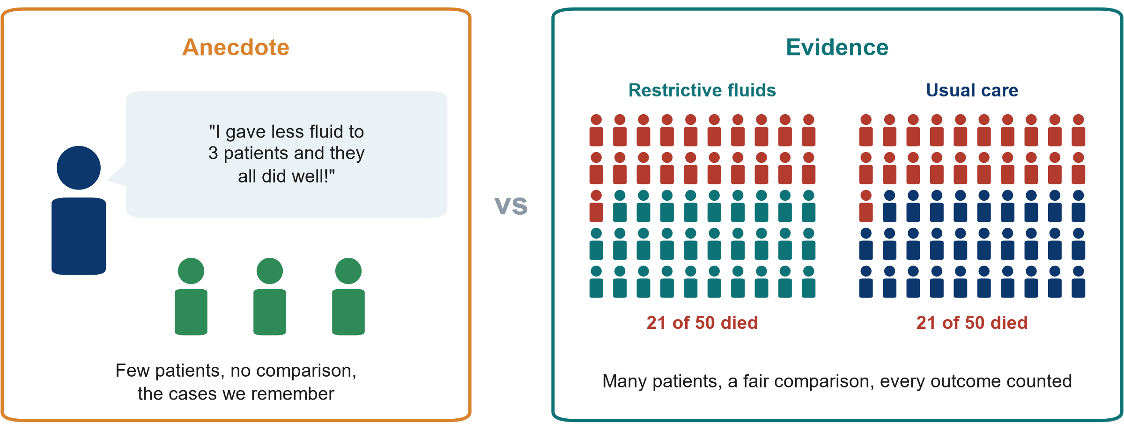
Anecdote vs evidence
KEY MESSAGE Experience suggests questions. Fair comparisons in many patients answer them.
Neudata | #ClearDataClearImpact
Notes:
Left: one clinician, three patients, a vivid memory, no comparison group.
Right: 50 patients per group, every death counted, the same outcome measured in both arms.
The numbers are illustrative, but the pattern is real: the large CLASSIC trial (Meyhoff, NEJM 2022, 1,554 septic shock patients) found 90-day mortality of 42.3% with restrictive fluids vs 42.1% with standard care. The three 'success' patients would have done well either way.
Misconception: 'if it worked in my patients it works'. Without a comparison we cannot tell what would have happened anyway (natural recovery, regression to the mean, selective memory).
Ask the class (call on two or three people, microphone on): 'Why do we remember the three good outcomes?' Expected answer: recall bias. Dramatic and recent cases stick, and we forget the failures.
Timing: 4 minutes. Go slowly: this is the idea the whole course rests on.

Slide 15
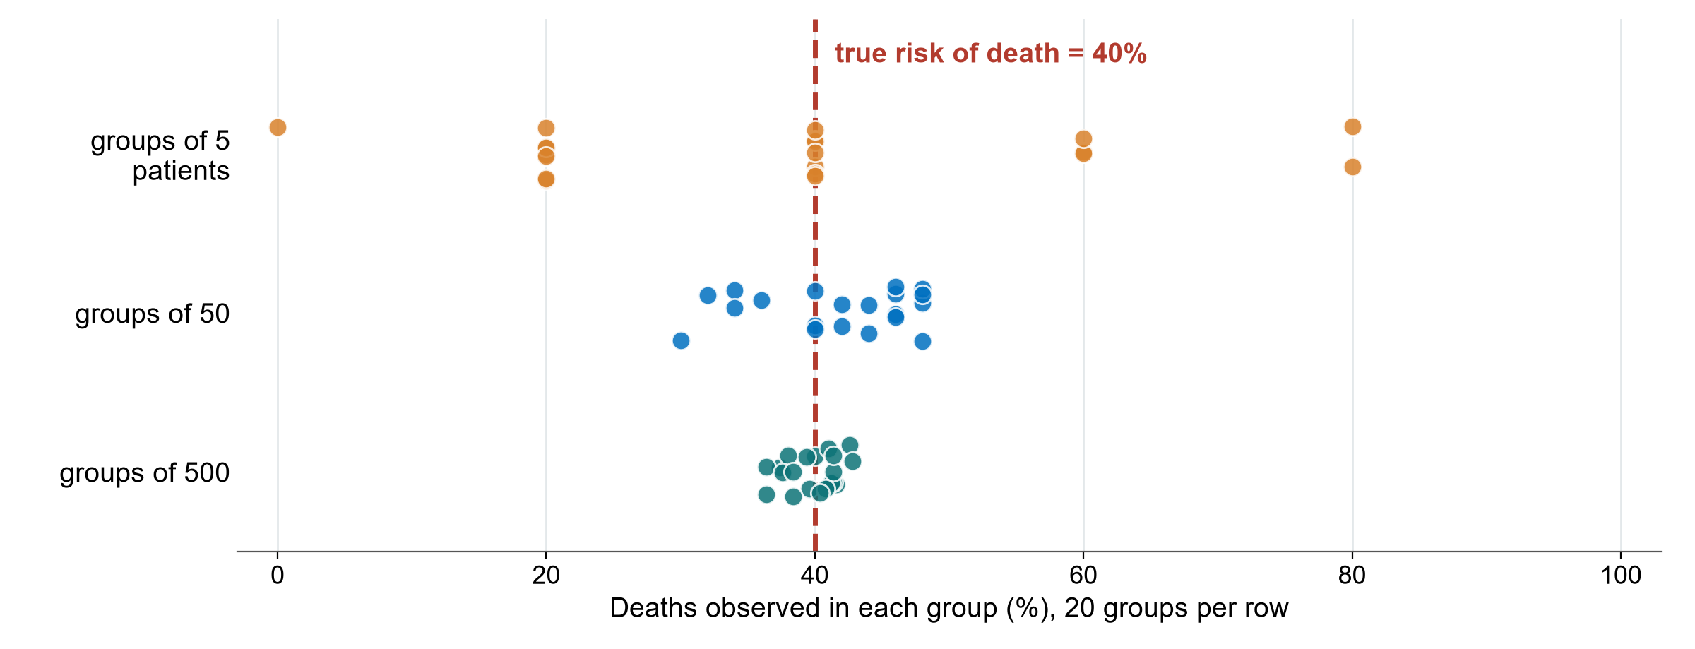
Why one ward's experience is not enough
KEY MESSAGE Small numbers jump around by chance. Large, fair comparisons settle down.
Neudata | #ClearDataClearImpact
Notes:
This picture is a simulation (fixed seed): imagine a disease where the true risk of death is 40%.
Top row: 20 wards each see only 5 patients. By pure chance some see 0% deaths, others 80%. Each ward would 'learn' something different from its own experience.
Middle row: groups of 50, closer to the truth but still scattered. Bottom row: groups of 500 cluster tightly around 40%.
Teaching point: chance alone produces impressive-looking differences in small numbers. This is why research needs enough patients and a comparison group, and why 'my last three patients' can mislead.
Misconception: 'a big difference in a small group must be real'. A big difference in a small group is exactly what chance produces.
Ask the class (poll, yes / no / cannot tell): 'One ward lost 0 of 5 patients after a new protocol. Does the protocol work?' Expected answer: cannot tell, because 0 of 5 happens often by chance even when the true risk is 40%.
Timing: 4 minutes. Sample size returns in Session 6.

Slide 16
The two papers we read together in this course
Both are in the course folder, Course/Papers: the original and an annotated copy in English and Vietnamese.
Paper 1: Boulet 2024, a trial
Paper 2: Hyun 2023, a cohort
Boulet N, et al. Crit Care 2024;28:429
Impact on fluid balance of an optimized restrictive strategy targeting non-resuscitative fluids in intensive care patients with septic shock
A small pilot randomised controlled trial (RCT) of 48 patients
Main outcome: fluid balance at day 5
Hyun DG, et al. Ann Intensive Care 2023;13:105
Impact of a cumulative positive fluid balance during the first three ICU days in patients with sepsis
A matched cohort study from the Korean sepsis registry
Main outcome: death by day 28
KEY MESSAGE Paper 1 is a trial, Paper 2 is a cohort. Both study fluids in sepsis.
Neudata | #ClearDataClearImpact
Notes:
Introduce the two course papers now, because we refer to them in every session from here on.
Paper 1 (Boulet 2024, Critical Care): a pilot RCT in three French ICUs. Adults with septic shock were randomised to a restrictive strategy for 'non-resuscitative' fluids (maintenance fluids and fluids used to dilute drugs) or usual care. Primary outcome: cumulative fluid balance at day 5.
Paper 2 (Hyun 2023, Annals of Intensive Care): a propensity score-matched cohort from the Korean Sepsis Alliance registry. Patients with a positive cumulative fluid balance on ICU days 2-3 were compared with those without. Outcome: 28-day mortality.
Where to find them: Course/Papers in the course folder, sent by email before Session 1. Each paper has the original PDF and an annotated teaching copy in English and Vietnamese.
Do not read them now. In Session 2 we read Paper 1's abstract together.
Timing: 3 minutes.

Slide 17
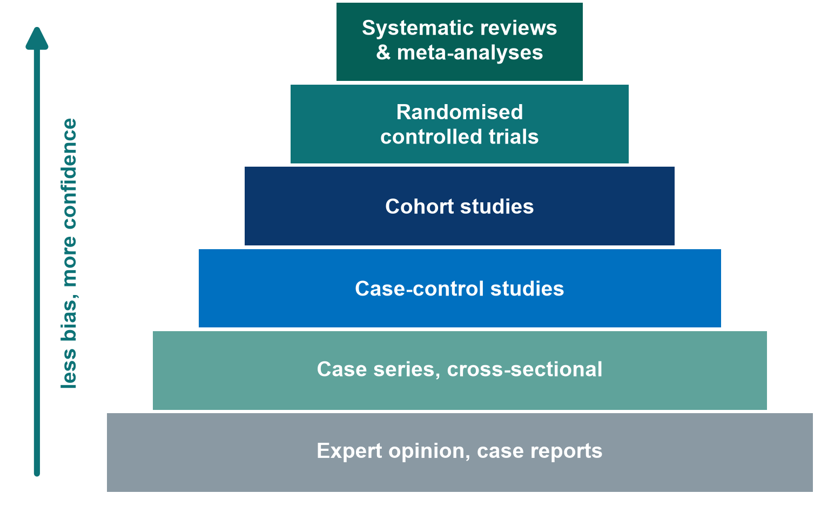
The evidence pyramid
How to read it
Higher = less risk of bias for questions about treatment effects
Paper 1 (Boulet 2024) is a trial. Paper 2 (Hyun 2023) is a cohort
A well-done cohort can beat a poorly done trial
Descriptive questions do not need a trial
KEY MESSAGE The pyramid ranks designs, not individual papers: quality still has to be checked.
Neudata | #ClearDataClearImpact
Notes:
Build from the bottom: expert opinion and case reports, then case series and cross-sectional studies, case-control, cohort, randomised trials, and at the top systematic reviews and meta-analyses that combine several studies.
Teaching point: moving up, the design does more to protect against bias. That is why higher levels give more confidence for 'does treatment X work?' questions.
Misconception 1: 'an RCT is always right'. A small or badly run trial can mislead. Frameworks such as GRADE rate the certainty of a whole body of evidence, not the design label alone.
Misconception 2: 'only RCTs count'. For prevalence, harm and prognosis, observational designs are often the right (or only ethical) choice. Qualitative research sits outside this pyramid because it answers different questions.
Ask the class (call on two or three people, microphone on): 'Where would a systematic review of 10 poor-quality trials sit?' Expected answer: at the top by label, but its conclusions are only as strong as the trials inside it.
Timing: 4 minutes. Session 3 covers each design in detail, so do not teach designs here.

Slide 18
Quick quiz: rank the evidence
QUICK QUIZ | 3 min
The question: do restrictive fluids reduce deaths in septic shock?
A: a senior colleague says, 'In 20 years, my patients kept dry did better'
B: a study that followed thousands of ICU patients with sepsis in a registry (a cohort)
C: a trial that randomly assigned 1,554 patients to restrictive or usual fluids
D: a systematic review that combines all trials of fluid restriction
Vote in the poll: which order runs from weakest to strongest?
Poll options
A, B, C, D
B, A, C, D
A, C, B, D
D, C, B, A
OUTPUT Poll results on screen, then one question: what could make C weaker than B?
Neudata | #ClearDataClearImpact
Notes:
Launch the poll with the four orders shown on the right. Give 1 minute, then share the results.
Answer: A (expert opinion), then B (cohort), then C (RCT), then D (systematic review / meta-analysis).
C is the real CLASSIC trial (NEJM 2022), which found no difference in 90-day mortality. B resembles Paper 2 (Hyun 2023): a positive fluid balance on days 2-3 was associated with higher 28-day mortality.
Ask (call on two or three people, microphone on): 'What could make C weaker than B?' Expected: very small, many patients lost, poorly concealed allocation, a population unlike ours.
If time allows: why might a cohort find harm when a trial finds none? In a cohort, sicker patients get more fluid, so fluid looks harmful (confounding by indication). This is a preview of Session 4.
Timing: 3 minutes, strictly.

Slide 19
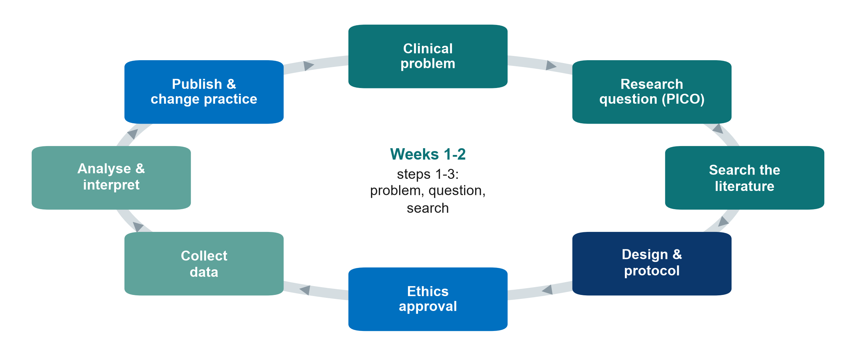
The research cycle
KEY MESSAGE Research is a cycle: published results change practice and raise new questions.
Neudata | #ClearDataClearImpact
Notes:
Walk round the cycle quickly, one sentence per box.
Weeks 1-2 = clinical problem and research question (today), literature search (next Saturday). These are the three teal boxes top right.
Teaching point: published results change practice, which creates new uncertainties and new questions.
Misconception: 'research = collecting data'. Data collection comes after the question, design, protocol and ethics approval.
Timing: 2 minutes.

Slide 20
The question decides the type of research
Type of research | What it gives | Example
Quantitative | Numbers: how many? Does X change Y? | 28-day mortality with two fluid strategies
Qualitative | Words: why? How? What is it like? | Interviews: why nurses hesitate to stop fluids
Mixed methods | Numbers + words in one study | Survey of fluid practice + focus groups
Primary research | You collect new data: trial, cohort, survey, interviews | Paper 1: a new trial
Secondary research | You reuse data that exist: records, registries, systematic reviews | Paper 2: a sepsis registry
KEY MESSAGE Numbers answer how many and how much. Words answer why and how.
Neudata | #ClearDataClearImpact
Notes:
First three rows: what kind of data. Quantitative research counts and measures (mortality, fluid balance). Qualitative research collects words (interviews, focus groups, observation) to understand experiences, reasons and barriers. Mixed methods combine both in one study.
Last two rows: where the data come from. Primary research collects new data for this study (Paper 1, a new trial). Secondary research reuses data that already exist: medical records, registries (Paper 2 used a sepsis registry) or published studies (a systematic review).
Teaching point: the question decides the type. 'Does restriction reduce deaths?' is quantitative. 'Why do nurses hesitate to stop fluids?' is qualitative.
Misconception: 'qualitative research is just opinion'. It has its own rigorous methods and reporting guideline (COREQ for interviews and focus groups). It is the right tool when numbers cannot explain behaviour.
Timing: 3 minutes. Qualitative designs return in Session 3.

Slide 21
Check your understanding: which type of research?
QUICK QUIZ | 2 min
A: counting how many patients with septic shock are fluid-positive on day 3 this year
B: interviewing ICU nurses about why they hesitate to stop IV fluids
C: re-analysing 3 years of ICU records for fluid balance and death
D: a survey of fluid prescribing plus focus groups with doctors
For each: numbers, words or both? New data or existing data?
OUTPUT Two or three people answer aloud, e.g. 'A: numbers, new'. The next slide shows them
Neudata | #ClearDataClearImpact
Notes:
Quick check, not a test. Read each item. Call on two or three people for short answers, microphone on.
Answers (next slide): A quantitative, primary. B qualitative, primary. C quantitative, secondary (records already exist). D mixed methods, primary.
If people hesitate on C: the data were collected for care, not for this study, so reusing them is secondary research. It still needs ethics review.
Timing: 2 minutes.

Slide 22
Answers: which type of research?
A Counting
B Interviews
C Old records
D Survey + groups
Quantitative
Primary
(new counts)
Qualitative
Primary
(words, why)
Quantitative
Secondary
(data exist)
Mixed methods
Primary
(numbers + words)
KEY MESSAGE Ask two things: numbers or words? New data or existing data?
Neudata | #ClearDataClearImpact
Notes:
Go through the four cards quickly.
Teaching point: two simple questions classify almost any study: what kind of data (numbers or words) and where they come from (new or existing).
Secondary research is often the most feasible for a busy department, but data quality depends on how well the records were kept (Session 5).
Research, audit and quality improvement are compared in the extra slides at the end of this session, for self-study.
Timing: 2 minutes.

Slide 23
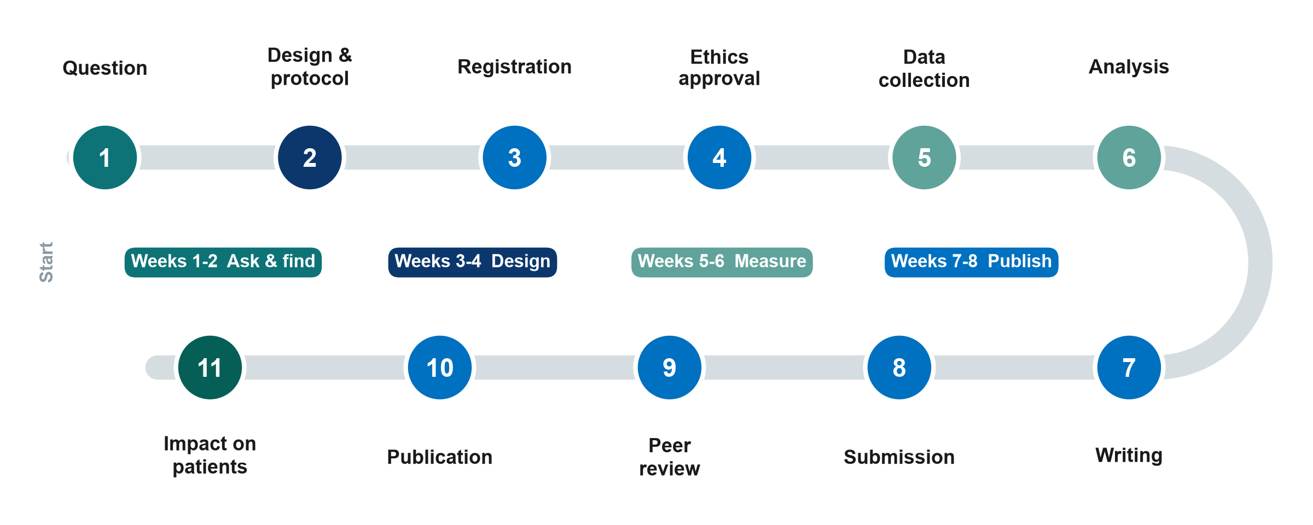
The whole road: from idea to publication
KEY MESSAGE This course walks the whole road. Your proposal covers stops 1 to 6.
Neudata | #ClearDataClearImpact
Notes:
Eleven stops from question to impact. The colours show which weeks of the course teach each stop.
Stops 1-6 are planning and doing: question, design and protocol, registration (trials must be registered before the first patient: Paper 1 was registered in July 2021 and recruitment began in September 2021), ethics approval, data collection, analysis.
Stops 7-11 are publishing: writing, submission, peer review, publication and impact on patients. The road usually takes one to three years. Many good studies stall at stop 7.
Teaching point: every stop depends on stop 1. A vague question produces a weak protocol, an unanswerable analysis and a paper that is hard to publish.
Misconception: 'publication is the end'. The point is impact: a changed guideline, protocol or practice.
Ask the class (call on two or three people, microphone on): 'At which stop do you think most hospital studies get stuck?' Expected answers: ethics paperwork, data collection, or writing (stop 7). We will tackle each one.
Timing: 3 minutes, then 3 minutes for questions (raise hand or chat). Segment 1.1 ends at 1:10 (20:40), then the break.

Slide 24
Break
15 min
Neudata | #ClearDataClearImpact
Notes:
The slide is only a picture on purpose. Before the break, say the restart time aloud and post it in the chat. Optional thought to leave with the class: which problem in your own department could become your question?
Break (1:10-1:25, 20:40-20:55).
During the break: post the link to the Session 1 exercise sheet (PDF sent by email before the session) in the chat again. Exercise 1 is used after the break.
Say clearly in the chat what time you will begin again, and restart on time.

Slide 25
1.2 From problem to question
A good question is half of the answer.
40 minutes: where questions come from, PICO(T) and PECO, question types and FINER, then a whole-class task
Neudata | #ClearDataClearImpact
Notes:
Segment 1.2 (1:25-2:05, 20:55-21:35).
Teaching point: a vague clinical worry ('are fluids bad?') must be turned into a precise, answerable question before anything else can happen.
We build PICO slowly on the running example, look at three more examples, and then improve our running example together as a class.
Timing: 30 seconds.

Slide 26
Where do research questions come from?
Clinical uncertainty: is the answer already known? How we find out: search first.
Where questions come from
Yes: known
No or unsure
Bedside doubt: "Why do we do it this way?"
Variation: colleagues do it differently
Audit, incident and registry data
Guidelines that say "low-certainty evidence"
Papers ending with "more research is needed"
Questions from patients and families
Apply it
Guideline, audit or quality improvement (QI) project
Research question
KEY MESSAGE If the answer is known, apply it. If it is not, you have a research question.
Neudata | #ClearDataClearImpact
Notes:
Six common sources of good questions, all from daily work.
The key decision is in the line under the title: before calling something research, check whether the answer already exists. If it does, the job is implementation: a guideline, an audit or a quality improvement project.
Teaching point: 'how we find out' is the literature search, covered next Saturday in Session 2.
Point back to the questions the class typed in the chat during the welcome. They are candidate topics for each person's proposal.
Timing: 3 minutes.

Slide 27
PICO(T): our running example
In adults with septic shock in the ICU, does a restrictive fluid strategy, compared with usual care, reduce 28-day mortality?
P Population
I Intervention
C Comparison
O Outcome
T Time
Adults (18+) with septic shock in the ICU
Restrictive fluid strategy
Usual care (standard fluids)
Death from any cause
Within 28 days
KEY MESSAGE Every session we come back to this one question.
Neudata | #ClearDataClearImpact
Notes:
PICO = Population, Intervention, Comparison, Outcome. The T (Time) states when the outcome is measured.
Read the five boxes, then the full sentence above them. This is the running example for the whole course.
Teaching point: each letter forces a decision. Which patients exactly? Restrictive how? Compared with what? Which outcome, measured when?
Misconception: 'the comparison is obvious'. Usual care varies between hospitals and over time, so it must be described.
Ask the class (call on two or three people, microphone on): 'Is 28-day mortality the only sensible outcome?' Expected: 90-day mortality, days alive without life support, kidney injury needing dialysis, fluid balance. The large trials used 90-day mortality.
Timing: 4 minutes. The next slide shows a variant, PECO.

Slide 28
Three more examples: PICO, PECO and P + O
 | P | I / E | C | O | T
Treatment (PICO) | Ventilated adults in the ICU | Twice-daily bed-head checklist | Usual care | Ventilator-associated pneumonia | ICU day 28
Risk factor (PECO) E = Exposure | Adults on the medical ward | Obesity (BMI 30+) | BMI under 30 | New pressure injury | During admission
How common? (P + O) | Adults 65+ after hip surgery | - | - | Delirium (4AT screen) | First 7 days
KEY MESSAGE PECO: E = Exposure, used when we cannot assign the factor (e.g. obesity).
Neudata | #ClearDataClearImpact
Notes:
Three other examples, not about fluids, to show that the method works on any ward.
Define PECO first: PECO is PICO with E (Exposure) in place of I (Intervention). An exposure is something patients have or receive that the researcher does not assign, such as obesity or a positive fluid balance. We use PECO for risk-factor (observational) questions.
Row 1, treatment (PICO): ventilated adults. A twice-daily bed-head checklist vs usual care. Ventilator-associated pneumonia by ICU day 28.
Row 2, risk factor (PECO): we cannot assign obesity, so I becomes E. Adults on the medical ward. Obese vs not. New pressure injury during admission.
Row 3, how common? Only P and O (and T): adults 65 and over after hip-fracture surgery. Delirium screened with the 4AT in the first 7 days.
Ask the class (call on two or three people, microphone on): 'Make a PECO question about fluids.' Expected: in adults with sepsis, is a positive fluid balance by day 3 (E), compared with a neutral or negative balance (C), associated with death by day 28 (O, T)? This is Paper 2's question, and the main question of the FLUID-ICU course study (Session 5).
Timing: 4 minutes.

Slide 29
Check your understanding: spot the PICO
QUICK QUIZ | 3 min
Paper 1's question (Boulet 2024): 'In adults with septic shock in the first 24 hours of vasopressors, does restricting non-resuscitative fluids, compared with usual care, reduce cumulative fluid balance at day 5?'
Which words are P, I, C, O and T?
Poll: which words are the outcome (O)?
Then two or three people say the population (P), microphone on
Poll options
A: septic shock
B: restricting non-resuscitative fluids
C: cumulative fluid balance
D: day 5
OUTPUT Poll answer, then P said aloud. The full answer is on the next slide
Neudata | #ClearDataClearImpact
Notes:
Read the question aloud slowly. Launch the poll, give 1 minute, share the results.
Answer: C, cumulative fluid balance, is the outcome. D (day 5) is the time point (T). A is part of the population. B is the intervention.
Then call on two or three people to say P with the microphone on. Answer: adults with septic shock in the first 24 hours of vasopressors.
Watch for people choosing 'septic shock' as the outcome. It is part of the population: it has already happened.
Timing: 3 minutes.

Slide 30
Answer: spot the PICO in Paper 1's question
P
I
C
O
T
Adults with septic shock
First 24 hours of vasopressors
Restricting non-resuscitative fluids
Usual care
Cumulative fluid balance
Day 5
KEY MESSAGE The condition that brings patients in (septic shock) is part of P, not O.
Neudata | #ClearDataClearImpact
Notes:
Reveal and ask in a poll how many got the outcome right.
Teaching point: the outcome must be something that can happen after the intervention starts. Septic shock has already happened: it defines who is eligible.
Note: Paper 1's outcome is fluid balance, not death. Keep this in mind: it explains why the trial cannot answer our 28-day mortality question (Session 2).
Timing: 2 minutes.

Slide 31
Two families of questions
The question decides the design (more in Session 3).
Descriptive
Analytical: observe
Analytical: intervene
What? How many? Who?
"How many of our septic shock patients have a positive fluid balance on day 3?"
Case series, cross-sectional
Is X linked to Y?
Observe (no intervention)
"Is a positive fluid balance associated with death?"
Cohort, case-control
Does X cause Y?
Intervene (we assign)
"Does restricting fluids reduce 28-day mortality?"
Randomised controlled trial
KEY MESSAGE Descriptive questions describe. Analytical questions compare or test a cause.
Neudata | #ClearDataClearImpact
Notes:
Descriptive: what, how many, who. No comparison group is needed.
Analytical: is X linked to Y (observational: we watch), or does X cause Y (experimental: we assign X).
Teaching point: the verbs give it away. 'How many' is descriptive. 'Is associated with' is observational. 'Does it reduce' implies an experiment.
Misconception: 'descriptive studies are not real research'. They often come first and show that the problem exists.
Ask the class (call on two or three people, microphone on): 'Paper 2 (Hyun): which box?' Expected: analytical, observational (cohort).
Timing: 3 minutes. The full design menu is Session 3.

Slide 32
From a vague worry to an answerable question
Vague
Answerable, with PICO
"Are fluids bad for ICU patients?"
Which patients?
Which fluid, how much?
Bad compared with what?
Bad how? By when?
P: In adults with septic shock in the ICU,
I: does a restrictive fluid strategy,
C: compared with usual care,
O: reduce mortality
T: at 28 days?
KEY MESSAGE If you cannot fill all four PICO boxes, the question is not ready yet.
Neudata | #ClearDataClearImpact
Notes:
Left: the question we ask in the corridor: every word is undefined. Right: the same worry written with PICO(T).
Teaching point: a researchable question is specific, has one primary outcome, and implies the design.
Misconception: 'a broad question is more important'. Broad questions produce vague answers.
Ask the class (call on two or three people, microphone on): 'Make this answerable: Is albumin better?' Expected direction: in adults with septic shock (P), does albumin plus crystalloid (I) vs crystalloid alone (C) reduce 28-day mortality (O, T)?
Timing: 3 minutes.

Slide 33
FINER: is the question worth asking?
Check every question against five tests before you invest time in it.
F Feasible
I Interesting
N Novel
E Ethical
R Relevant
Enough patients
Time, money and skills
Data you can get
To you and your team
To readers
Confirms, refutes or extends what is known
An ethics committee could approve it
Could change practice, policy or research
KEY MESSAGE If the question fails one letter, rewrite it before going further.
Neudata | #ClearDataClearImpact
Notes:
FINER = Feasible, Interesting, Novel, Ethical, Relevant (Hulley and colleagues, Designing Clinical Research). Say each English word with its letter, as we did for PICO.
Feasible fails most often in hospital research: not enough eligible patients, or an outcome that is too rare.
Novel does not mean 'never studied'. Repeating a study in a new setting, or with a better design, can be novel. That is why the literature search matters.
Ethical: is there genuine uncertainty (equipoise) about which option is better?
Ask the class (poll with F, I, N, E, R): 'Which letter does our running example fail?' The next slide answers.
Timing: 3 minutes.

Slide 34
FINER check of our running example
Restrictive fluids vs usual care in septic shock: 28-day mortality, in our own ICU.
F Feasible
I Interesting
N Novel
E Ethical
R Relevant
Red
Mortality needs more than 1,000 patients
Too big for one unit
Green
Fluids are debated on every ward round
Amber
Large trials exist: CLASSIC 2022 and CLOVERS 2023
Amber
Both strategies are used today
Consent in the ICU needs care
Green
Every patient with septic shock gets fluid
KEY MESSAGE Important, but not feasible for one unit: rewrite it, e.g. as a pilot like Paper 1.
Neudata | #ClearDataClearImpact
Notes:
F is red: to show a few percentage points difference in mortality you need well over a thousand patients. CLASSIC randomised 1,554. CLOVERS (NEJM 2023) 1,563. One ICU cannot do this.
N is amber: large trials already exist and neither found a mortality difference.
E is amber: both strategies are used in practice so equipoise exists, but consent in septic shock is difficult (Session 7).
How to rescue it: change the outcome (fluid balance at day 5, as Paper 1 did), make it a feasibility pilot, or ask a descriptive question about our own practice. The whole-class task on the next slide does exactly this.
Misconception: 'a failed FINER check means a bad idea'. It means the idea needs reshaping, which is normal and expected.
Timing: 3 minutes.

Slide 35
Whole-class task: rescue our running example
WHOLE-CLASS TASK | 11 min
Open the Session 1 exercise sheet (PDF sent before the session), Exercise 1
It gives three feasible versions of our question: A, B and C (right)
Poll: which version could our own ICU do within two years?
For the version most of the class chose, people called on give P, I or E, C, O and T aloud
Together: name the question type and give each FINER letter a colour
Together: write H0 and H1, or say why none is needed
The three versions
A: restrictive protocol vs usual care. Fluid balance at day 5 (a pilot trial)
B: fluid-positive vs not by day 3. Death by day 28 (a cohort)
C: how many of our patients are fluid-positive on day 3? (descriptive)
OUTPUT One class question with PICO(T), FINER colours and H0/H1, typed on the shared screen
Neudata | #ClearDataClearImpact
Notes:
Whole class, led by the trainer. Share a blank copy of Exercise 1 on screen and type the class answers into it as people say them (call on one person per letter, microphone on).
Poll first (1 minute). Most classes choose A or C. If the vote is split, work on A: it is the pilot that Paper 1 ran, and it is used again in the quick exercise in segment 1.3.
Ask one letter at a time and call on a different person each time: 'Who is P?', 'What is compared?', 'Which outcome, measured when?'. Accept the first good answer and correct gently.
Point out: version B is an observational PECO question (fluid balance is an exposure we do not assign). It is the main question of the FLUID-ICU course study from Session 5. Version C is descriptive and needs no hypothesis.
Commonest problems to correct: a missing comparison, an outcome without a time point, two outcomes squeezed into one question.
Model answers for all three versions: Course/Solutions/s1_solutions.md, Exercise 1. Extra practice with other ward scenarios is at the end of the exercise sheet, for home.
Timing: 8 minutes work + 3 minutes summary. Segment 1.3 starts at 2:05 (21:35).

Slide 36
1.3 Aims, objectives, hypotheses
A question tells us what we want to know. Aims and objectives tell us what we will do.
20 minutes: aim, objectives, null and alternative hypotheses, and one quick exercise
Neudata | #ClearDataClearImpact
Notes:
Segment 1.3 (2:05-2:25, 21:35-21:55).
Teaching point: the aim, objectives and hypothesis are the question written as a plan. Ethics committees and grant reviewers read them first.
Keep it concrete: every example uses the running example or the pilot version (A) from the whole-class task.
Timing: 30 seconds.

Slide 37
Aim, objectives, hypothesis: our running example
Aim
Objectives
Hypothesis
The broad why, in one sentence
To compare a restrictive fluid strategy with usual care in adults with septic shock in the ICU
The specific what, with measurable verbs
Primary: compare 28-day mortality
Compare fluid balance at day 5
Compare kidney injury needing dialysis
The predicted answer to the primary objective
H0: 28-day mortality is the same in both groups
H1: 28-day mortality differs between the groups
KEY MESSAGE One aim, 2-3 measurable objectives, one testable hypothesis per main objective.
Neudata | #ClearDataClearImpact
Notes:
Read the three cards from left to right: the aim leads to the objectives, and the primary objective leads to the hypothesis.
Aim = the broad purpose in one sentence ('To compare...', 'To describe...').
Objectives = specific, measurable steps. Use measurable verbs: compare, estimate, describe, determine. Avoid 'understand', 'explore', 'study'.
Mark the primary objective: it drives the sample size (Session 6).
Hypothesis = the predicted answer to the main analytical objective, stated so data can reject it.
Misconception: 'every study needs a hypothesis'. Purely descriptive studies estimate. They do not test a hypothesis.
Timing: 3 minutes.

Slide 38
Objectives start with a measurable verb
Vague verbs
Measurable verbs
understand, know, study, explore, look at
"To understand fluid management in our ICU"
compare, estimate, describe, determine, measure
"To compare cumulative fluid balance at day 5 between the two groups"
KEY MESSAGE If you cannot say how you will measure it, it is not yet an objective.
Neudata | #ClearDataClearImpact
Notes:
Left: verbs that describe a wish, not an action you can check. Right: verbs that point to something you can count or measure.
Bottom: the same idea rewritten. 'To understand fluid management' cannot be finished or checked. 'To compare cumulative fluid balance at day 5 between groups' tells us the outcome, the time and the comparison.
Teaching point: each objective should match one outcome and, later, one analysis (Session 6).
Misconception: 'more objectives make a stronger proposal'. Two or three focused objectives are better than eight vague ones.
Ask the class (call on two or three people, microphone on): 'Rewrite: to study fluid balance in our ICU.' Expected: to estimate the proportion of adults with septic shock in our ICU who have a positive cumulative fluid balance on day 3.
Timing: 3 minutes.

Slide 39
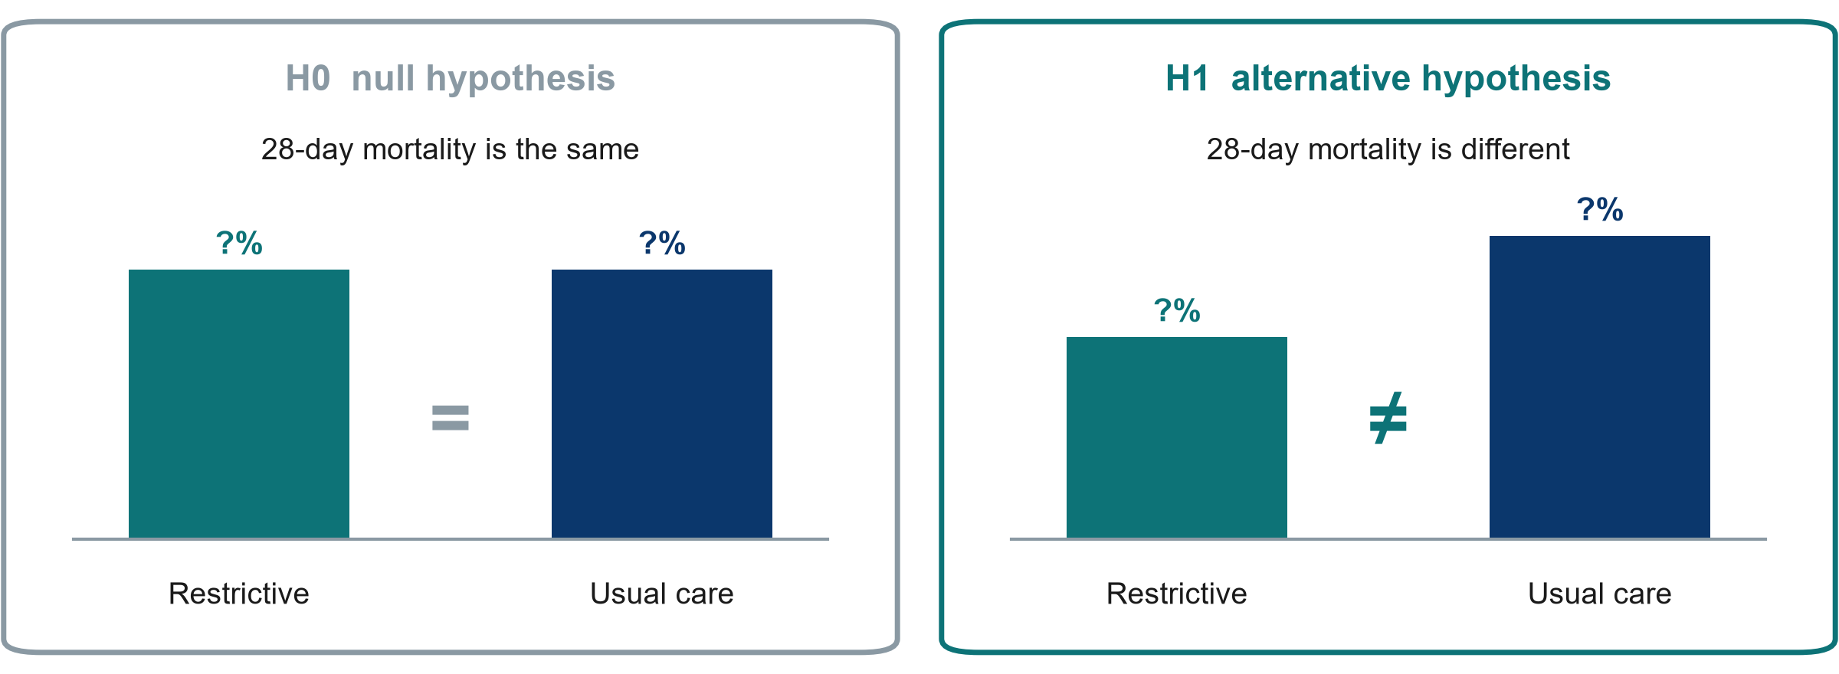
Null and alternative hypotheses
KEY MESSAGE We test H0. Data can reject it or fail to reject it, but never prove it.
Neudata | #ClearDataClearImpact
Notes:
H0, the null hypothesis: no difference. H1, the alternative: a difference.
Analogy: a court assumes 'not guilty' (H0) until the evidence is strong enough. 'Not guilty' is not 'innocent', and 'no significant difference' is not 'no difference'.
H1 is usually written as 'differs' (in either direction), even when we expect benefit, because restriction could also harm. One- vs two-sided tests: Session 6.
Misconception: 'p > 0.05 proves the treatments are equal'. Small studies like Paper 1 (48 patients) often cannot detect real differences. P-values are Session 6.
Timing: 3 minutes.

Slide 40
Quick exercise: aim, objectives and hypothesis for the pilot
INDIVIDUAL TASK | 7 min
Our pilot question (version A of Exercise 1): in adults with septic shock, does a restrictive fluid protocol, compared with usual care, reduce cumulative fluid balance at day 5?
On your own, write one aim: 'To compare...'
Write two objectives with measurable verbs. Mark the primary one
Write H0 and H1 for the primary objective
Two or three people read their primary objective aloud
Verbs that work
compare
estimate
describe
determine
measure
OUTPUT Exercise 2 on the Session 1 exercise sheet. Model answer on the next slide
Neudata | #ClearDataClearImpact
Notes:
Individual, in your own notes or on the exercise sheet: 5 minutes writing, then 2 minutes in which two or three people read theirs aloud.
Call on several people to read their primary objective aloud. Look for 'understand/know/study', objectives with no time point, and hypotheses about an outcome that is not in the objectives.
Model answer on the next slide and in Course/Solutions/s1_solutions.md (Exercise 2).
Timing: 7 minutes.

Slide 41
Model answer: the pilot question
Aim
Objectives
Hypothesis
To compare a restrictive fluid protocol with usual care in adults with septic shock in our ICU
Primary: to compare cumulative fluid balance at day 5 between groups
Secondary: to estimate the recruitment rate and protocol adherence
H0: fluid balance at day 5 is the same in both groups
H1: it differs between the groups
KEY MESSAGE Aim, primary objective and hypothesis all name the same outcome.
Neudata | #ClearDataClearImpact
Notes:
Read the three cards.
Check the chain: the question's O (cumulative fluid balance at day 5) = the primary objective = the outcome in H0/H1. If any of these differ, the proposal is inconsistent, and reviewers spot this immediately.
A descriptive version (C) needs no hypothesis: 'To estimate the proportion of adults with septic shock in our ICU who have a positive cumulative fluid balance on day 3.'
Timing: 3 minutes. Segment 1.3 ends at 2:25 (21:55).

Slide 42
Proposal builder 1
Now start your own proposal: one question, one aim.
30 minutes: we model Part 1 on the running example, then you draft your own
Neudata | #ClearDataClearImpact
Notes:
Proposal builder 1 (2:25-2:55, 21:55-22:25). The 30 minutes start with this slide.
Teaching point: everything taught today is now applied to each participant's own question from their own department. Everyone writes their own proposal. Nobody works in a group.
The search, the 5 references, the problem statement and the working title are next Saturday (Proposal builder 2).
Move straight to the next slide.

Slide 43
Proposal builder 1: your own question
PROPOSAL BUILDER | 30 min
Watch: we fill Part 1 of the proposal template for the running example
Open your copy of the template (sent by email before the session)
Choose one problem from your own department
Write your PICO(T) question in one sentence and check it with FINER
Add one aim, 2-3 objectives (mark the primary) and H0/H1
Two volunteers read their question aloud. Others suggest one improvement, microphone on
Timing
0-8 min: we model Part 1
8-25 min: you draft your own
25-30 min: two volunteers share
OUTPUT Your Proposal Part 1 started: question, FINER check, aim, objectives, hypothesis
Neudata | #ClearDataClearImpact
Notes:
Minutes 0-8, the trainer models it: share Course/Templates/Research_Proposal_Template.docx and fill Part 1 for the pilot version (A) of the running example, using the class answers from today: problem, PICO(T), question, FINER colours, aim, objectives, H0/H1. Think aloud about each choice.
Minutes 8-25, everyone drafts their own Part 1 alone. Cameras may go off. The trainers stay online and answer questions in the chat. A second trainer can take private chat messages.
If someone cannot choose a topic, point them to the questions saved from the welcome chat, or let them use version A or C of the running example for now.
Remind people of the commonest problem: a red F. Shrink the outcome, shorten the time frame, or make it a descriptive question or a pilot.
Minutes 25-30: two volunteers read their question and aim aloud. Call on two or three people to suggest one improvement each, microphone on.
What good looks like: Course/Solutions/s1_solutions.md (Exercise 3). Anything unfinished becomes homework.
Timing: 30 minutes. Wrap-up starts at 2:55 (22:25).

Slide 44
Key words of the day
Key word | In one line
Evidence pyramid | Ranks designs by how well they protect against bias
PICO(T) | Population, Intervention, Comparison, Outcome, Time
PECO | The same, with E = Exposure, for factors we do not assign
FINER | Feasible, Interesting, Novel, Ethical, Relevant
Aim / objective | The broad why / the specific, measurable what
H0 / H1 | No difference / a difference (we test H0)
Neudata | #ClearDataClearImpact
Notes:
Wrap-up (2:55-3:00, 22:25-22:30).
Read the six key words quickly. These are also in the course glossary (EN-VN), Course/References/glossary_EN_VN.
Ask one participant to explain PICO in their own words.
Timing: 1 minute.

Slide 45
Session 1 recap
Why research
Ask precisely
Plan it
Experience suggests questions
Fair comparisons in enough patients answer them
A PICO(T) question
One primary outcome
A FINER check before you start
One aim
2-3 measurable objectives
A testable H0 and H1
KEY MESSAGE Next Saturday: find and read what is already known about your question.
Neudata | #ClearDataClearImpact
Notes:
Read the three messages.
Link forward: next Saturday (Session 2) we search PubMed live for our question, manage references in Zotero, and learn to read a paper in 15 minutes.
Timing: 1.5 minutes.

Slide 46
Exit question (in the chat)
QUICK QUIZ | 2 min
Answer now in the chat, or in the 1-question form linked there
Q1: which FINER letter did our running example fail, and why?
Q2: rewrite as an objective: 'To understand fluid balance in our ICU'
Why we ask
It is not homework and not marked
It shows us what is still unclear
We read every answer before next Saturday
Session 2 opens with what we find
OUTPUT One short answer per person, before you leave
Neudata | #ClearDataClearImpact
Notes:
Purpose: a 2-minute check of understanding on the running example. It is not homework.
Answers: Q1 Feasible: a mortality outcome needs well over a thousand patients. Q2 For example, 'To estimate the proportion of adults with septic shock in our ICU who have a positive cumulative fluid balance on day 3'.
Save the chat (or download the form responses). Read them during the week. If many still use vague verbs, open Session 2 with one extra minute on objectives.
Timing: 1.5 minutes.

Slide 47
Homework for next Saturday (Session 2)
INDIVIDUAL TASK
Finish your own Proposal Part 1 draft: question, FINER check, aim, objectives, H0/H1
Exercise 4 on the Session 1 exercise sheet: 2-3 English synonyms for each PICO word
Install Zotero (free, zotero.org) and its Word plug-in: required before Session 2
Ready for next Saturday
Your PICO question
Your synonym list
A computer with internet and Zotero
OUTPUT Question, synonym list and Zotero ready for next Saturday's search
Neudata | #ClearDataClearImpact
Notes:
Keep it light: about 45 minutes during the week, on your own.
The synonym list makes next Saturday's PubMed search much faster, because PubMed searches in English.
Zotero is required: in Session 2 everyone imports references from PubMed into Zotero and cites them in Word. Install Zotero desktop, the Zotero Connector for your browser and the Word plug-in (zotero.org/download). Anyone who has problems should email the trainers before Friday.
Close on time. Thank the class.
Timing: 1 minute.

Slide 48
Extra slides: Session 1
Use if time allows, or for self-study
Neudata | #ClearDataClearImpact
Notes:
Extra slides (Session 1).
Everything after this slide is optional. Use it if the class is fast or asks, or point participants to it for self-study.
The core session is complete without these slides.

Slide 49
Research, audit or quality improvement?
 | Research | Clinical audit | Quality improvement
Asks | What is the best practice? | Are we meeting the standard? | How do we get better, step by step?
Fluid example | Restrictive vs usual: which is better? | Is fluid balance recorded daily? | A daily checklist, tested in PDSA cycles
Results apply to | Patients elsewhere (generalisable) | Our unit | Our unit
Ethics | Ethics committee approval: always | Local approval, usually no committee | Local approval, ethics review if new risk
Not sure which it is? Ask the ethics committee before you start. Journals ask for approval or a waiver.
KEY MESSAGE Research asks what is best. Audit asks if we do it. QI makes it better.
Neudata | #ClearDataClearImpact
Notes:
Extra: research, audit and quality improvement (for self-study, or when a participant asks whether their project needs ethics approval).
Research generates new, generalisable knowledge: which option is best? Audit compares our practice with an agreed standard. Quality improvement (QI) changes a local process step by step, usually in Plan-Do-Study-Act (PDSA) cycles.
Why it matters: research always needs ethics committee approval before it starts. Audit and QI usually need local approval only. But if a project randomises patients, adds a new intervention or risk, or collects data beyond routine care, it is research and needs ethics review.
Publishing does not change what a project was. Journals ask for ethics approval or a formal waiver, so decide (and ask) at the start, not after the data are collected.
Note: rules differ between institutions. Tell participants to check the local policy and, if in doubt, ask the ethics committee. Ethics approval is taught in Session 7.
Timing: 3 minutes if used.

Slide 50
PICO for other kinds of question
Diagnosis
Prognosis
Qualitative (SPIDER)
P: patients tested
I: the new test
C: the reference standard
O: accuracy
Example: in adults with suspected sepsis in the emergency department, how accurate is qSOFA compared with the full Sepsis-3 criteria?
P: patients with a condition
E: a risk factor (Exposure)
O: what happens
T: by when
Example: in adults with septic shock, is a lactate above 4 mmol/L on admission linked to death by day 28?
S: Sample
PI: Phenomenon of Interest
D: Design
E: Evaluation, R: Research type
Example: how do ICU nurses (S) experience stopping IV fluids (PI), in interviews (D), in terms of barriers (E), in a qualitative study (R)?
KEY MESSAGE The letters change, but the idea stays the same: be explicit.
Neudata | #ClearDataClearImpact
Notes:
Extra: diagnosis, prognosis and qualitative question frameworks, each with one example question.
Diagnostic questions: the index test is I, the reference standard is C, the outcome is accuracy (sensitivity and specificity, Session 4). Example: qSOFA against Sepsis-3 in the emergency department.
Prognosis: often PECO plus a time frame (E = Exposure). Example: high lactate on admission and death by day 28.
Qualitative questions often use SPIDER (Cooke and colleagues, 2012): Sample, Phenomenon of Interest, Design, Evaluation, Research type. Example: ICU nurses' experience of stopping fluids, studied by interviews.
Timing: 2 minutes if used.

Slide 51
More practice: which FINER letter fails?
QUICK QUIZ | 4 min
All hospitalised adults in the country: does vitamin D reduce mortality over 10 years?
Septic shock: does withholding antibiotics for 24 h reduce resistance?
Do our ICU nurses wash their hands? (already audited monthly for 5 years)
Pneumonia: does the colour of the drug chart affect 28-day mortality?
OUTPUT One letter per question, in the poll
Neudata | #ClearDataClearImpact
Notes:
Extra: extra FINER practice.
Answers: 1 Feasible (huge, long, expensive, large vitamin D trials also exist, so Novel too). 2 Ethical (withholding antibiotics in septic shock causes harm, so there is no equipoise). 3 Novel (the answer is already measured: an audit question). 4 Relevant (no plausible mechanism, no impact on practice).
Also in the extra practice section at the end of the Session 1 exercise sheet.
Timing: 4 minutes if used.

Slide 52
Vague vs answerable: another example from the ward
Vague
Answerable, with PICO
"Are fluids bad for ICU patients?"
Which patients?
Which fluid, how much?
Bad compared with what?
Bad how? By when?
P: In adults with septic shock in the ICU,
I: does a restrictive fluid strategy,
C: compared with usual care,
O: reduce mortality
T: at 28 days?
KEY MESSAGE Practise on your own ward: take a corridor question and fill the PICO boxes.
Neudata | #ClearDataClearImpact
Notes:
Extra: more vague-to-answerable practice with another example from the ward.
Use this slide again if the class needs more practice.
Ask: 'Make this answerable: Do night shifts cause medication errors?' Expected direction: in ward nurses (P), are night shifts (E) compared with day shifts (C) associated with more medication administration errors per 1,000 doses (O) over 6 months (T)?
Point out that this becomes a PECO (observational) question, E = Exposure, because we cannot easily randomise nurses to night shifts.
Timing: 3 minutes if used.

Slide 53
Copyright © Neudata, 2026
All property rights and copyright are reserved.
This presentation contains proprietary data, information, and materials developed by Neudata for dedicated use only and may not be communicated, copied, reproduced, distributed, published, or cited, in whole or in part, without the prior written consent of Neudata.
Where explicit written permission has been granted, appropriate attribution must be included, followed by “by courtesy of Neudata”.
Any unauthorized use or infringement of these materials may give rise to legal action and claims for damages, without prejudice to any other rights of Neudata, including rights relating to patents, trademarks, or other forms of intellectual property protection.
Neudata | #ClearDataClearImpact
Notes:
Copyright slide. Leave it on screen while participants leave the meeting.

